Slide 1
Перспектива

Slide 2


Slide 3
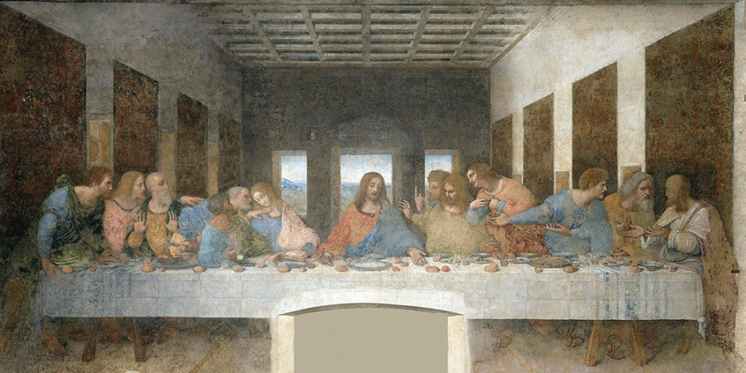

Slide 4
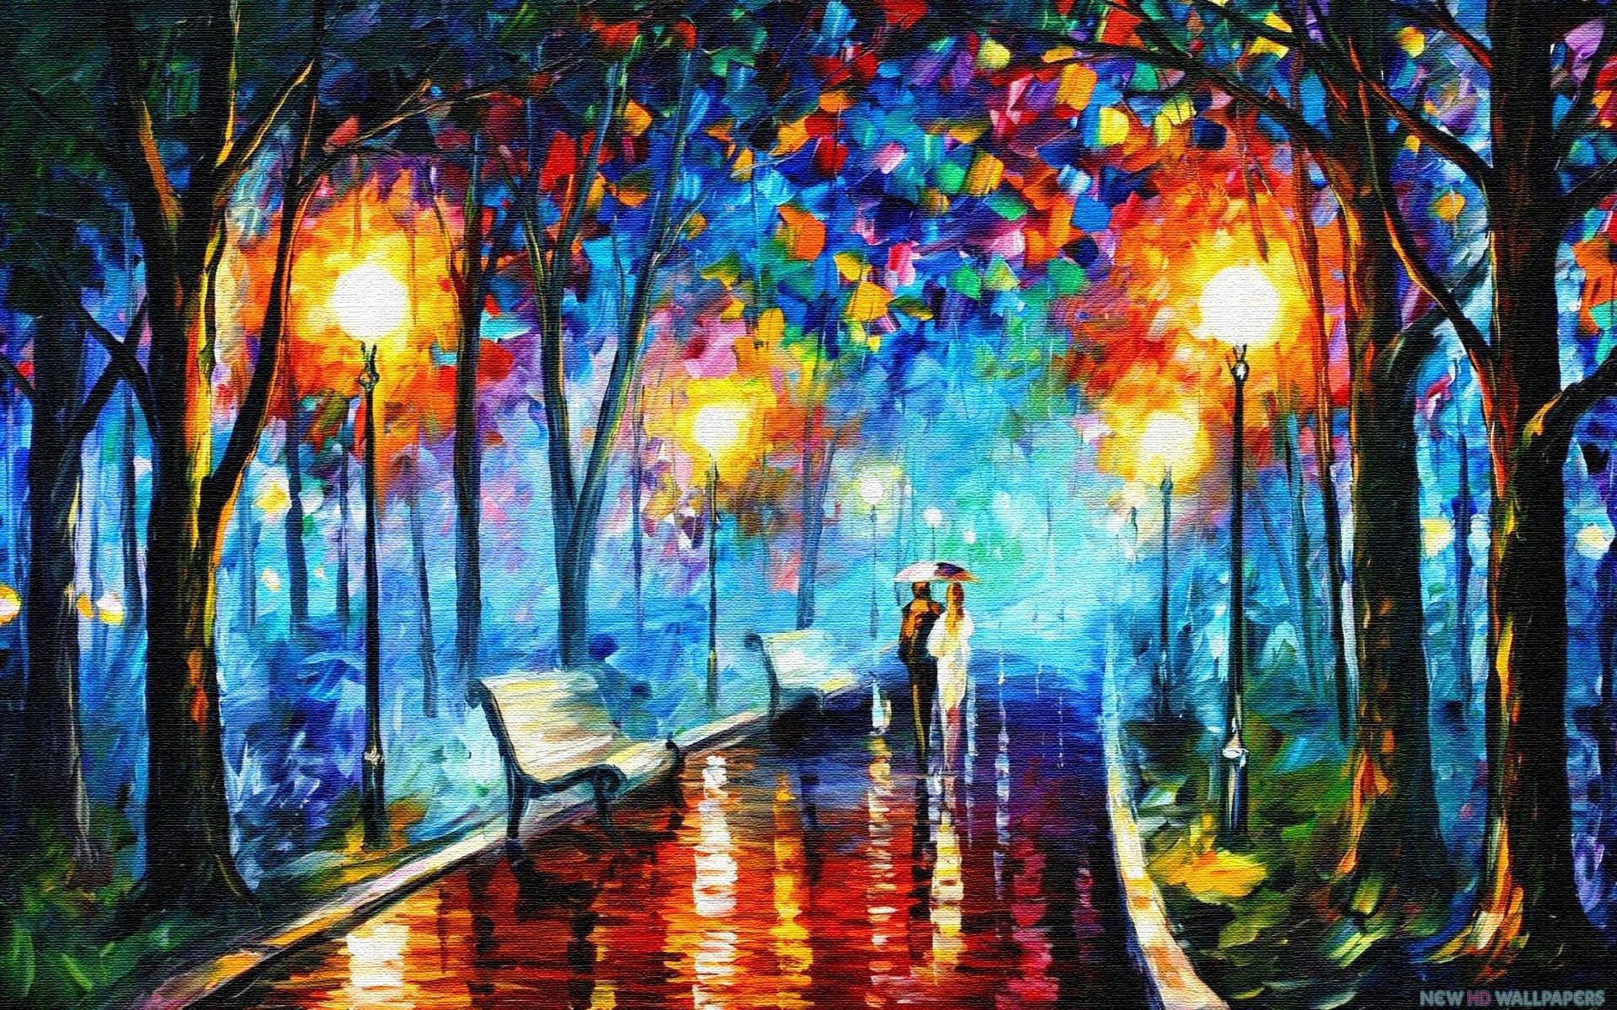
Notes:
Leonid Afremov

Slide 5
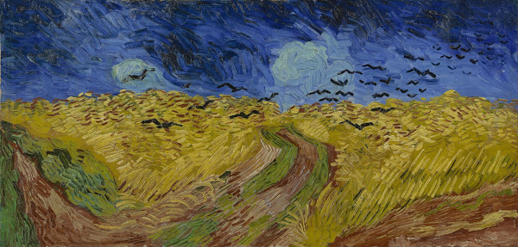
Notes:
Wheatfield with Crows
Vincent van Gogh, 1890

Slide 6
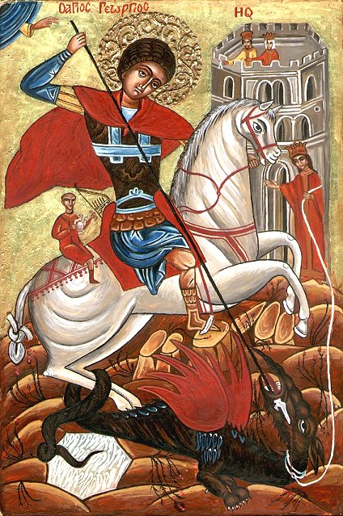

Slide 7
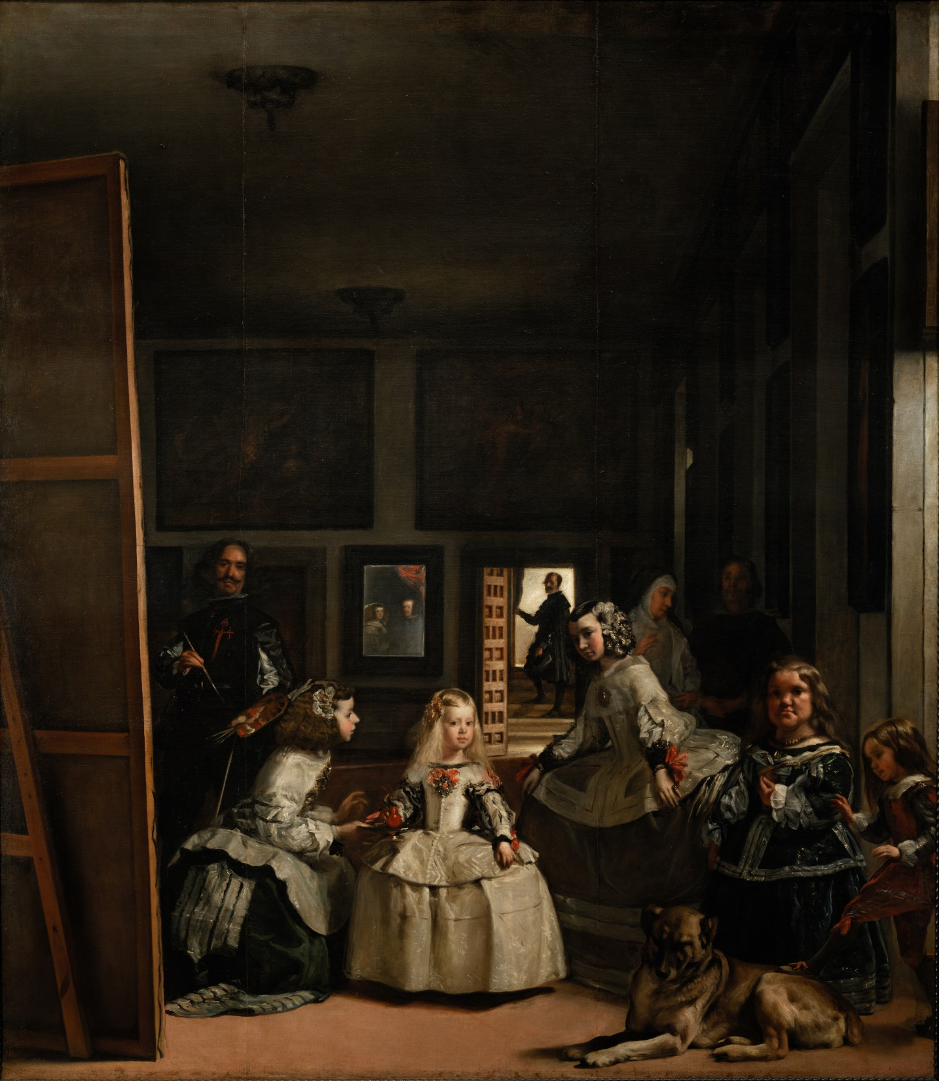

Slide 8
