Slide 1
Phrasal Verbs

Slide 2
Here is a table with common phrasal verbs and their more formal equivalents in academic writing.
The phrasal verbs are in bold, in alphabetical order.
The equivalents are also in an alphabetical order (they do not match the phrasal verb in the same line.
Match the verbs with their definitions.
Some phrasal verbs have different meanings.

Slide 3
break down | acquire | go down | contact
break down | activate | go on (with) | contact
bring about | arrange/organize | go through | continue
call off | arrive | go up | deactivate
carry out | avoid | go up | decrease
come out | be admitted | make up | design/invent/originate
come up with | be approved | make up for | disconnect
come up with | be published | mix up | employ
cut down (on) | calculate | pick up | fail
cut off | cancel | put off | find/discover/ascertain
find out | categorize | set up | increase
get hold of | cause | take on | increase
get hold of | compensate | turn off/switch off | postpone
get in | conduct | turn on/switch on | present/produce/propose
get in touch | confuse | turn up | receive
get round | constitute | work out | reduce

Slide 4
break down | fail | go down | decrease
break down | categorize | go on (with) | continue
bring about | cause | go up | increase
call off | cancel | go through | be approved
carry out | conduct | go up | increase
come out | be published | make up | constitute
come up with | design/invent/originate/ | make up for | compensate
come up with | present/produce/propose | mix up | confuse
cut down (on) | reduce | pick up | receive
cut off | disconnect | put off | postpone
find out | find/discover/ascertain | set up | arrange/organize
get hold of | contact | take on | employ
get hold of | acquire | turn on/switch on | activate
get in | be admitted | turn off/switch off | deactivate
get in touch | contact | turn up | arrive
get round | avoid | work out | calculate

Slide 5
Try to break the list down into several categories
Possible categories:
Technology / Engineering,
Medicine,
Environment, etc.
Business correspondence,
Reports,
Academic/specialized journals, etc.
Your choice of category should be based on the type of text /the field of knowledge which the FORMAL EQUIVALENT is usually associated with, e.g. “fail” (break down) is commonly associated with technology / engineering

Slide 6
Choose 5 of the phrasal verbs and write sentences with them. Try to comply with the requirements of the topic you ascribed to each one.
Leave some space after each sentence, so that a classmate will be able to rewrite the sentence using the formal equivalent of the phrasal verbs.
The result should be something like:
The destruction of the rain forest has brought about environmental damage.
…………………………………………………………………………………

Slide 7
Multiple meanings and metaphorical use
From:
English phrasal verbs in use, Michael McCarthy and Felicity O’Dell, Cambridge, 2004

Slide 8
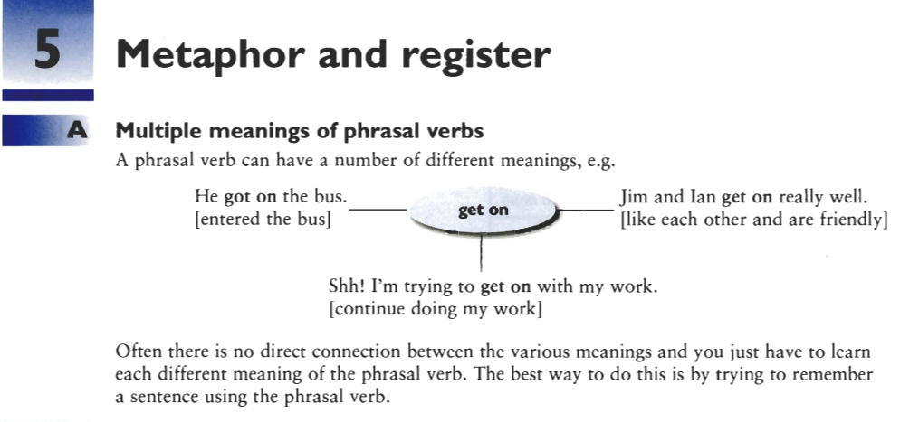

Slide 9
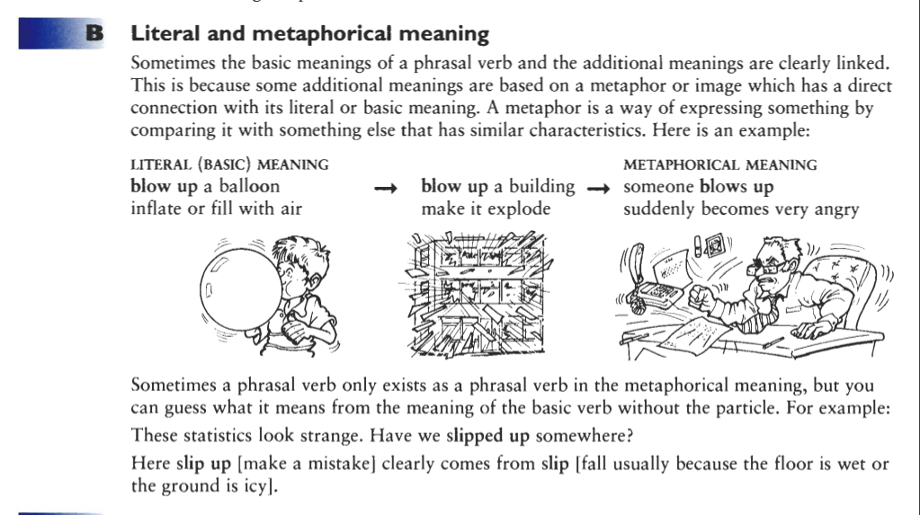

Slide 10
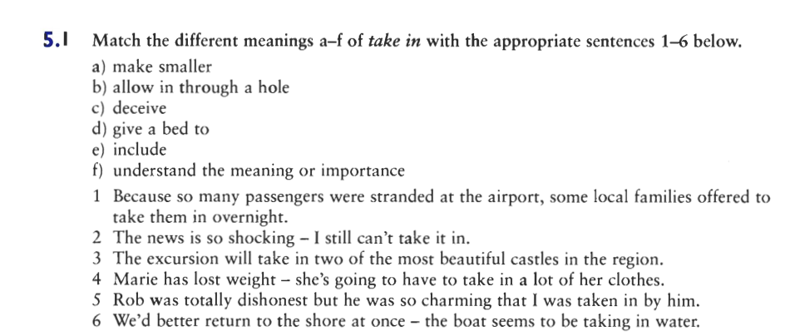

Slide 11
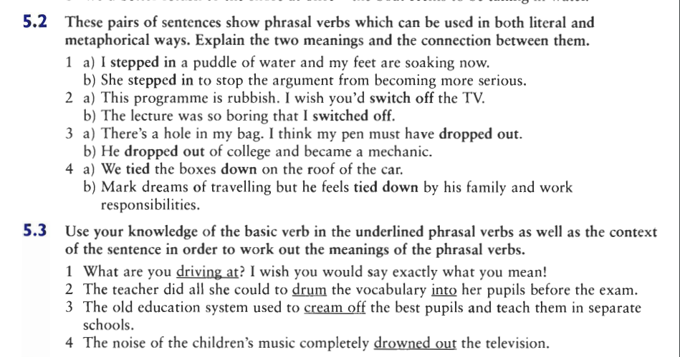

Slide 12
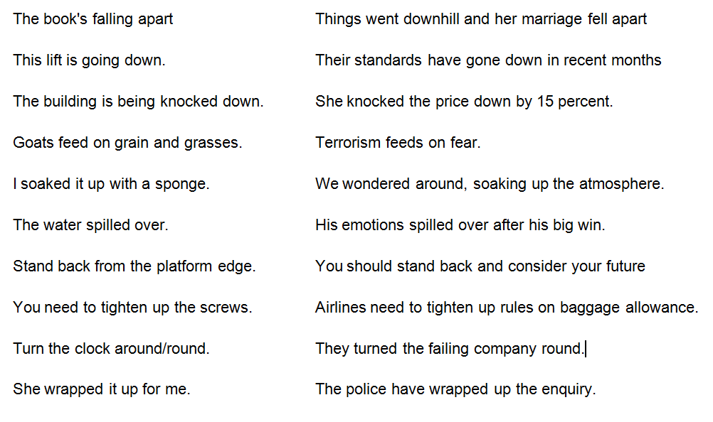
Explain the two meanings and the connection between them:

