Slide 1
ENGB 016
Verb Patterns

Slide 2
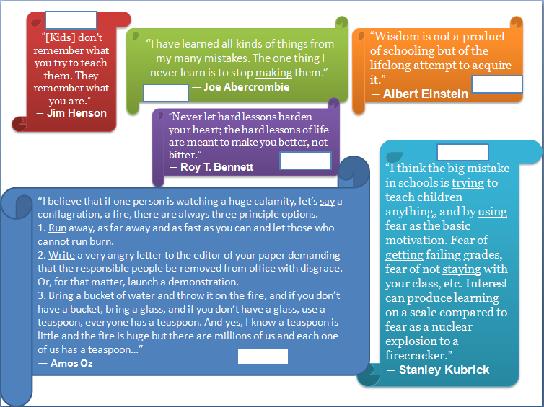
Recognizing the Forms
Read the quotes. What is the form of the underlined verbs? Write G (gerund), FI (full infinitive) or BI (bare infinitive) in the space on each parchment.

Slide 3
Answers
FI
G
FI
G
BI
BI

Slide 4
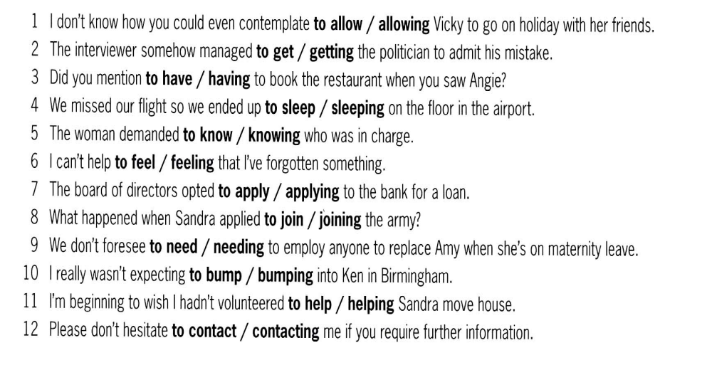
Circle the correct word or phrase. When you finish, add the verb before the bolded options in the respective column in the table.

Slide 5
Answers

Slide 6
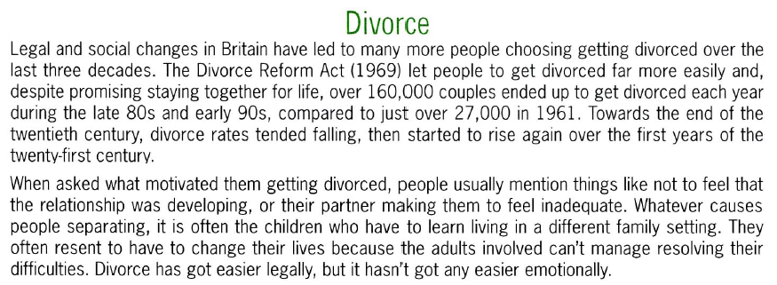
Underline 12 verbs in the wrong form and rewrite them correctly. Then distribute the preceding verbs from each pattern in the columns of the table.
1. | 2. | 3. | 4.
5. | 6. | 7. | 8.
9. | 10. | 11. | 12.

Slide 7
Answers
1. to get | 2. get | 3. to stay | 4. getting
5. to fall | 6. to get | 7. feeling | 8. feel
9. to separate | 10. to live | 11. having | 12. to resolve

Slide 8
Verbs followed by GERUND
Some verbs are usually followed by ~ing form. These include:
Verbs (e.g. admit, deny, fancy, practice, suggest*, etc.);
Some of the verbs in a) (*) can be followed by a THAT clause (e.g. suggest*);
Verbs with fixed prepositions (e.g. insist on, think of/about, believe in, give up, keep on, etc.)
Phrases (e.g. feel like, can’t help, don’t mind)
Verbs with passive meaning (e.g. need, require)

Slide 9
Practice a):
Choose the best verbs to complete the sentences. Then put the patterns encountered in the “Verb + GERUND” and “Phrases + GERUND” columns in the table.
“What’s your new job like?” “Mixed. I ___________ earning a bit more money, but I ___________ working in my own office, and I really ___________ having to write a detailed report on every single job I do.” (admit, appreciate, deny, miss, resent)
Not another meeting! I just ___________ seeing all those people again. Honestly, when Peter opens his mouth I just ___________ screaming. Would you ___________ going and taking notes for me? Tell them I’m ill, or my grandmother’s died, or something. (can’t face, feel like, imagine, involve, mind)
They said the job would ___________ some light housework. They didn’t ___________ cooking, gardening and decorating the house from top to bottom. I can’t ___________ staying another day – I’m off! (admit, imagine, involve, mention, mind)
During his trial, the driver continued to ___________ talking on his mobile phone at the time of the accident, and refused to ___________ driving dangerously, claiming that he was forced to accelerate in order to___________ hitting an old lady who was crossing the road at the time. (admit appreciate, avoid, deny, involve)

Slide 10
Practice a): answers:
“What’s your new job like?” “Mixed. I appreciate earning a bit more money, but I miss working in my own office, and I really resent having to write a detailed report on every single job I do.”
Not another meeting! I just can’t face seeing all those people again. Honestly, when Peter opens his mouth I just feel like screaming. Would you mind going and taking notes for me? Tell them I’m ill, or my grandmother’s died, or something.
They said the job would involve some light housework. They didn’t mention cooking, gardening and decorating the house from top to bottom. I can’t imagine staying another day – I’m off!
During his trial, the driver continued to deny talking on his mobile phone at the time of the accident, and refused to admit driving dangerously, claiming that he was forced to accelerate in order to avoid hitting an old lady who was crossing the road at the time.

Slide 11
Practice b):
Pete ___________ leaving* the auditors to do their job, but I think we should better be available all the time in case they have some questions. I would even ___________ watching* them closely, otherwise we ___________ having to explain some unfavorable report. (endure, justify, recommends, risk, suggest,)
Rewrite the phrases with an * using verb + that + subject + bare inf.
__________________________________________________________________________________________________________________________________________________________________________________________

Slide 12
Practice b):
Answers
Pete recommends leaving* the auditors to do their job, but I think we should better be available all the time in case they have some questions. I would even suggest watching* them closely, otherwise we risk having to explain some unfavorable report.
Rewrite the phrases with an * using verb + that + subject + bare inf.
Pete recommends that we leave the auditors…
I would even suggest that we watch them closely…

Slide 13
Practice c):
c)
Complete the following sentences with your own ideas, using ~ing forms. Then put the patterns encountered in the “Verb + preposition + GERUND” column in the table
I’ve never thought of _______________________________________________________________
I don’t like to spend money on _______________________________________________________________
It is important to thank people for _______________________________________________________________
I do not believe in _______________________________________________________________
I always apologise for _______________________________________________________________

Slide 14
Look at the list of examples below. Circle those which require gerund because of the (fixed) preposition. Underline those which require gerund after a certain phrase.
He apologized for being late. | They hate getting homework. (but: I'd hate to do it now.)
They objected to going hiking. | They dislike getting homework.
He prevented her from going out. | She would not even think of cheating.
She complained about having a headache. | He succeeded in becoming a famous physician.
They insisted on talking to the manager. | He isn't interested in emigrating to the U.S.A.
They enjoyed watching Northern Exposure. | He dreams of becoming a rich man.
She avoided going through the Common. | We look forward to meeting them again.
She didn't mind writing the letter again. | He is proud of being good at English.
She considered applying for a post at that company. | She doesn't feel like going out tonight.
She suggested performing a play at school. | He couldn't help laughing when he saw her in that dress.
They don't risk being late. | I can't stand taking exams.
They liked going to the zoo when they were little. | It's not worth mentioning.
He prefers riding to walking. (but: I'd prefer to do this now.) | It's no use complaining about that.
 | They aim at becoming rich and famous.

Slide 15
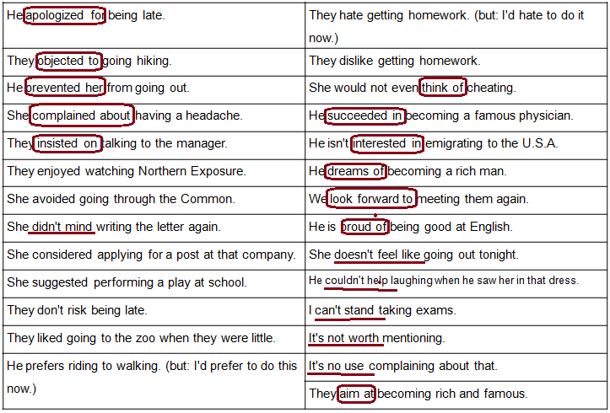
Answers:

Slide 16
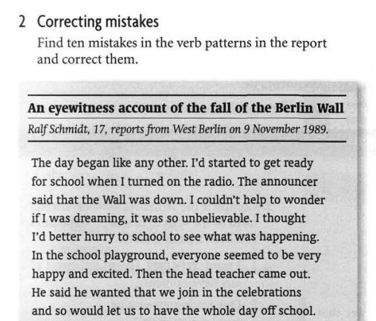

Slide 17
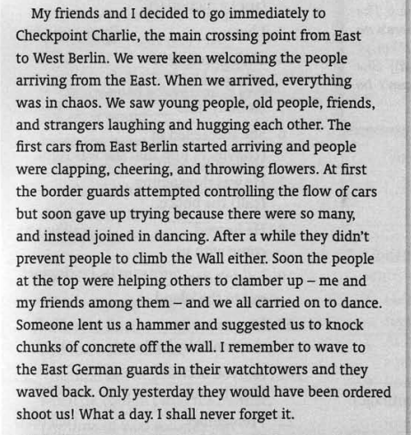
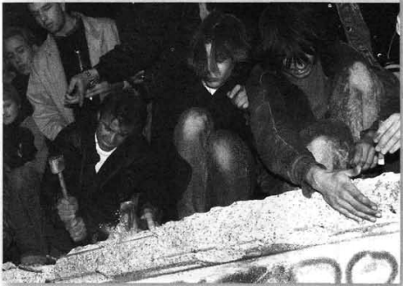

Slide 18
Answers:

Slide 19
Answers:

