Slide 1

Determiners
Determiners are words placed in front of a noun to make it clear what the noun refers to. Use the pages in this section to help you use English determiners correctly.
Based on EF

Slide 2
Match the two parts of each of the quotes below. Explain your answers.
“If there is a God, He will have to beg | one sinner that needed it most?” – Mark Twain
“Give a man a mask, and he will show you | another, are we not?” – Richard Ramirez
“Be yourself. | two evils, is still choosing evil.” – Jerry Garcia
“Isn’t it funny how day by day nothing changes, but when we look back | all week for Friday, all year for summer, all life for happiness.” Annonymous
“But who prays for Satan? Who, in eighteen centuries, has had the common humanity to pray for the | no moon, and the anger of a gentle man.” ~ Patrick Rothfuss
“We are all evil in some form or | everything is different.” ~ C.S. Lewis
“Choosing the lesser of | Everyone else is already taken.” – Oscar Wilde
“People wait | his true face.” – Oscar Wilde
“There are three things all wise men fear: the sea in storm, a night with | those that think, a tragedy to those that feel.” – Horace Walpole
“The world is a comedy to | my forgiveness.” ~ carved on the walls of a concentration camp cell during WWII by a Jewish prisoner.

Slide 3
Determiners in English
Definite article : the
Indefinite articles : a, an
Demonstratives: this, that, these, those
Pronouns and possessive determiners : my, your, his, her, its, our, their;
Quantifiers: a few, a little, much, many, a lot of, most, some, any, enough
Numbers: one, ten, thirty
Distributives: all, both, half, either, neither, each, every
Difference words: other, another
Pre-determiners: such, what, rather, quite

Slide 4
Definite article : the
Indefinite articles : a, an

Slide 5
Demonstratives (Demonstrative pronouns and Adverbs)
These determiners indicate proximity (physical/psychological) in relation to the speaker.
They can refer to objects as well as to abstract concepts but can also serve as time reference words (for events in the long gone past or recent/present events.
Examples:
Don’t you remember Alex, this friend of mine who always calls at weird hours, forgetting that, unlike him, I sleep at night? Take these urgent requests to the boss’s office, will you.
That man over there, shouldn’t make a step further or the snipers will shoot.
Note that the determiners are placed BEFORE the noun or the adjective that modifies it.

Slide 6
Theoretically speaking…
 | Near the speaker | Far from the speaker
Adverb | Here | There
Demonstrative with singular nouns & uncountable nouns | This | That
Demonstrative with plural countable nouns | These | Those

Slide 7
Pronouns – complete the blank cells
 | Subject Pronoun | Object Pronoun | Possessive Adjective (Determiner) | Possessive Pronoun | Reflexive or Intensive Pronoun
1st person singular | I | me | my |  | myself
2nd person singular | you | you | your | yours | yourself
3rd person singular, male | he | him | his | his | himself
3rd person singular, female | she |  | her |  | herself
3rd person singular, neutral | it | it | its
1st person plural | we | us | our | ours
2nd person plural | you | you | your | yours
3rd person plural | they | them | their

Slide 8
Examples: A really long sentence might contain them all… Find them!
Leo Tolstoy, “Anna Karenina.” 123 Words.
“It is true that Alexei Alexandrovich vaguely sensed the levity and erroneousness of this notion of his faith, and he knew that when, without any thought that his forgiveness was the effect of a higher power, he had given himself to his spontaneous feeling, he had experienced greater happiness than when he thought every minute, as he did now, that Christ lived in his soul, and that by signing papers he was fulfilling His will, but it was necessary for him to think that way, it was so necessary for him in his humiliation to possess at least an invented loftiness from which he, despised by everyone, could despise others, that he clung to his imaginary salvation as if it were salvation indeed.”

Slide 9
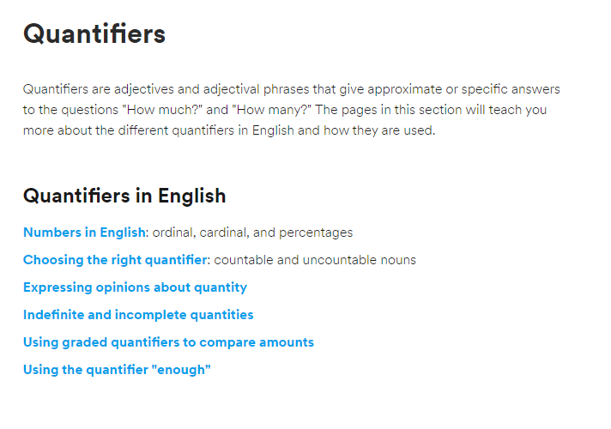
Check the EF site for details about each type

Slide 10
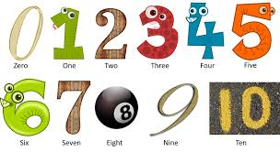
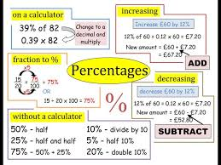
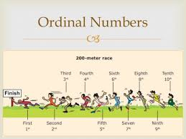
Cardinal and Ordinal Numbers

Slide 11
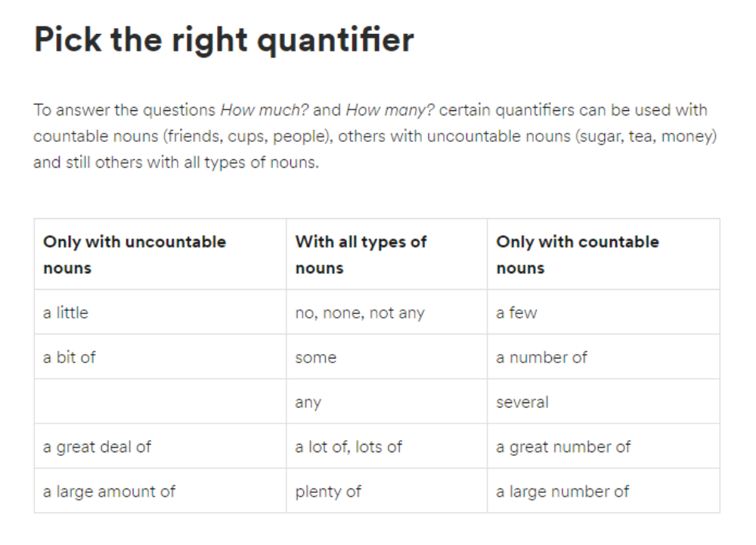

Slide 12
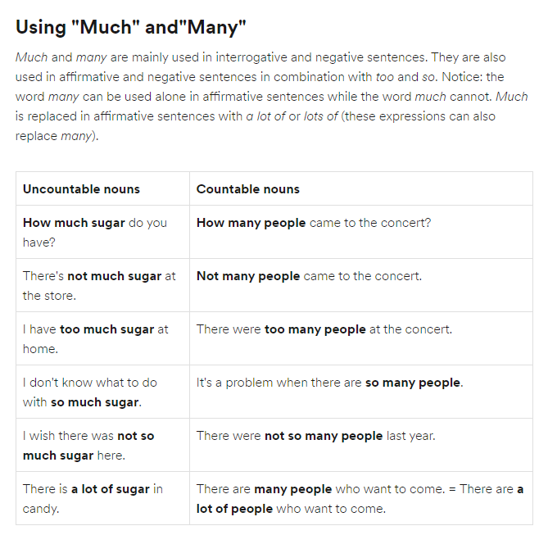

Slide 13
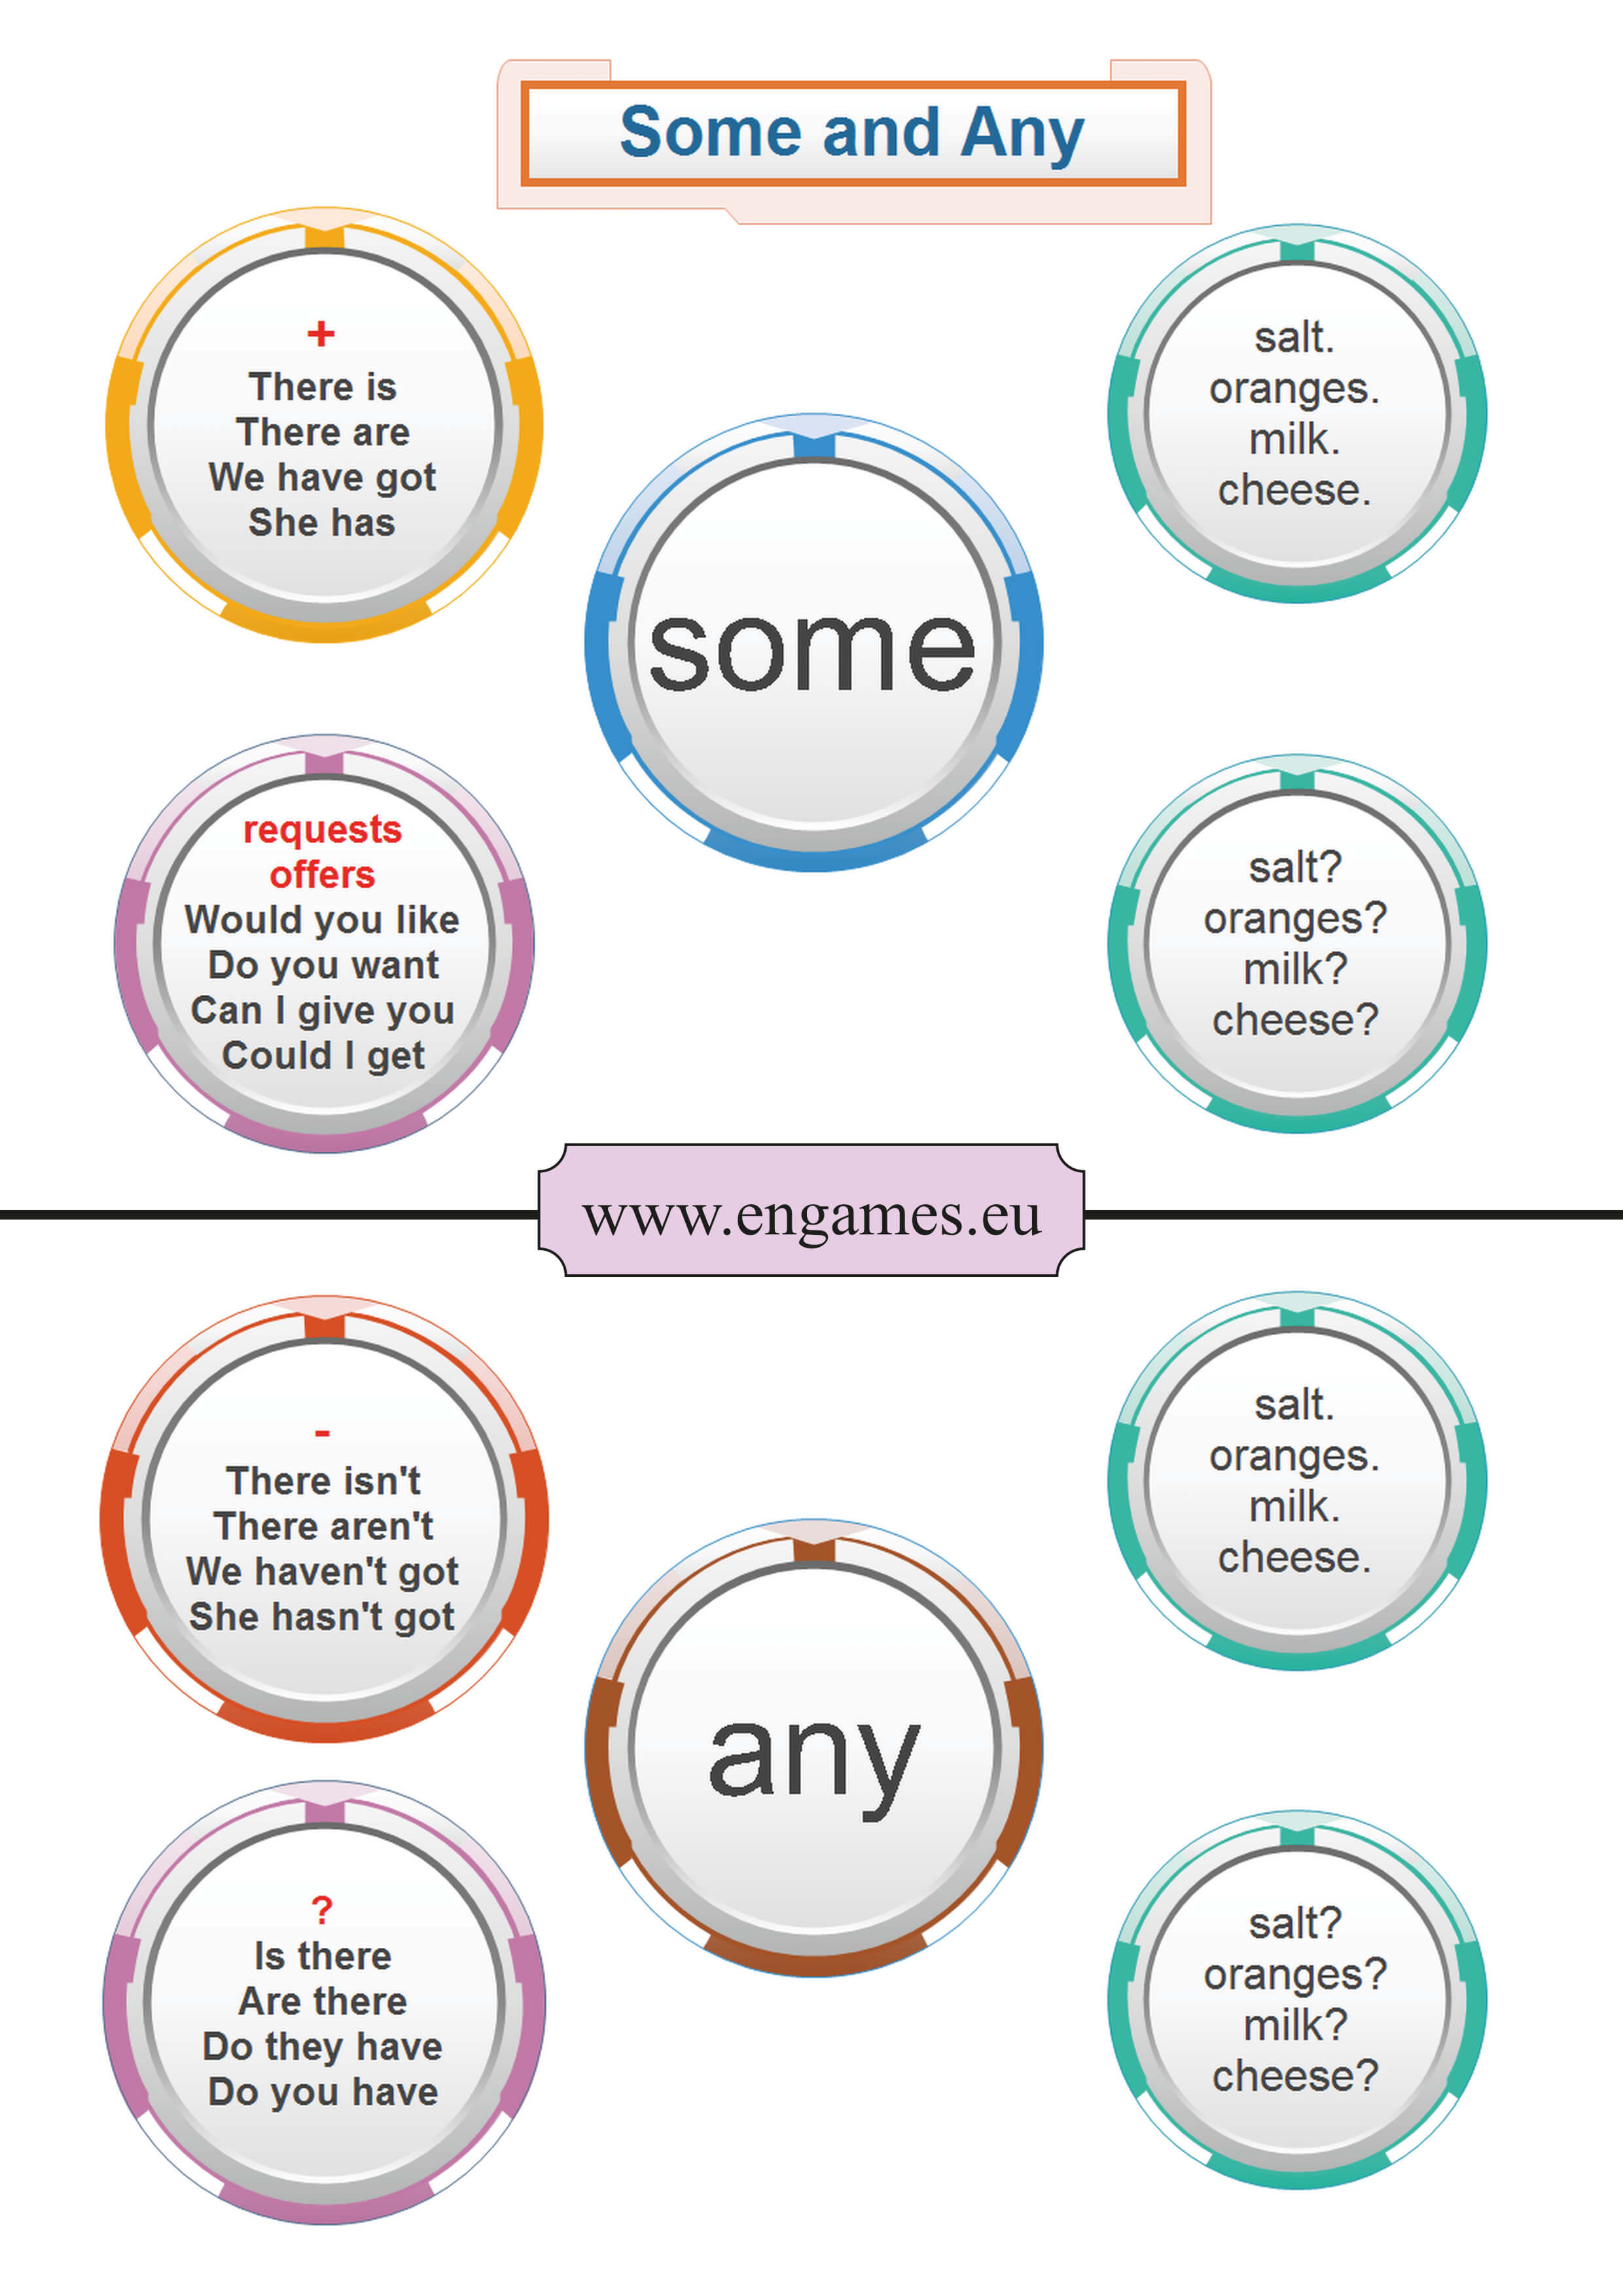
Indefinite and Incomplete Quantities

Slide 14
Graded Quantifiers
quantifier comparative grade superlative grade
With plural countable nouns
many more most
few fewer fewest
With uncountable nouns
much more most
little less least

Slide 15
Enough as a quantifier
We have
enough
money
to afford this flat, but
it isn’t
Good
enough
For my refined taste.
Before a NOUN and after an ADJECTIVE
BUT enough is also an ADVERB => NOT before the noun
How much is enough actually?

Slide 16
How many determiners can you find in this very long sentence?
Evelyn Waugh, “Scoop.” 150 words.
“The Francmason weighed anchor, swung about, and steamed into the ochre hills, through the straits and out into the open sea while Corker recounted the heroic legends of Fleet Street; he told of the classic scoops and hoaxes; of the confessions wrung from hysterical suspects; of the innuendo and intricate misrepresentations, the luscious, detailed inventions that composed contemporary history; of the positive, daring lies that got a chap a rise of screw; how Wenlock Jakes, highest paid journalist of the United States, scooped the world with an eye-witness story of the sinking of the Lusitania four hours before she was hit; how [Sir Jocelyn] Hitchcock, the English Jakes, straddling over his desk in London, had chronicled day by day the horrors of the Messina earthquake; how Corker himself, not three months back, had had the good fortune to encounter a knight’s widow trapped by the foot between lift and landing.”

