Slide 1
Successful Presentations
Why is it important to be a good speaker?

Slide 2
Good speakers:
KISS (Keep it straight and simple)
Use the rule of three
Rehearse, rehearse, rehearse

Slide 3
Communication skills
Study Skills
Future career

Slide 4
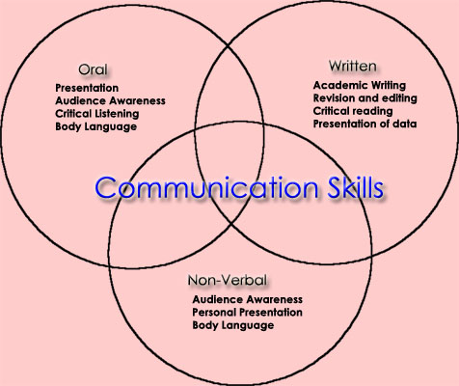
Communication Skills

Slide 5
Study Skills
Essay Writing
Reading
Note Taking

Slide 6
Future Career
Banking
Business management
Local government

Slide 7
To sum up
Good speakers (KISS; rule of 3; rehearse) successful in
Communication;
Studies;
Careers.

