Slide 1
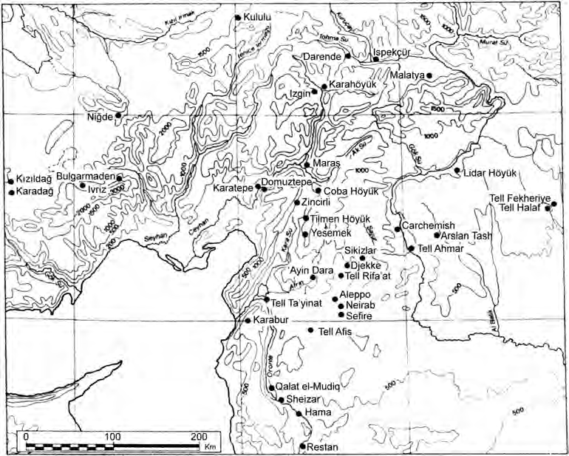
Нео-хититски царства/The Neo-Hittite Kingdoms

Slide 2
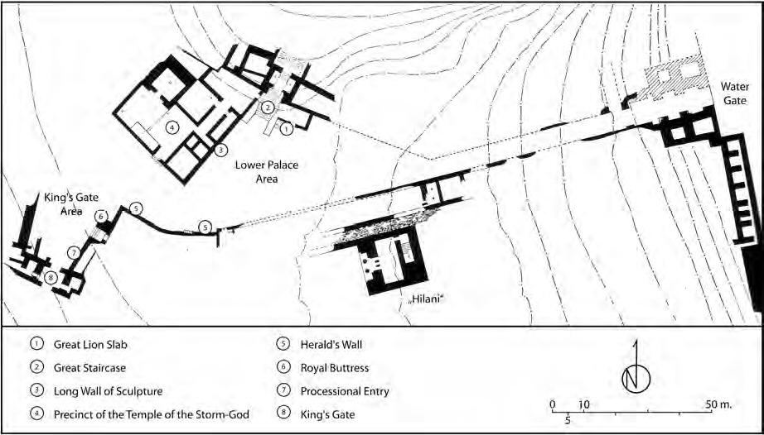
Carchemish

Slide 3
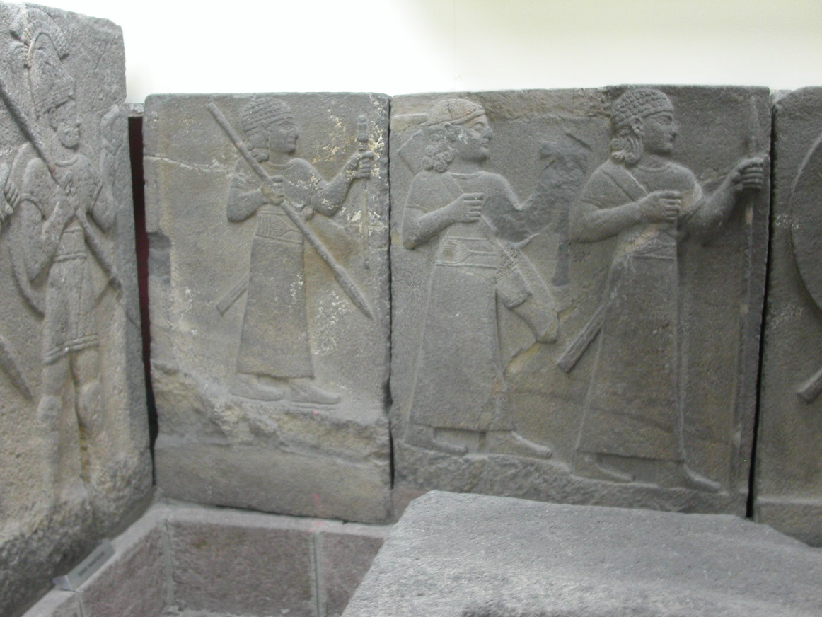
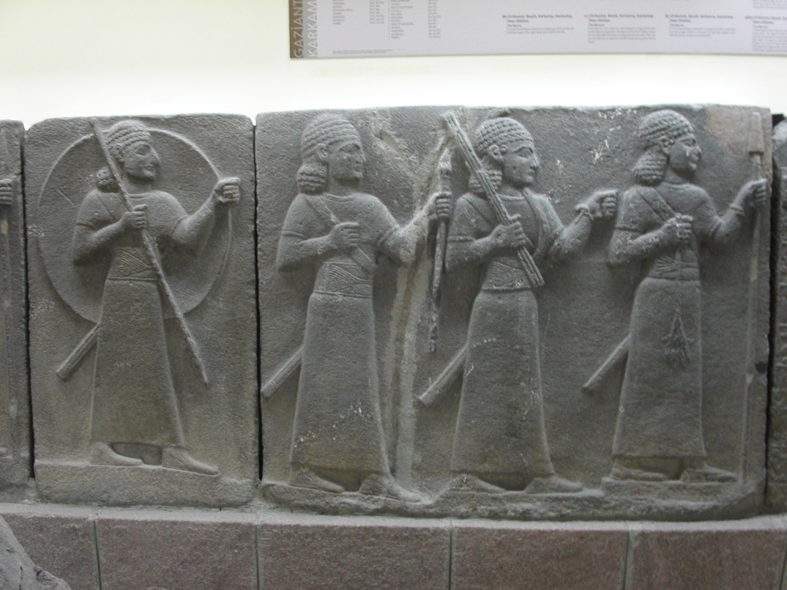
Reliefs (orthostates) from Karkemiš

Slide 4
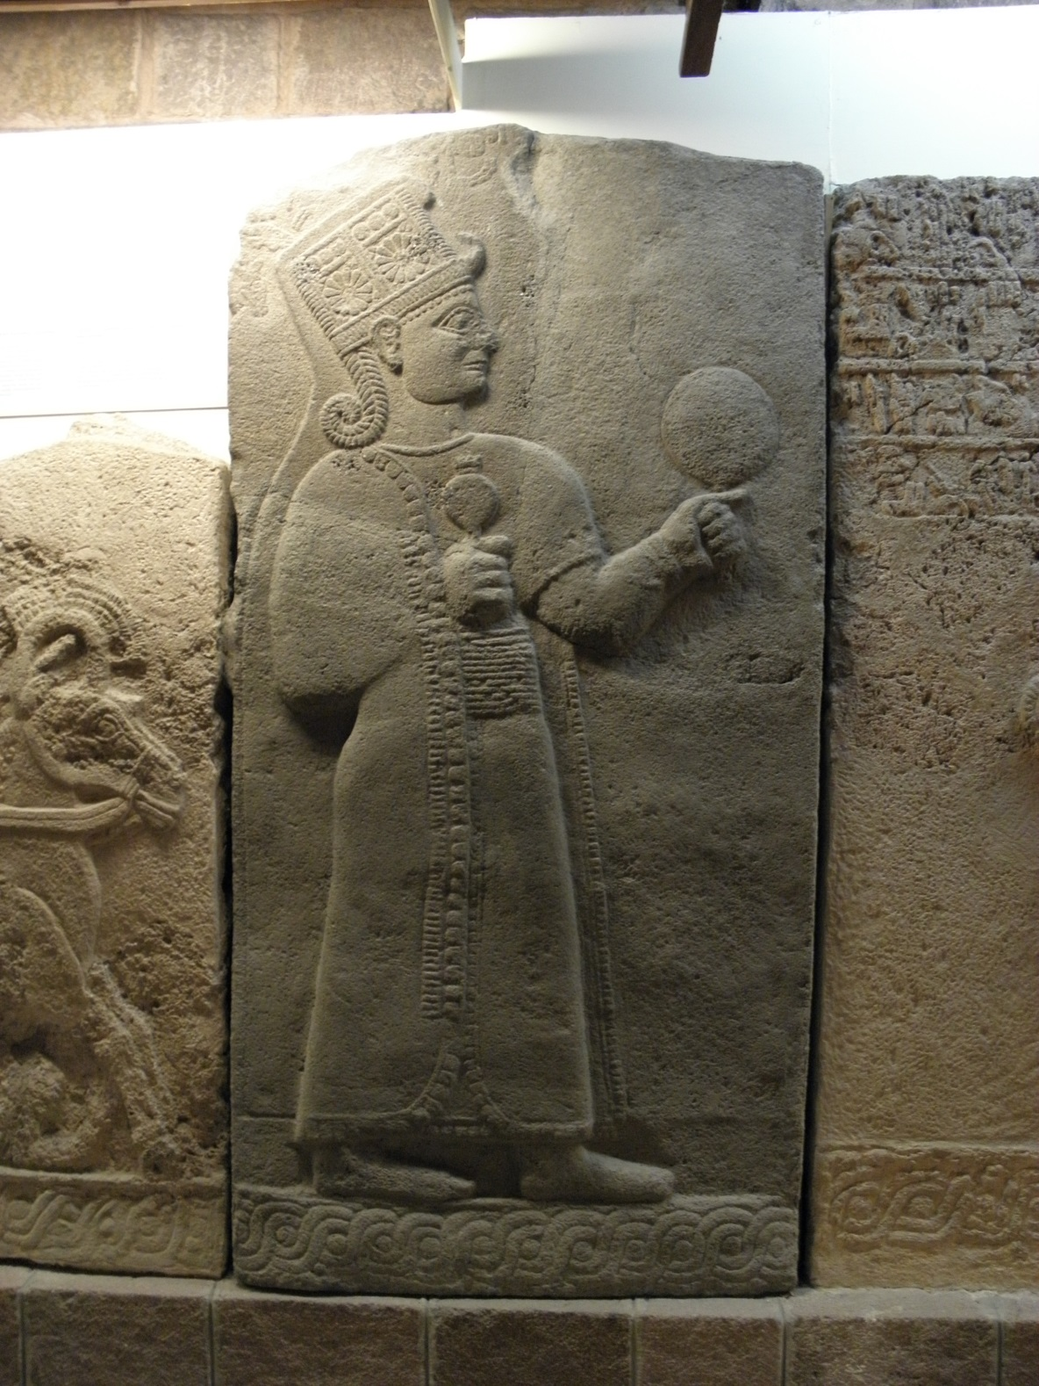
The goddess Kubaba from Karkemiš

Slide 5
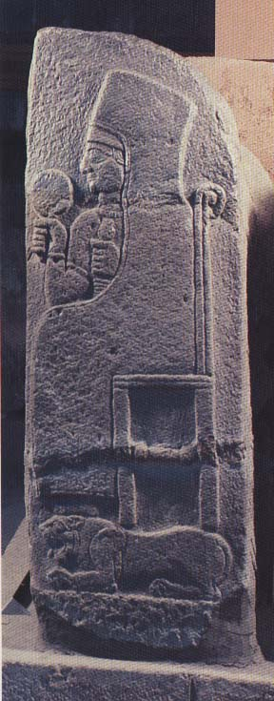
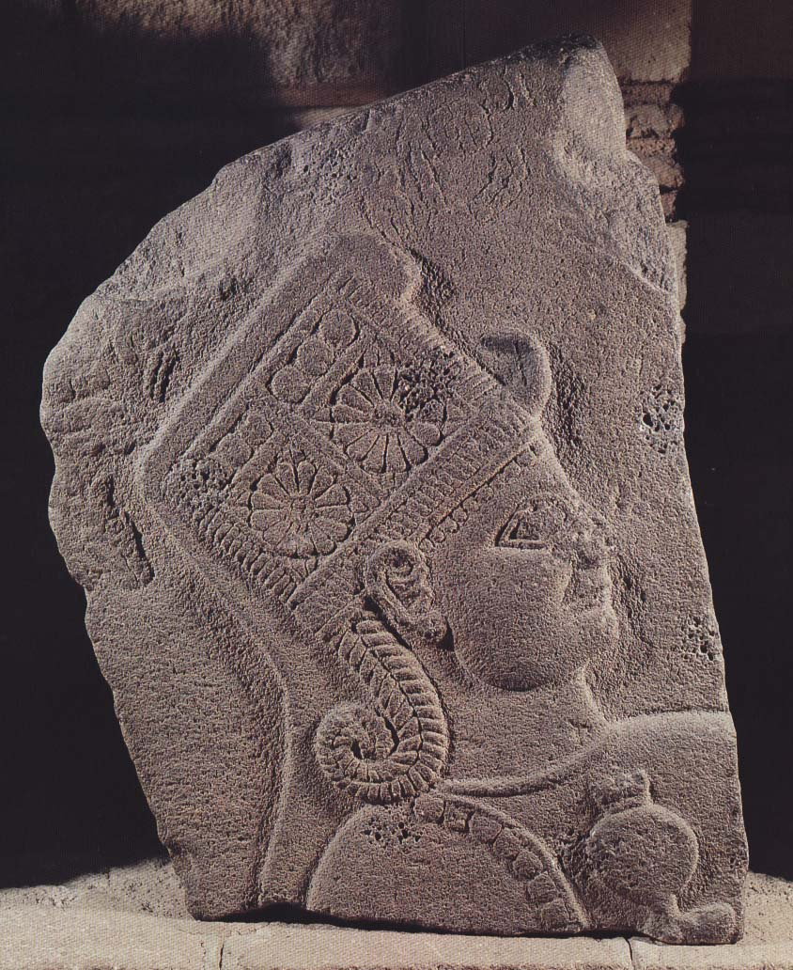
Релефи на Кубаба от Каркемиш, ІХ в. пр. Хр.

Slide 6
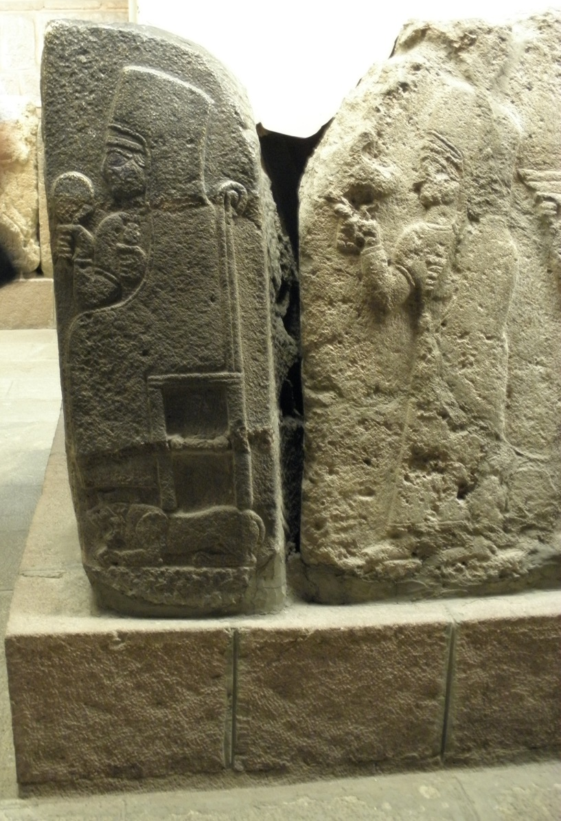
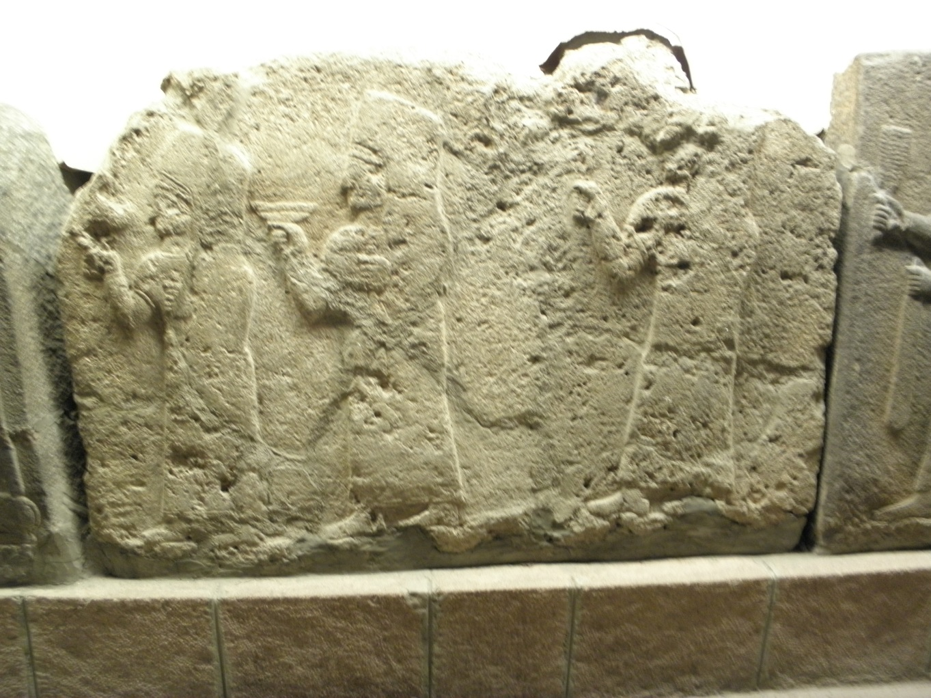

Slide 7
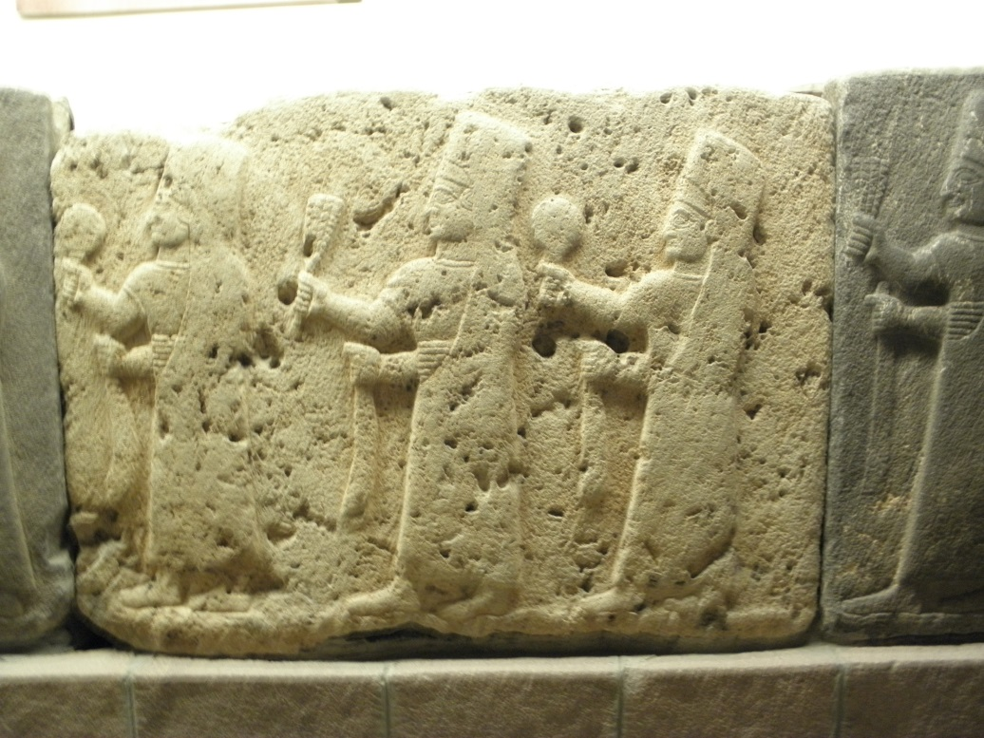
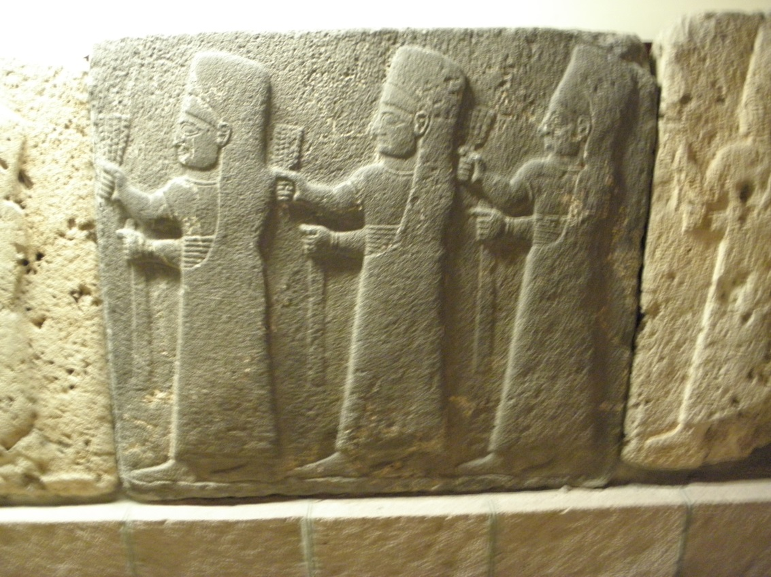

Slide 8
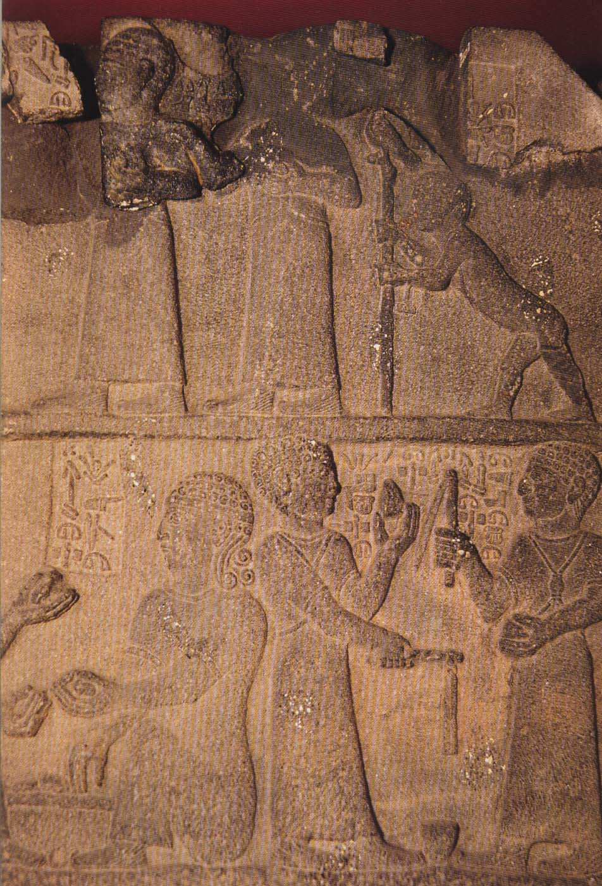
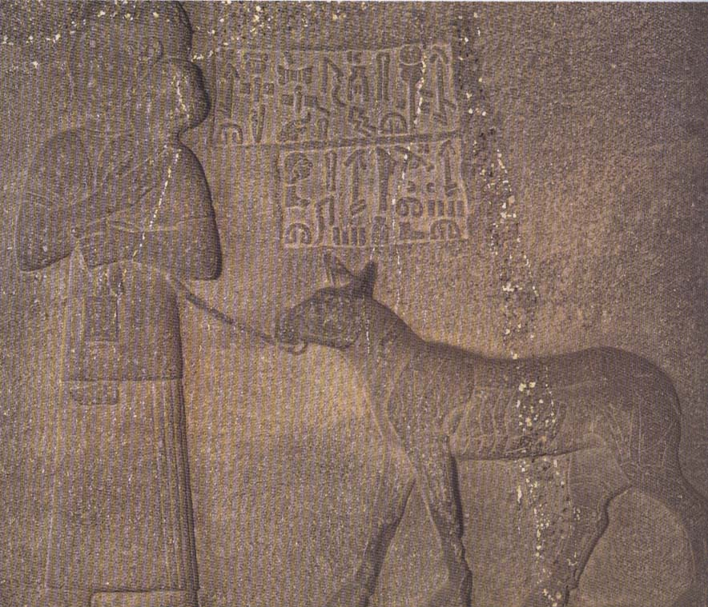

Slide 9
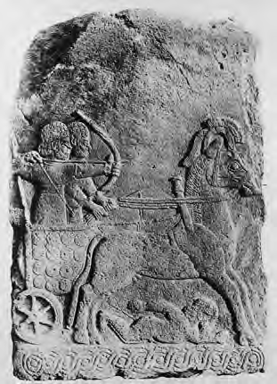
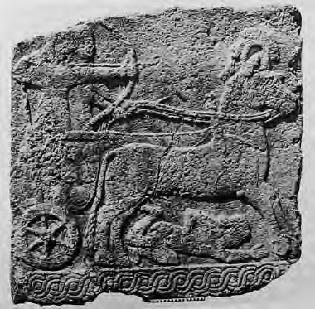

Slide 10
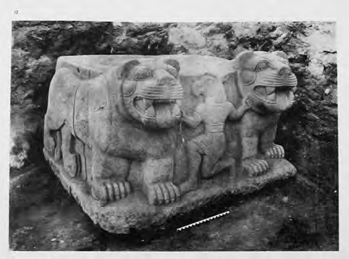
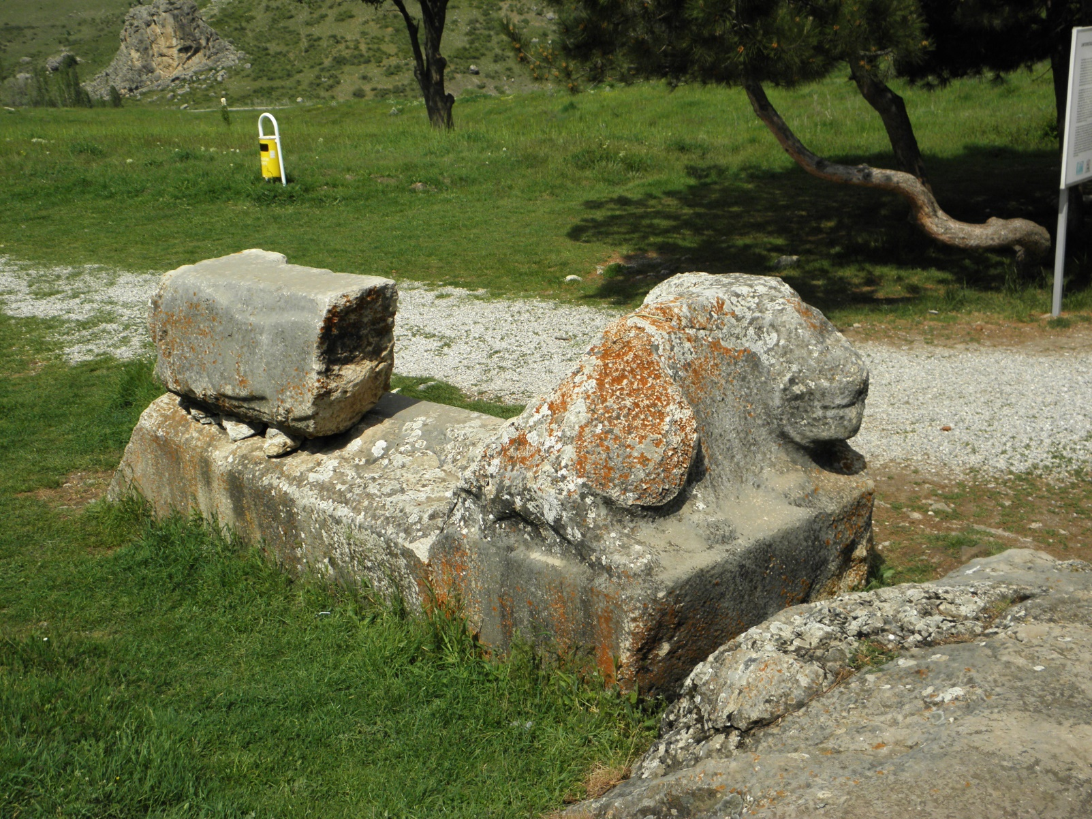
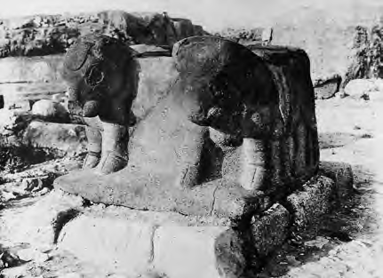
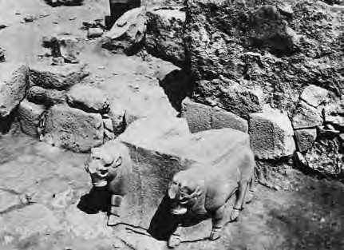
Hattusa

Slide 11
In Luwian Hieroglyphic Inscriptions:
Kubaba: ‘Queen of Karkemish’ (KARKAMIŠ A23.2, 5; A25a.3; A31.3)
Rulers of Karkemish
- addressed Kubaba as ‘my sovereign’ (KARKAMIŠ A18e3; A23.2)
- announced themselves as:
‘beloved of Kubaba’ (KARKAMIŠ A13c1; A21.1; A15b1)
or ‘Kubaba’s dear servant’ (KARKAMIŠ A15e1)

Slide 12
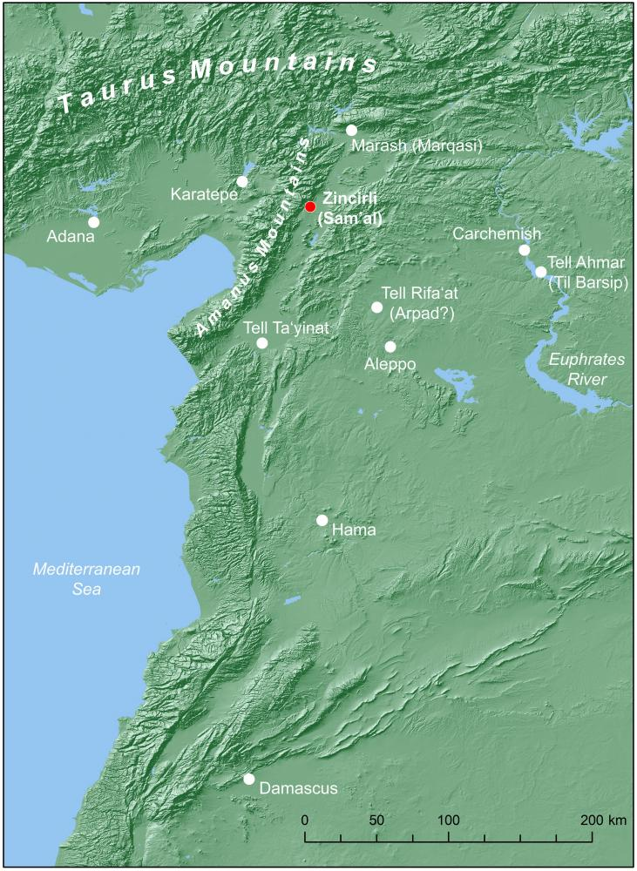
Sam’al - Zincirli

Slide 13
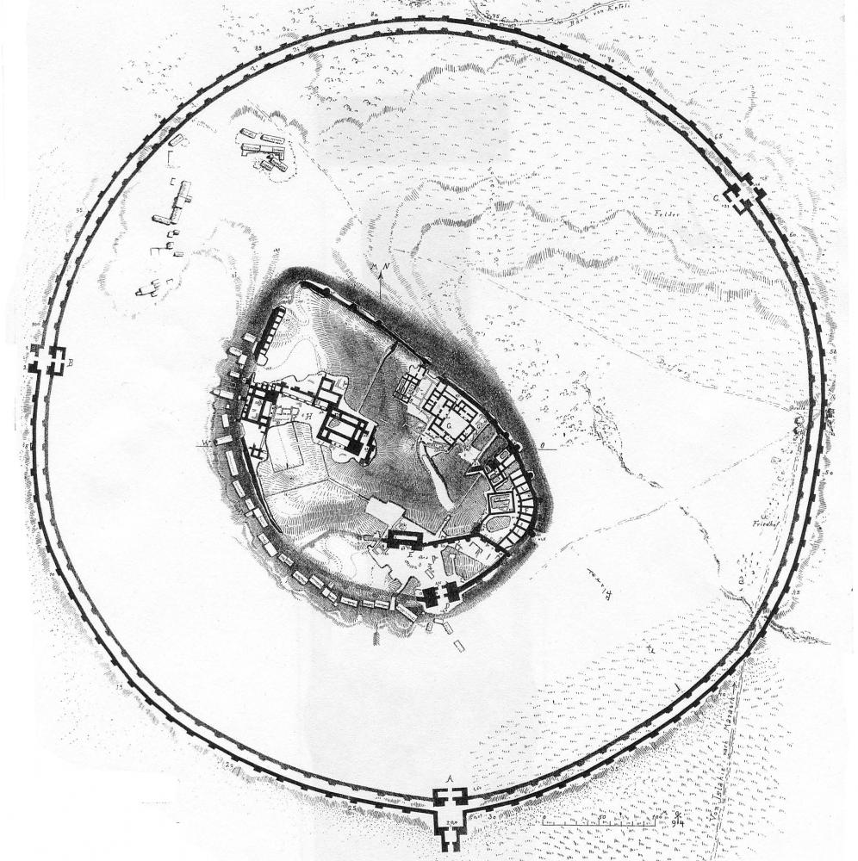
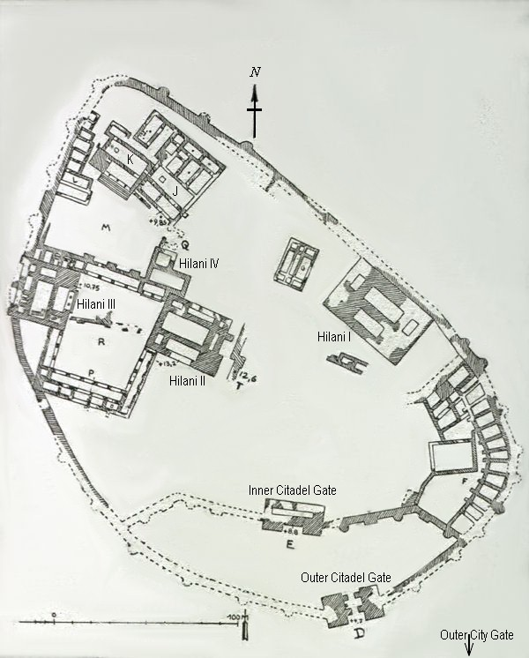
Plan of Sam’al - Zincirli

Slide 14
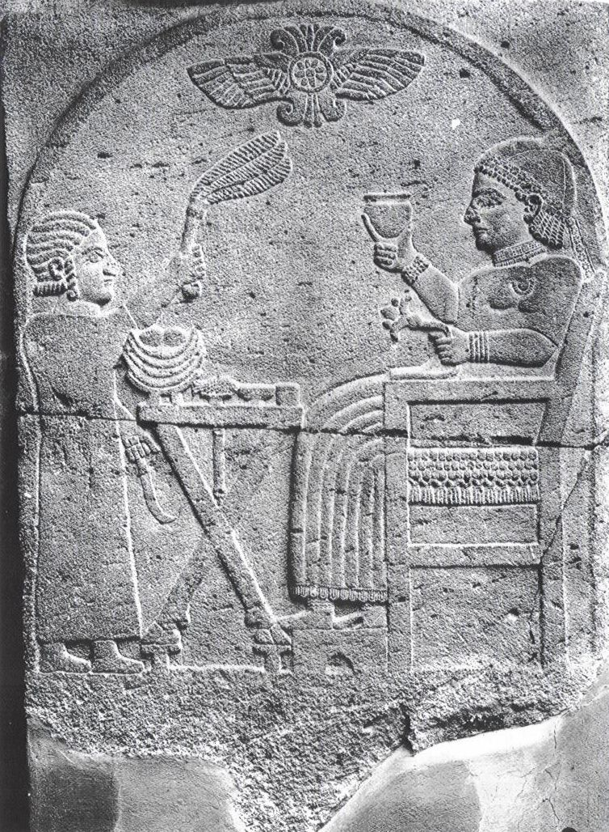
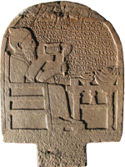

Slide 15
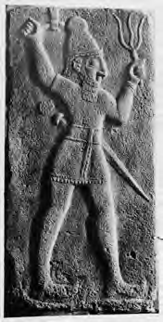
Zincirli

Slide 16
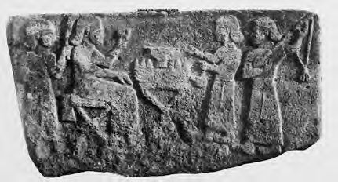
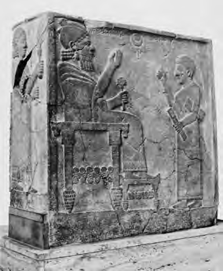
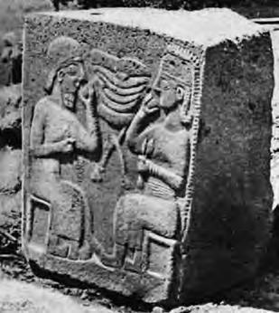
Karkemish
Zincirli, audience scene
Zincirli

Slide 17
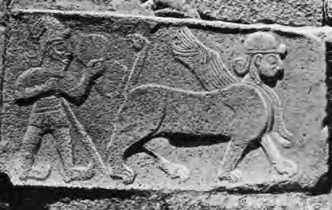
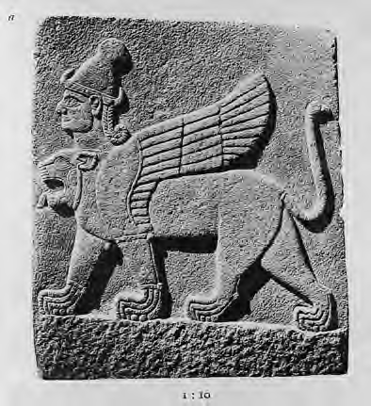
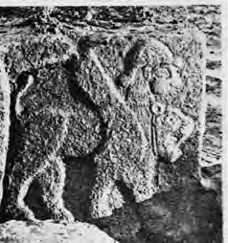
Zincirli
Karkemish

Slide 18
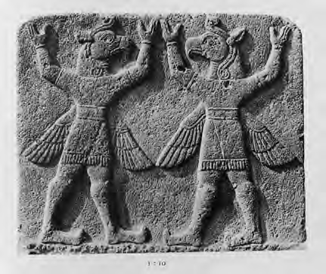
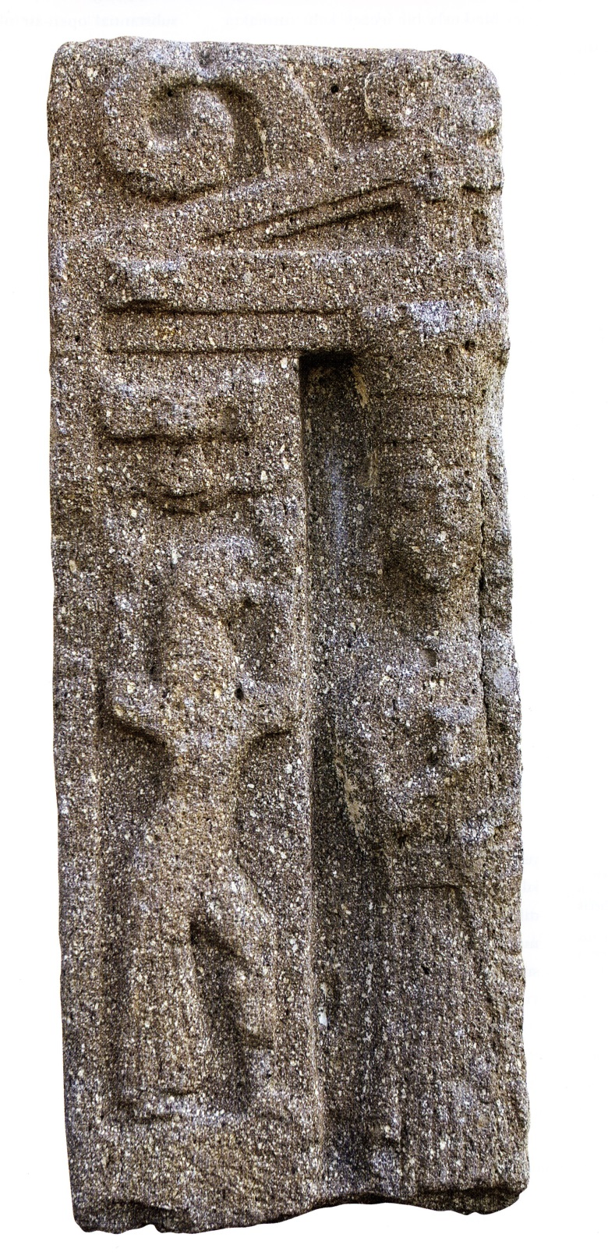
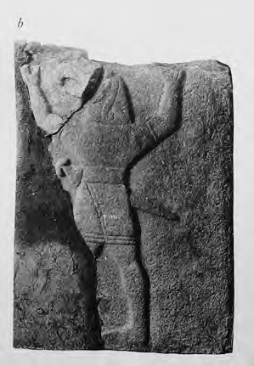
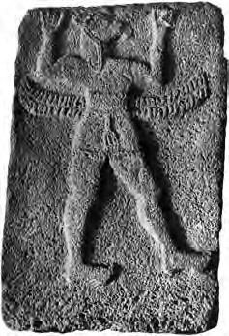
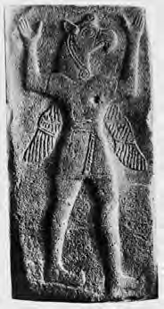
Karkemish
Stone relief of Kybele, found in Etlik, Ankara
Zincirli

Slide 19
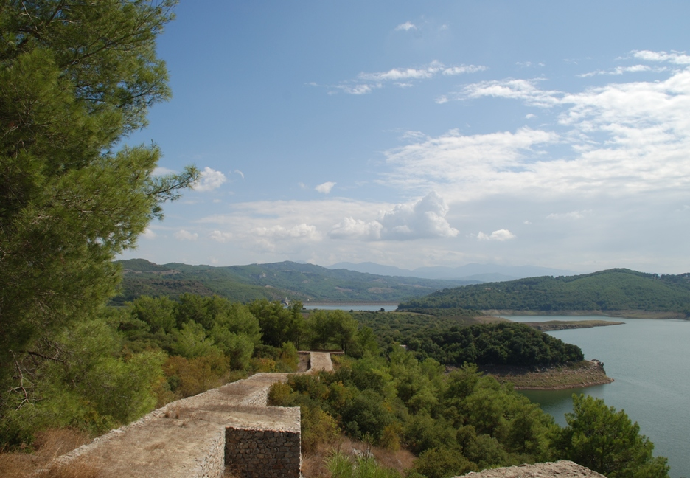
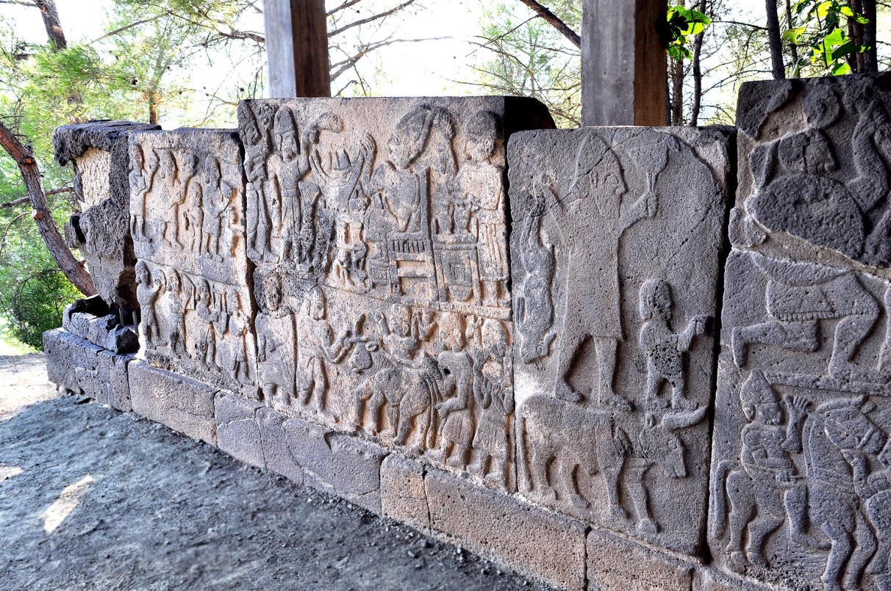
Karatepe, near Adana (Cilicia)

Slide 20
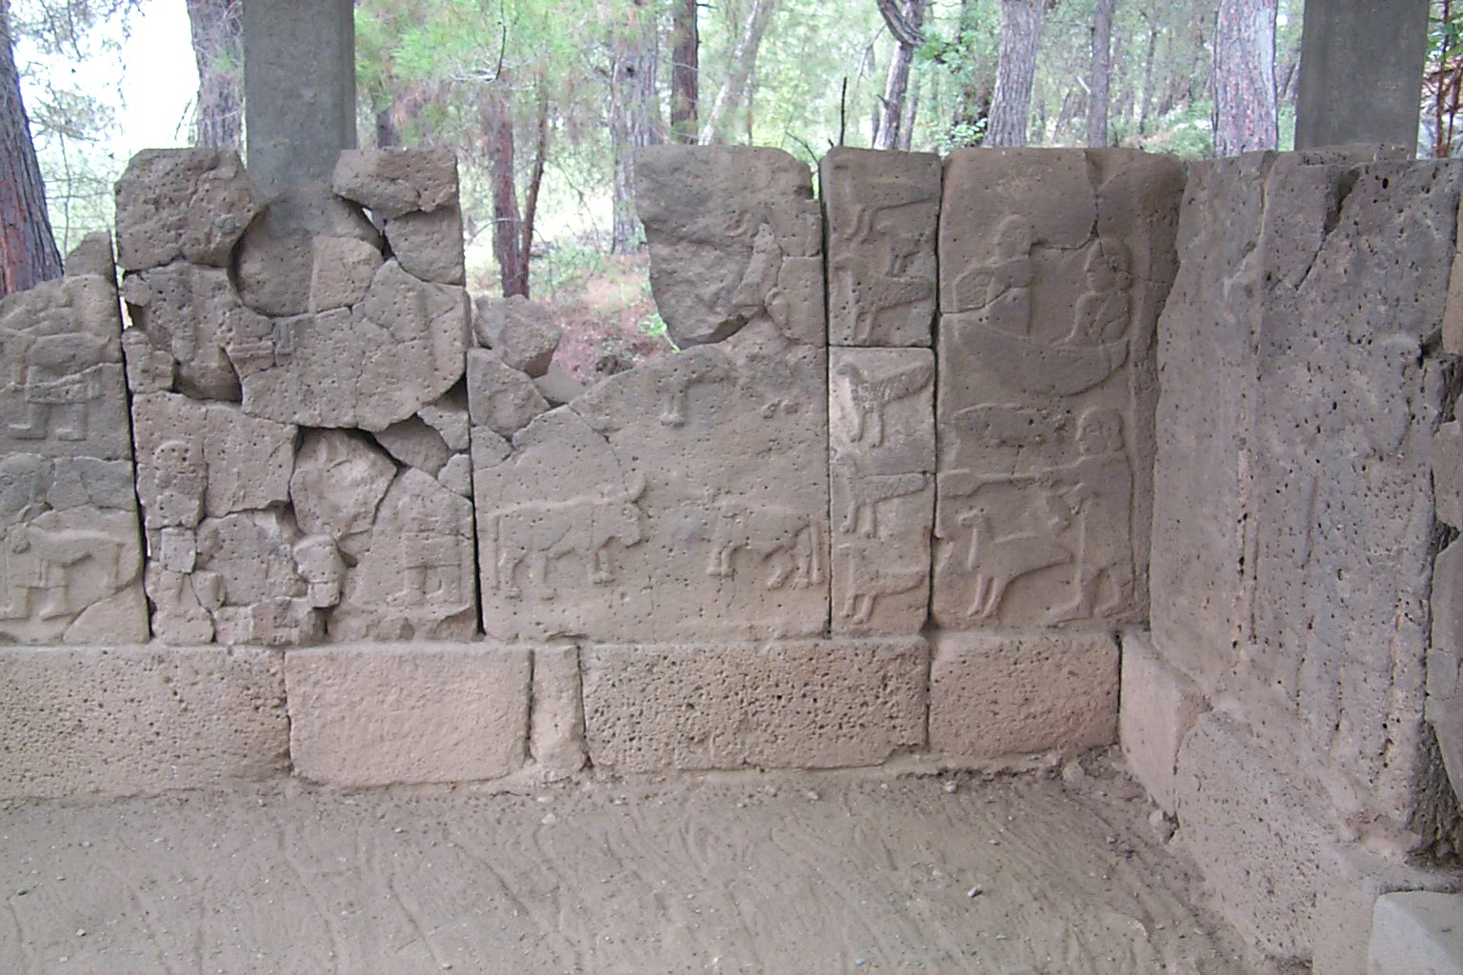

Slide 21
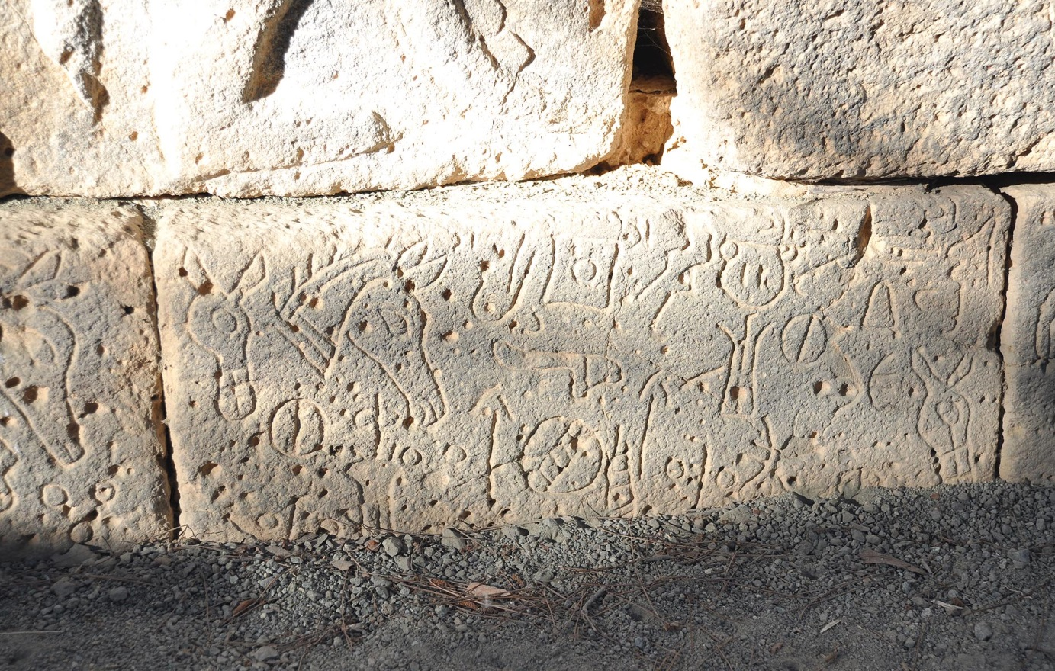
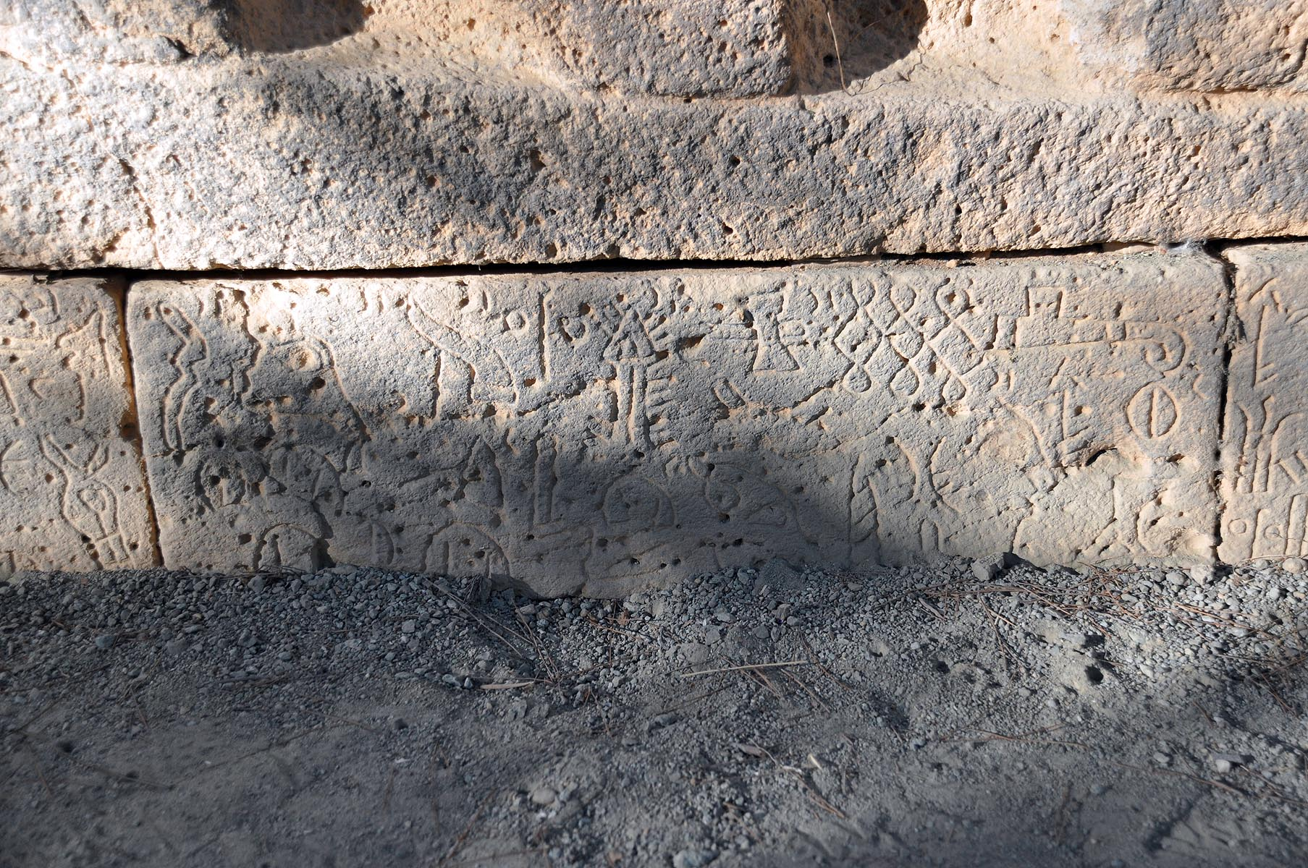

Slide 22
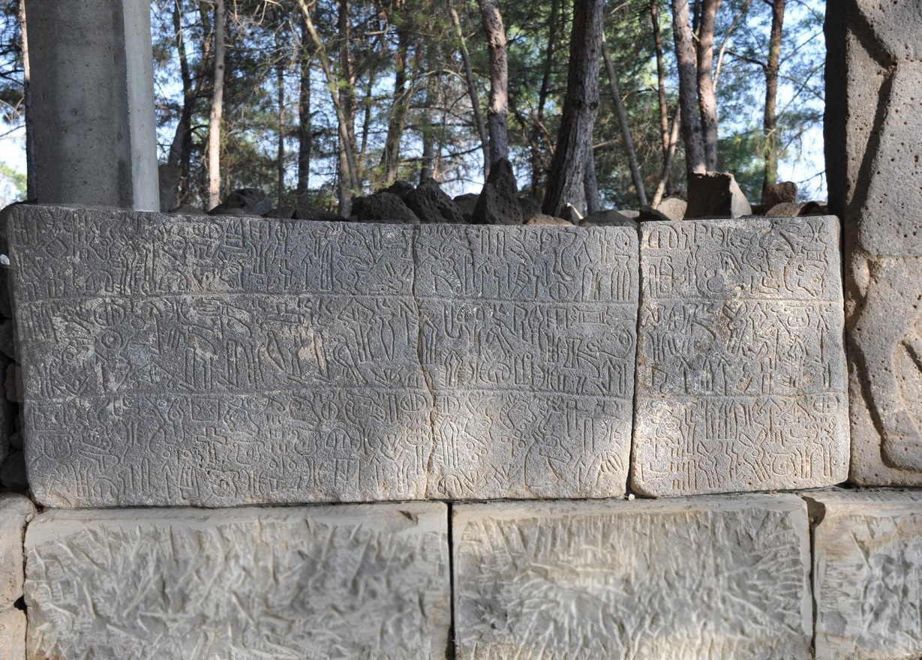
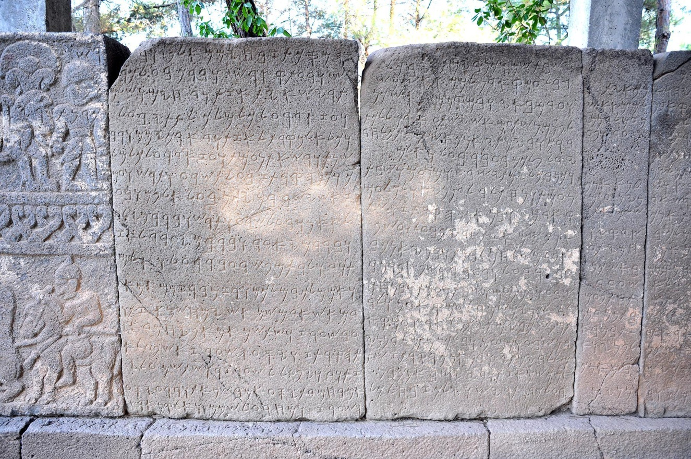
Different fragments of the bilingual Luwian-Phoenician inscription

Slide 23
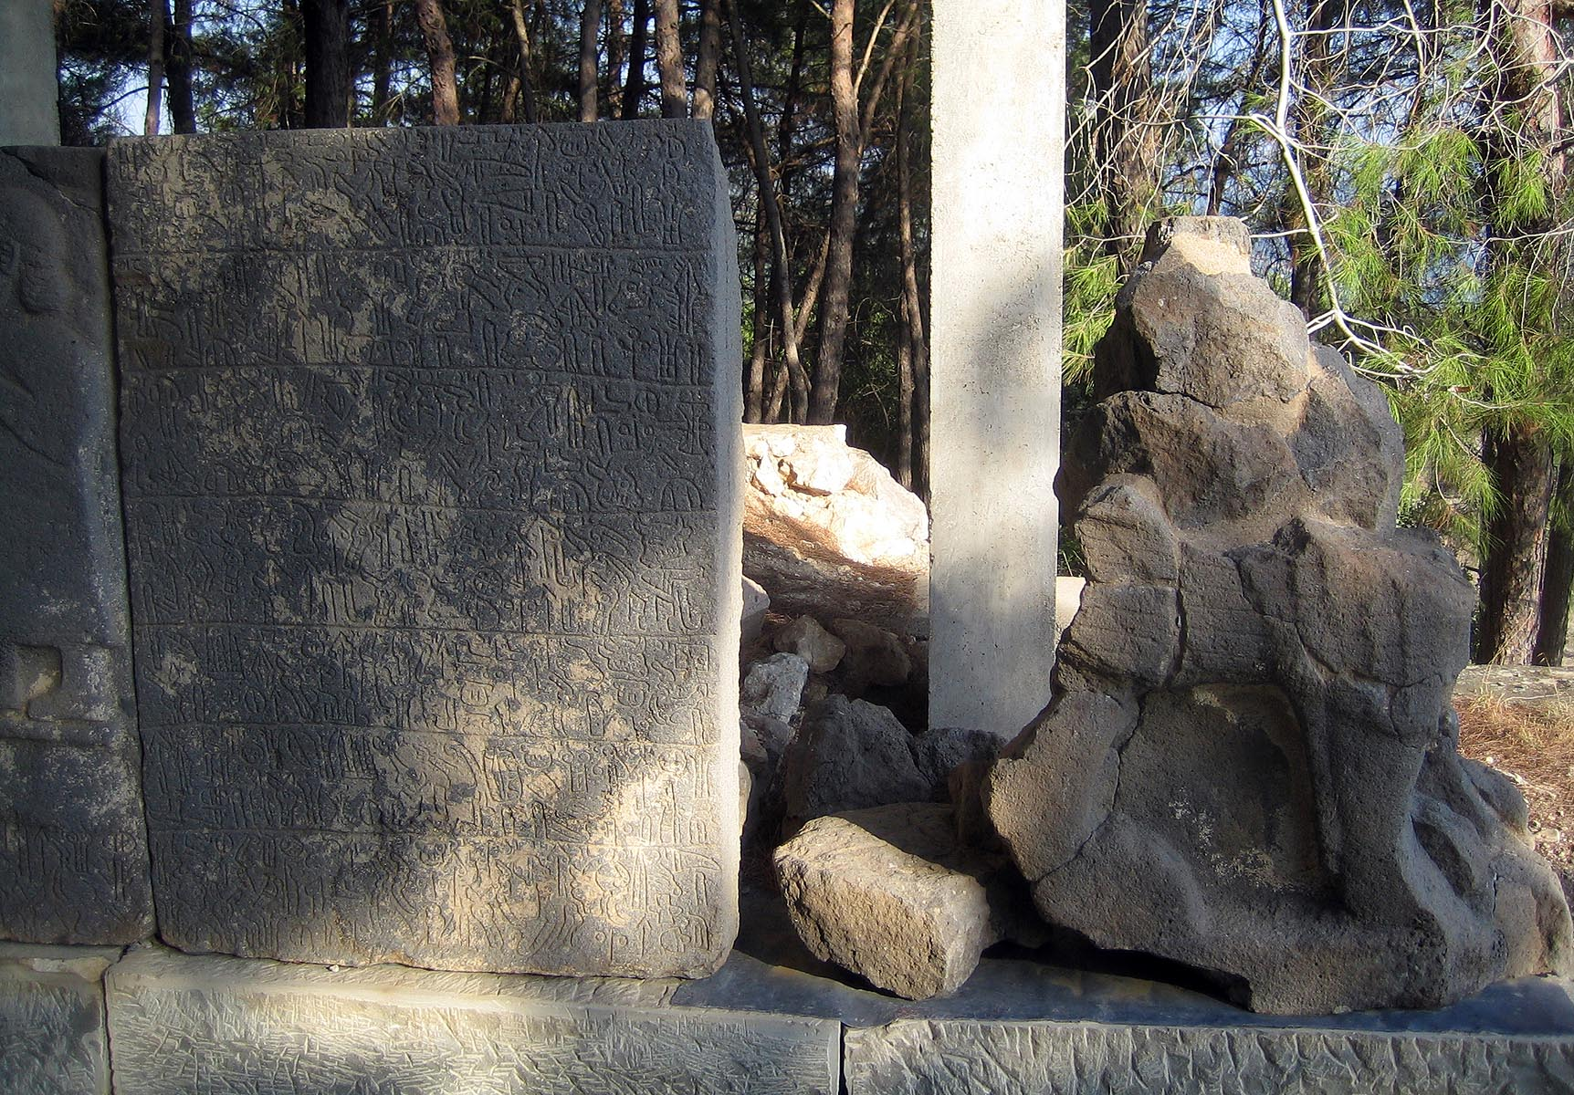

Slide 25
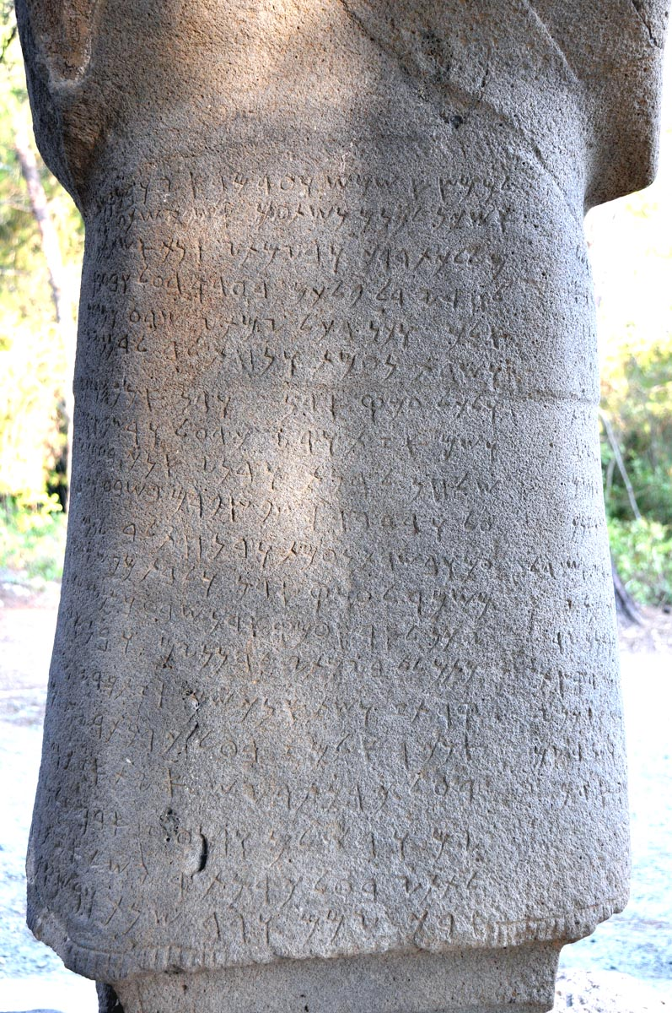
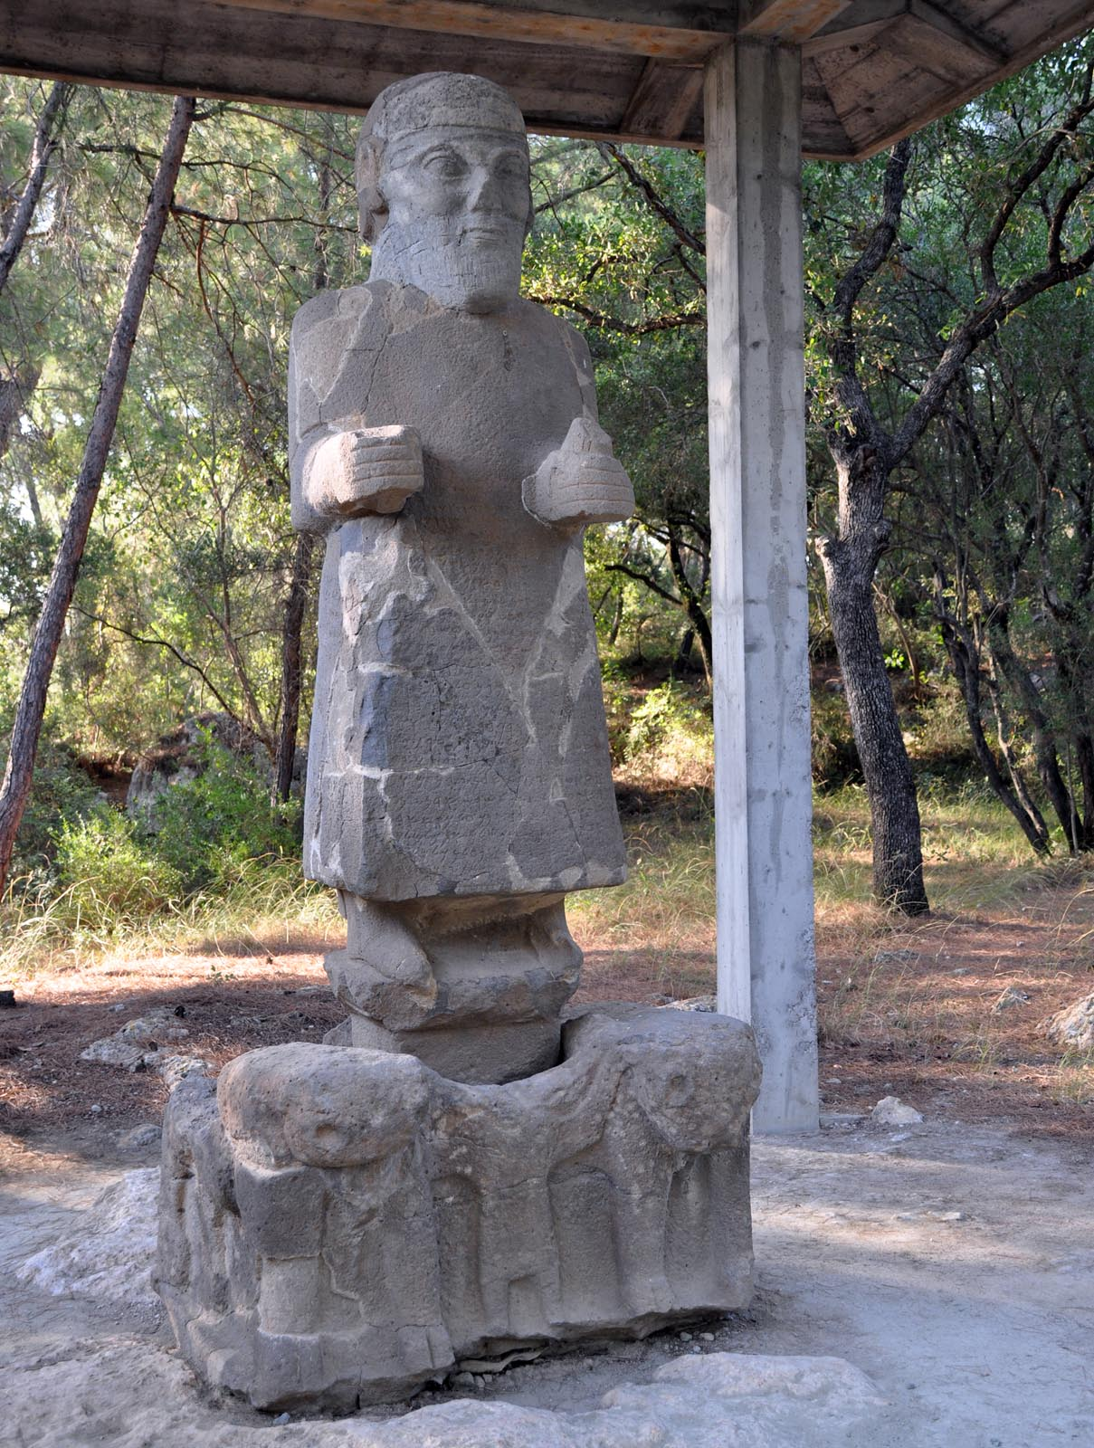
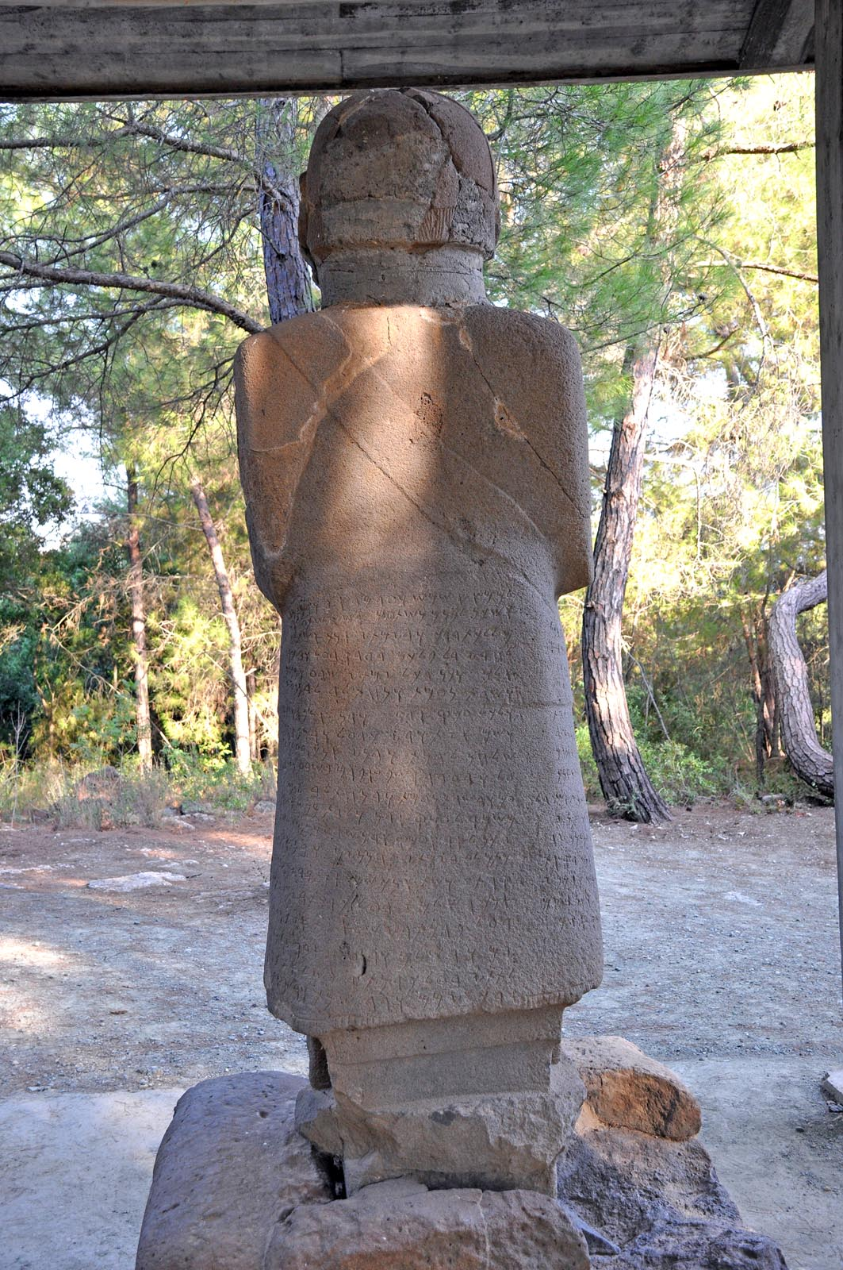

Slide 26
ASATIWATA SPEAKS
I am indeed Asatiwata, The blessed of the Sun, the servant of the Storm-God, Whom Awariku exalted, king of Adanawa. The Storm-God made me father and mother to the city of Adanawa, And I developed the city of Adanawa, And I enlarged the land of Adanawa, both to the west and to the east. And in my days the city of Adanawa had prosperity, Satiety and comfort, and I filled the granaries of Pahara, I added horse upon horse, shield upon shield, Army upon army, all for the Storm-God and the Gods I crushed the arrogance of the arrogant, all the evil that was in the land I cast outside. I erected mansions for my lordship, I brought prosperity to my race, And I sat on the throne of my father, I made peace with every king. Kings considered me their father, for my righteousness, for my wisdom, And for the goodness of my heart. I built mighty fortresses on all my borders, On the borders where there had been bad men, leaders of gangs, none of whom had been subservient to the house of Muksas, I, Azatiwata put them at my feet. I destroyed the fortresses there, I built fortresses in those places, so that the people of Adanawa might dwell in ease and in peace. In the west

Slide 27
I subjugated mighty lands Which the kings before me had not subjugated. And I, Azatiwata subjugated them, made them my servents. And I settled them in the east of my land, Within my borders. The people of Adanawa, too, I settled there. And in my days I enlargened the borders of Adanawa to the west as well as to the east, so that, in the places which had formerly been feared, on the desolate roads where men would be afraid to walk, in my days women could stroll with their spindles. And in my days there was plenty, satiety, comfort and peace. And Adanawa and the land of Adanawa lived in peace and plenty. And A built this citadel, And I gave it the name of Asatiwataya, Because the Storm-God and the Gods directed me towards this, So that this citadel might protect the plain of Adana and the house of Mopsos. In my days there were in the people of Adanawa was plenty and peace, In my days none of the people of Adanawa was put to the sword. And I built this citadel, I gave it the name of Azatiwataya, There I settled the Storm-God and I made sacrifices to him; annually an ox, in the season of ploughing a sheep, in autumn a sheep I sacrificed to him. I sanctified the Storm-God,

Slide 28
He granted me long days, countless years and great strength above all kings. And the people who dwell in this land became owners of cattle, herds, plenty (of food) and wine, Their offspring was plenty, by the grace of the Storm-God and the Gods They rendered service to Asatiwata and to the house of Muksas. And if any king among kings, or any prince among princes, or a person of renown, Obliterates the name of Asatiwata in this gate and puts here another name, or even covets this city and destroys this gate which Asatiwata made, and builds another gate in its place and puts his name upon it, Whether he destroys this gate from greed, or from hate and evil, Then may the God of the Sky, the God of the Earth And the Sun of the Universe and all the generations of gods obliterate this king, this prince or this person of renown from the face of earth. Only the name of Asatiwata is immortal in eternity, Like the name of the Sun and of the Moon.

Slide 30
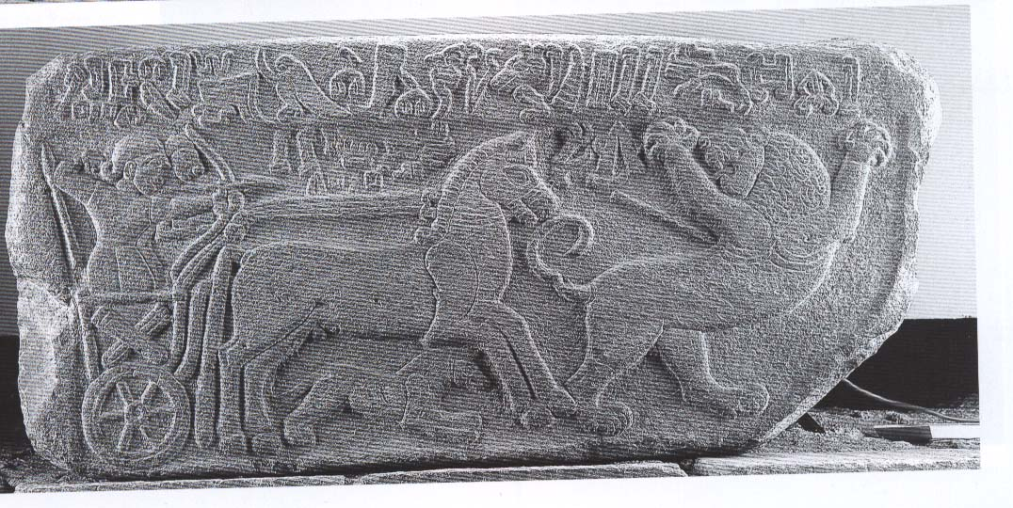

Slide 31
