Slide 1
HITTITE OPEN-AIR SANCTUARIES

Slide 2
The Sungod of the Sky - ^{d}UTU;
- ^{d}UTU-uš – šiuš = Luw. tiwat = Pal. tiyat = Greek Zeus/Διός → from “day light”
- Istanus – another Sungod originating from Hat. Estana
The Storm God/Weather God – ^{d}Tarhunnas, ^{d}IM, ^{d}X
The Sun Goddes of Arinna – from Hat. Wurusemu
Telepinus – God of vegetation similar to Osiris, Attis and Adonis
The War God – ^{d}ZA.BA.BA = Hat. Wurunkatte
Protective God - ^{d}KAL

Slide 3
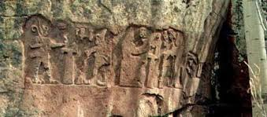
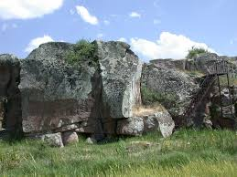
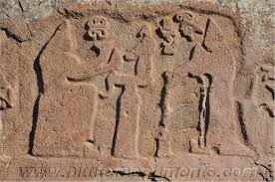
Fraktin. Mid-13 century BC. Hattusilis III makes a libation to the Storm God, while his wife, Puduhepa – to Hebat

Slide 4
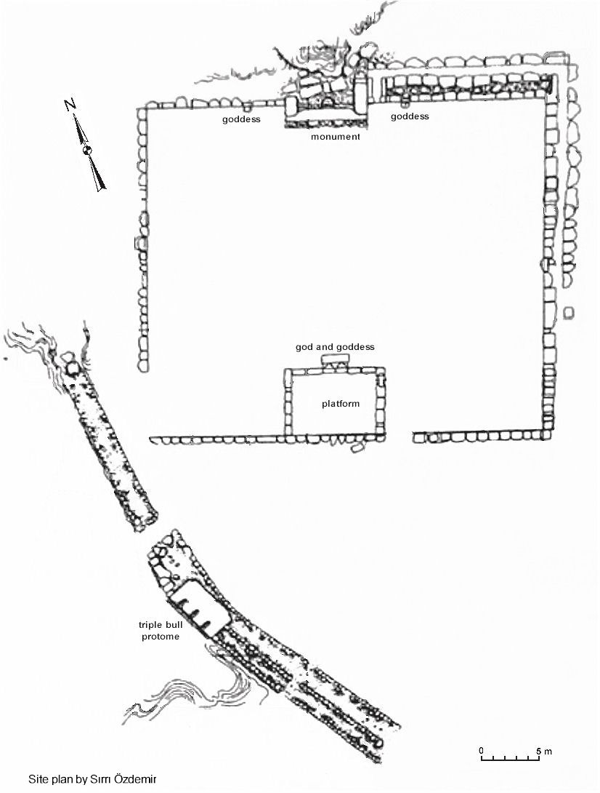
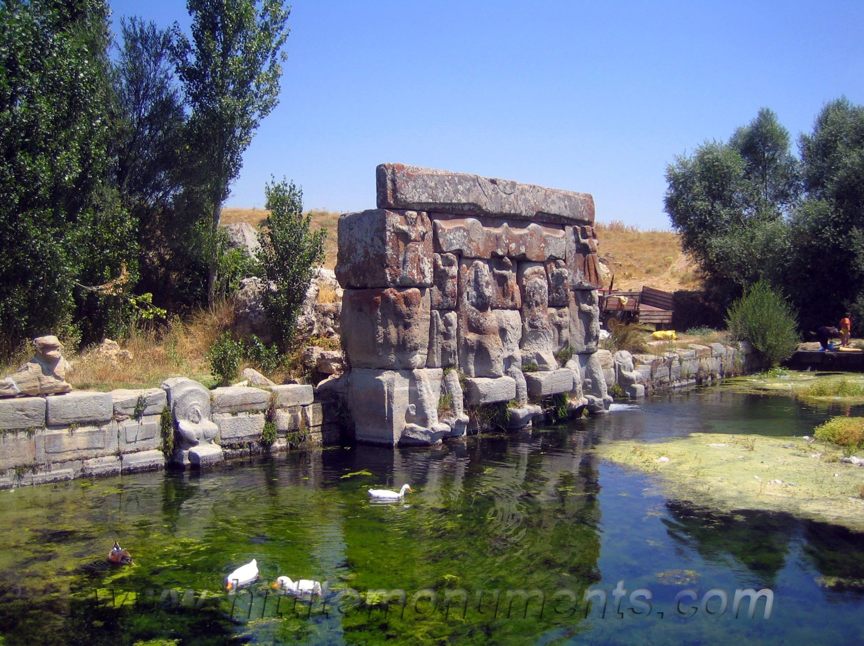
Eflatunpınar, Hittite Imperial period

Slide 5
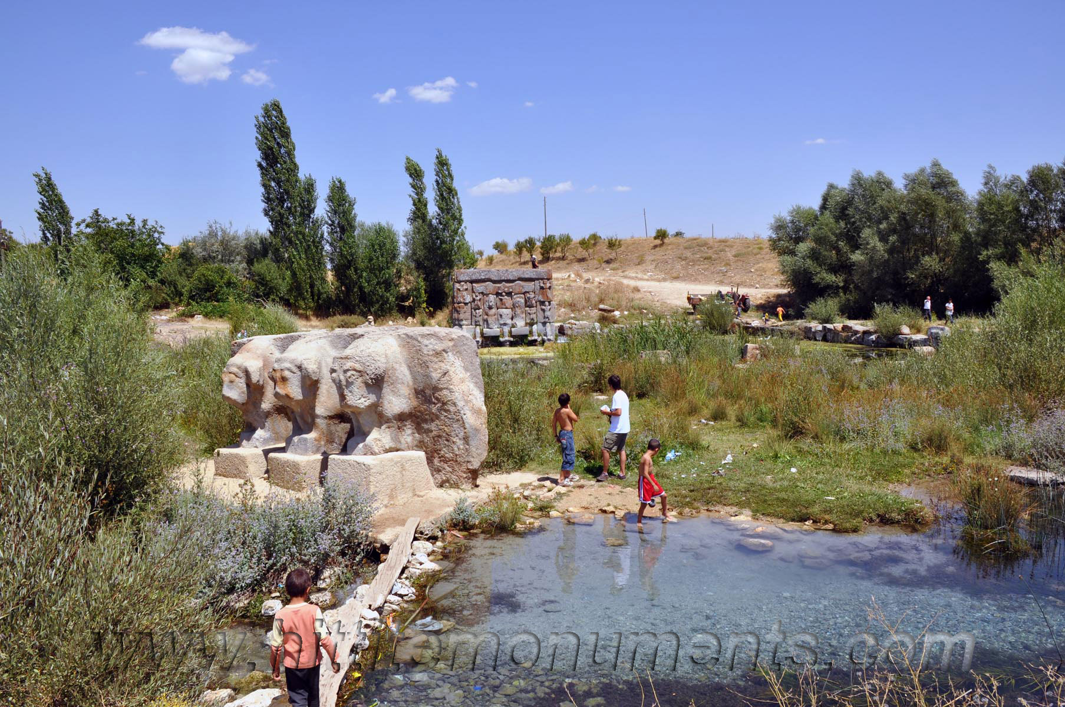
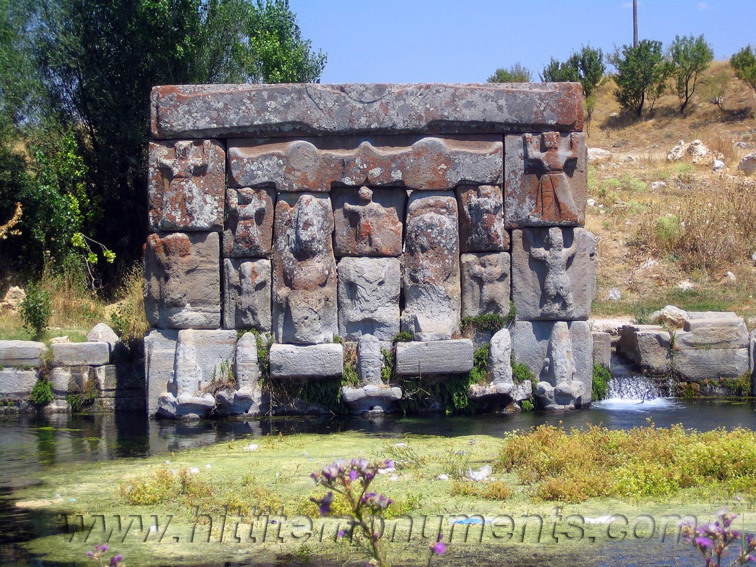

Slide 6
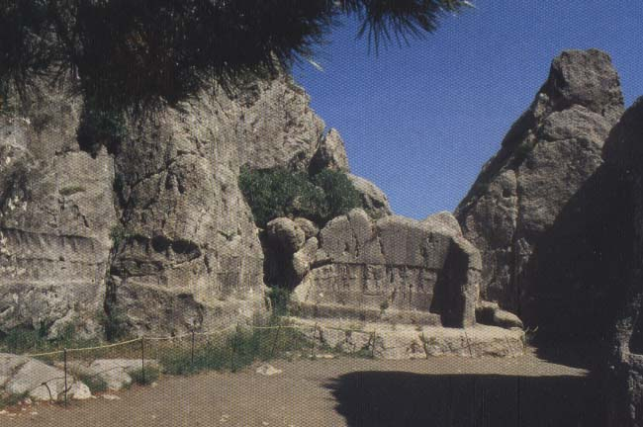
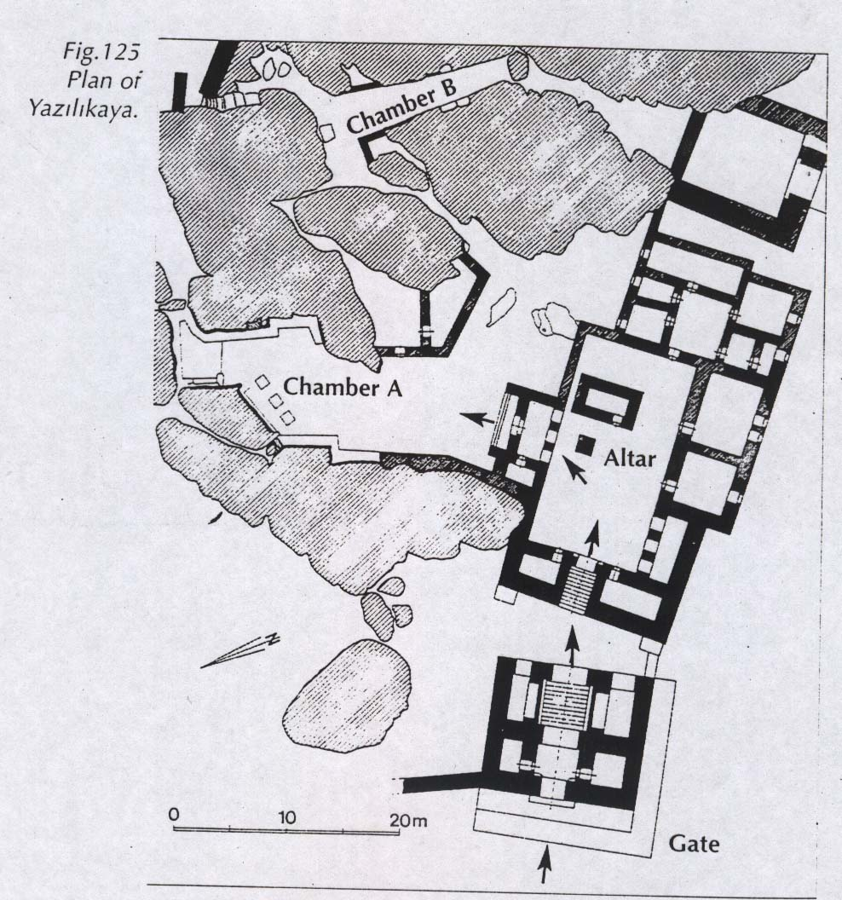
The rock-cut sanctuary at Yazılıkaya, about 2 km away from Hattusa

Slide 7
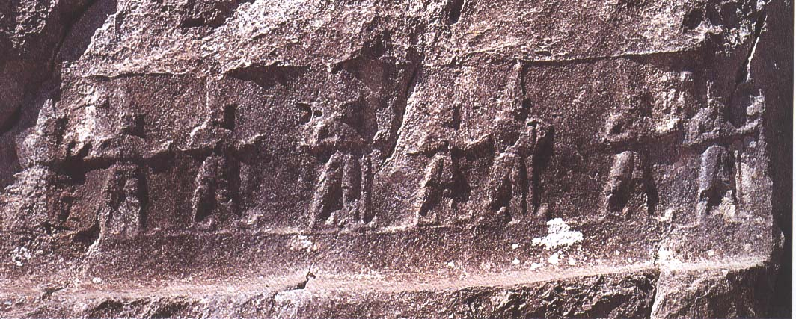
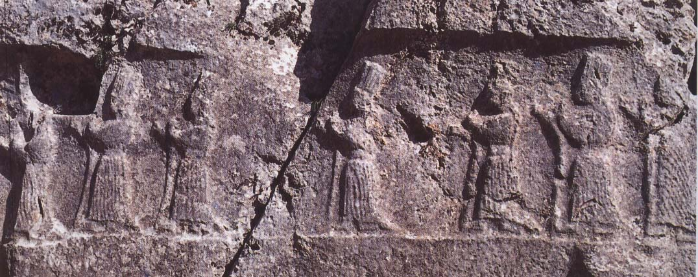

Slide 8
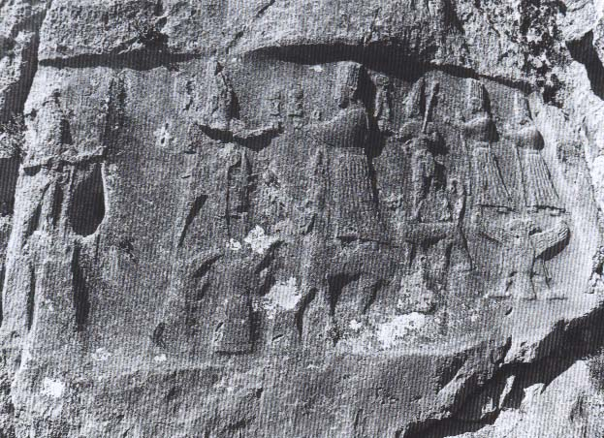
The central scene in Chamber A at Yazılıkaya.

Slide 9
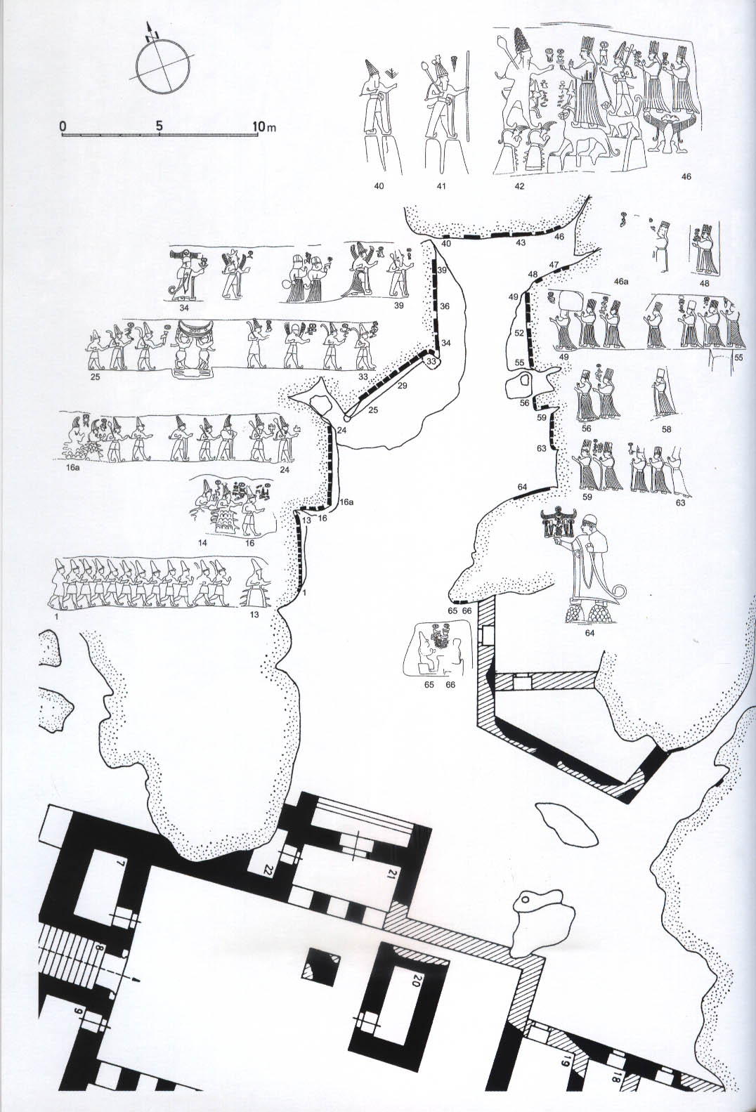
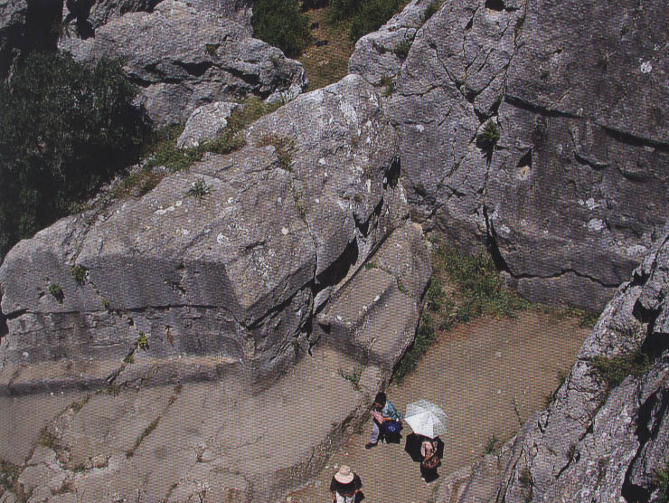
Chamber A at Yazılıkaya

Slide 10
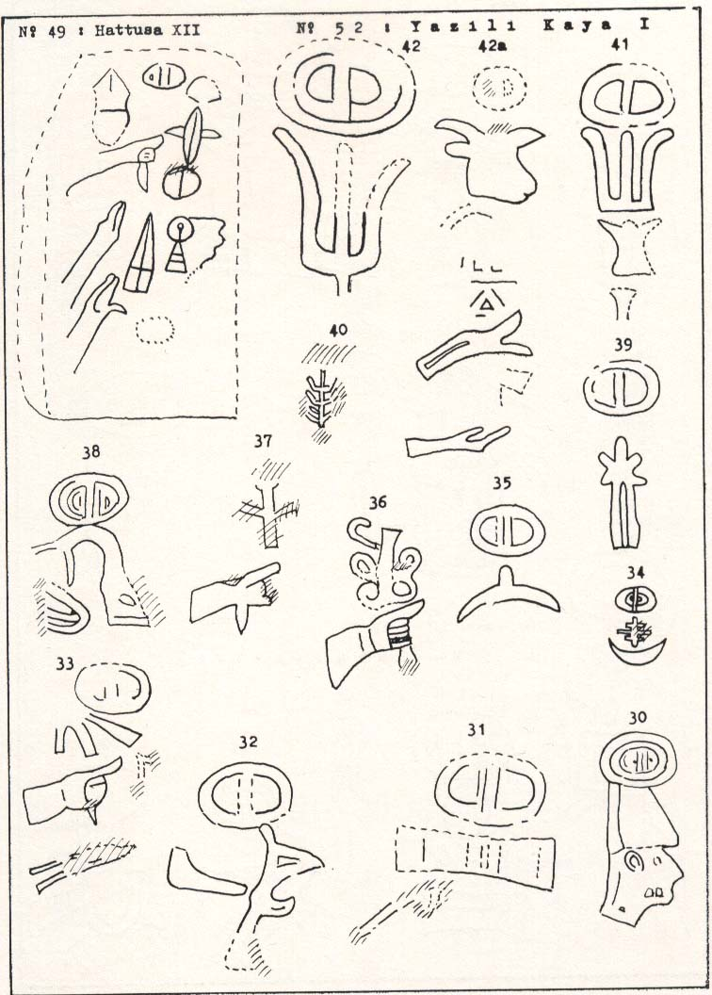
Some of the Luwian hieroglyphic signs hewn next to the images at Yazılıkaya

Slide 11
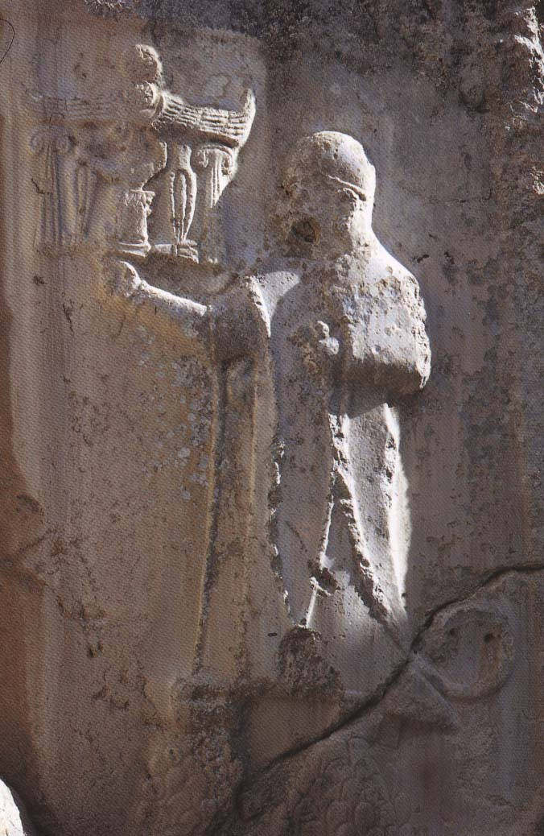
The image of Tudhaliyas IV in Chamber A at Yazılıkaya

Slide 12
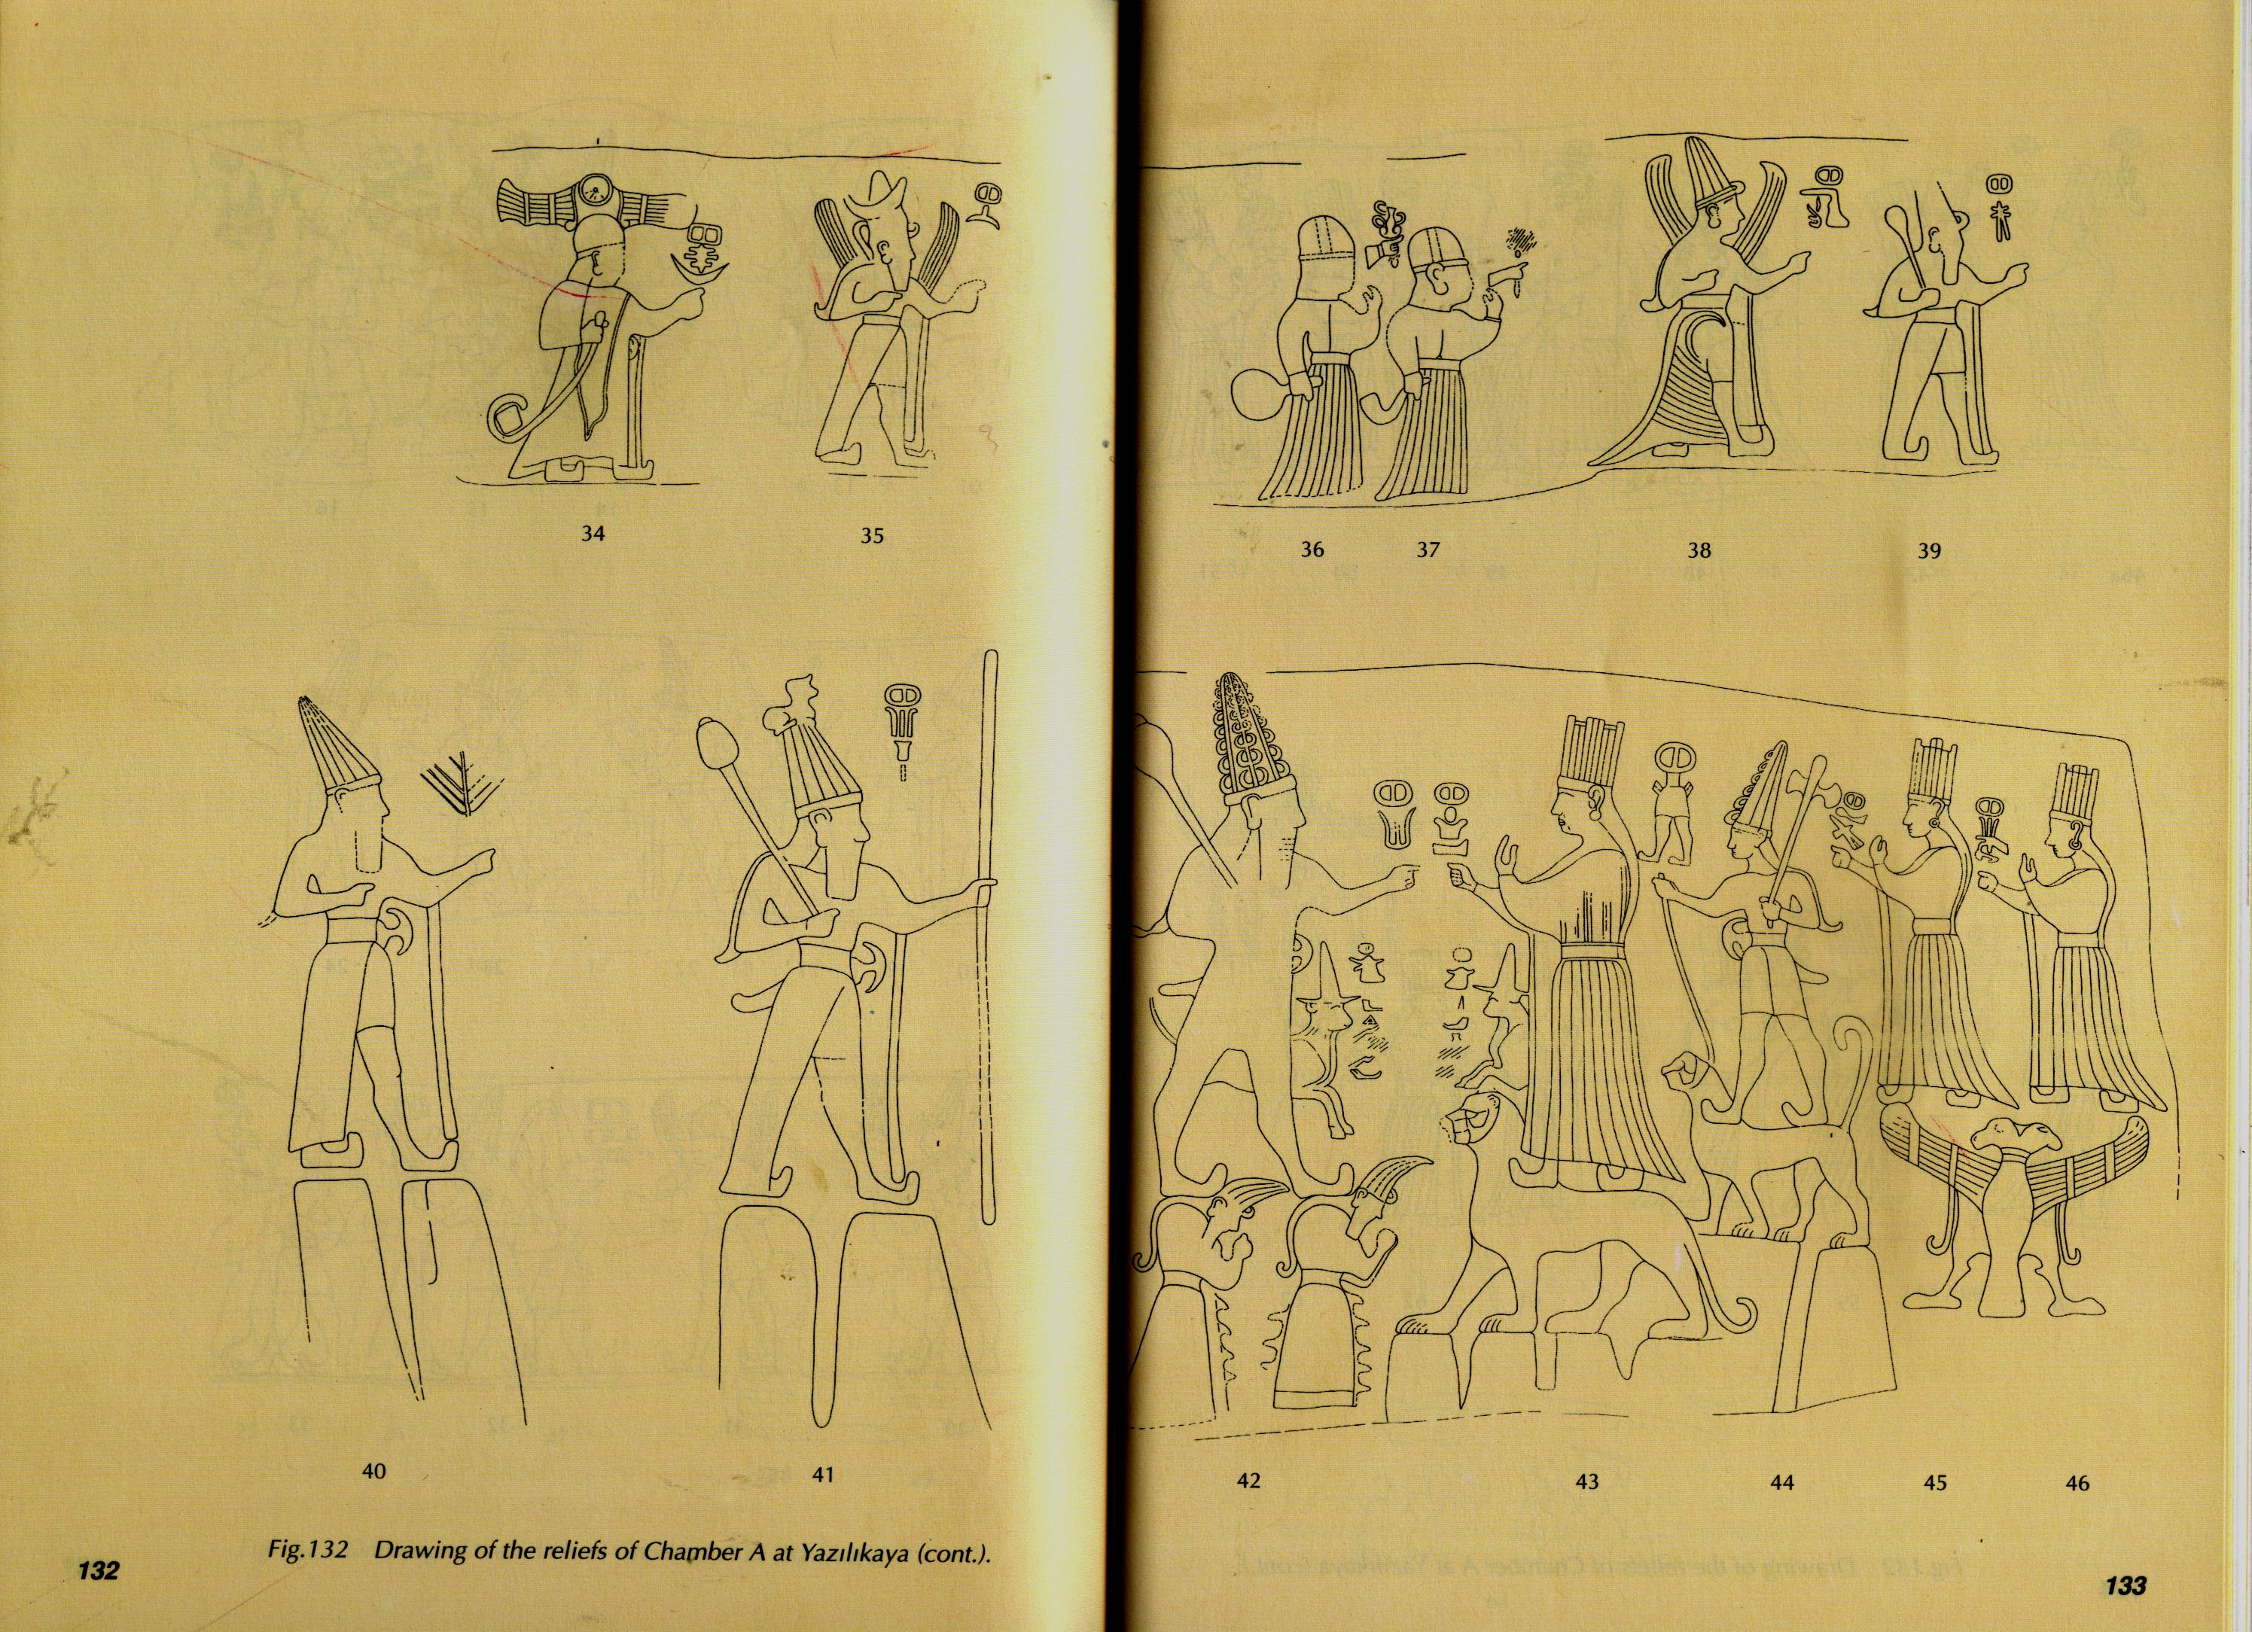

Slide 13
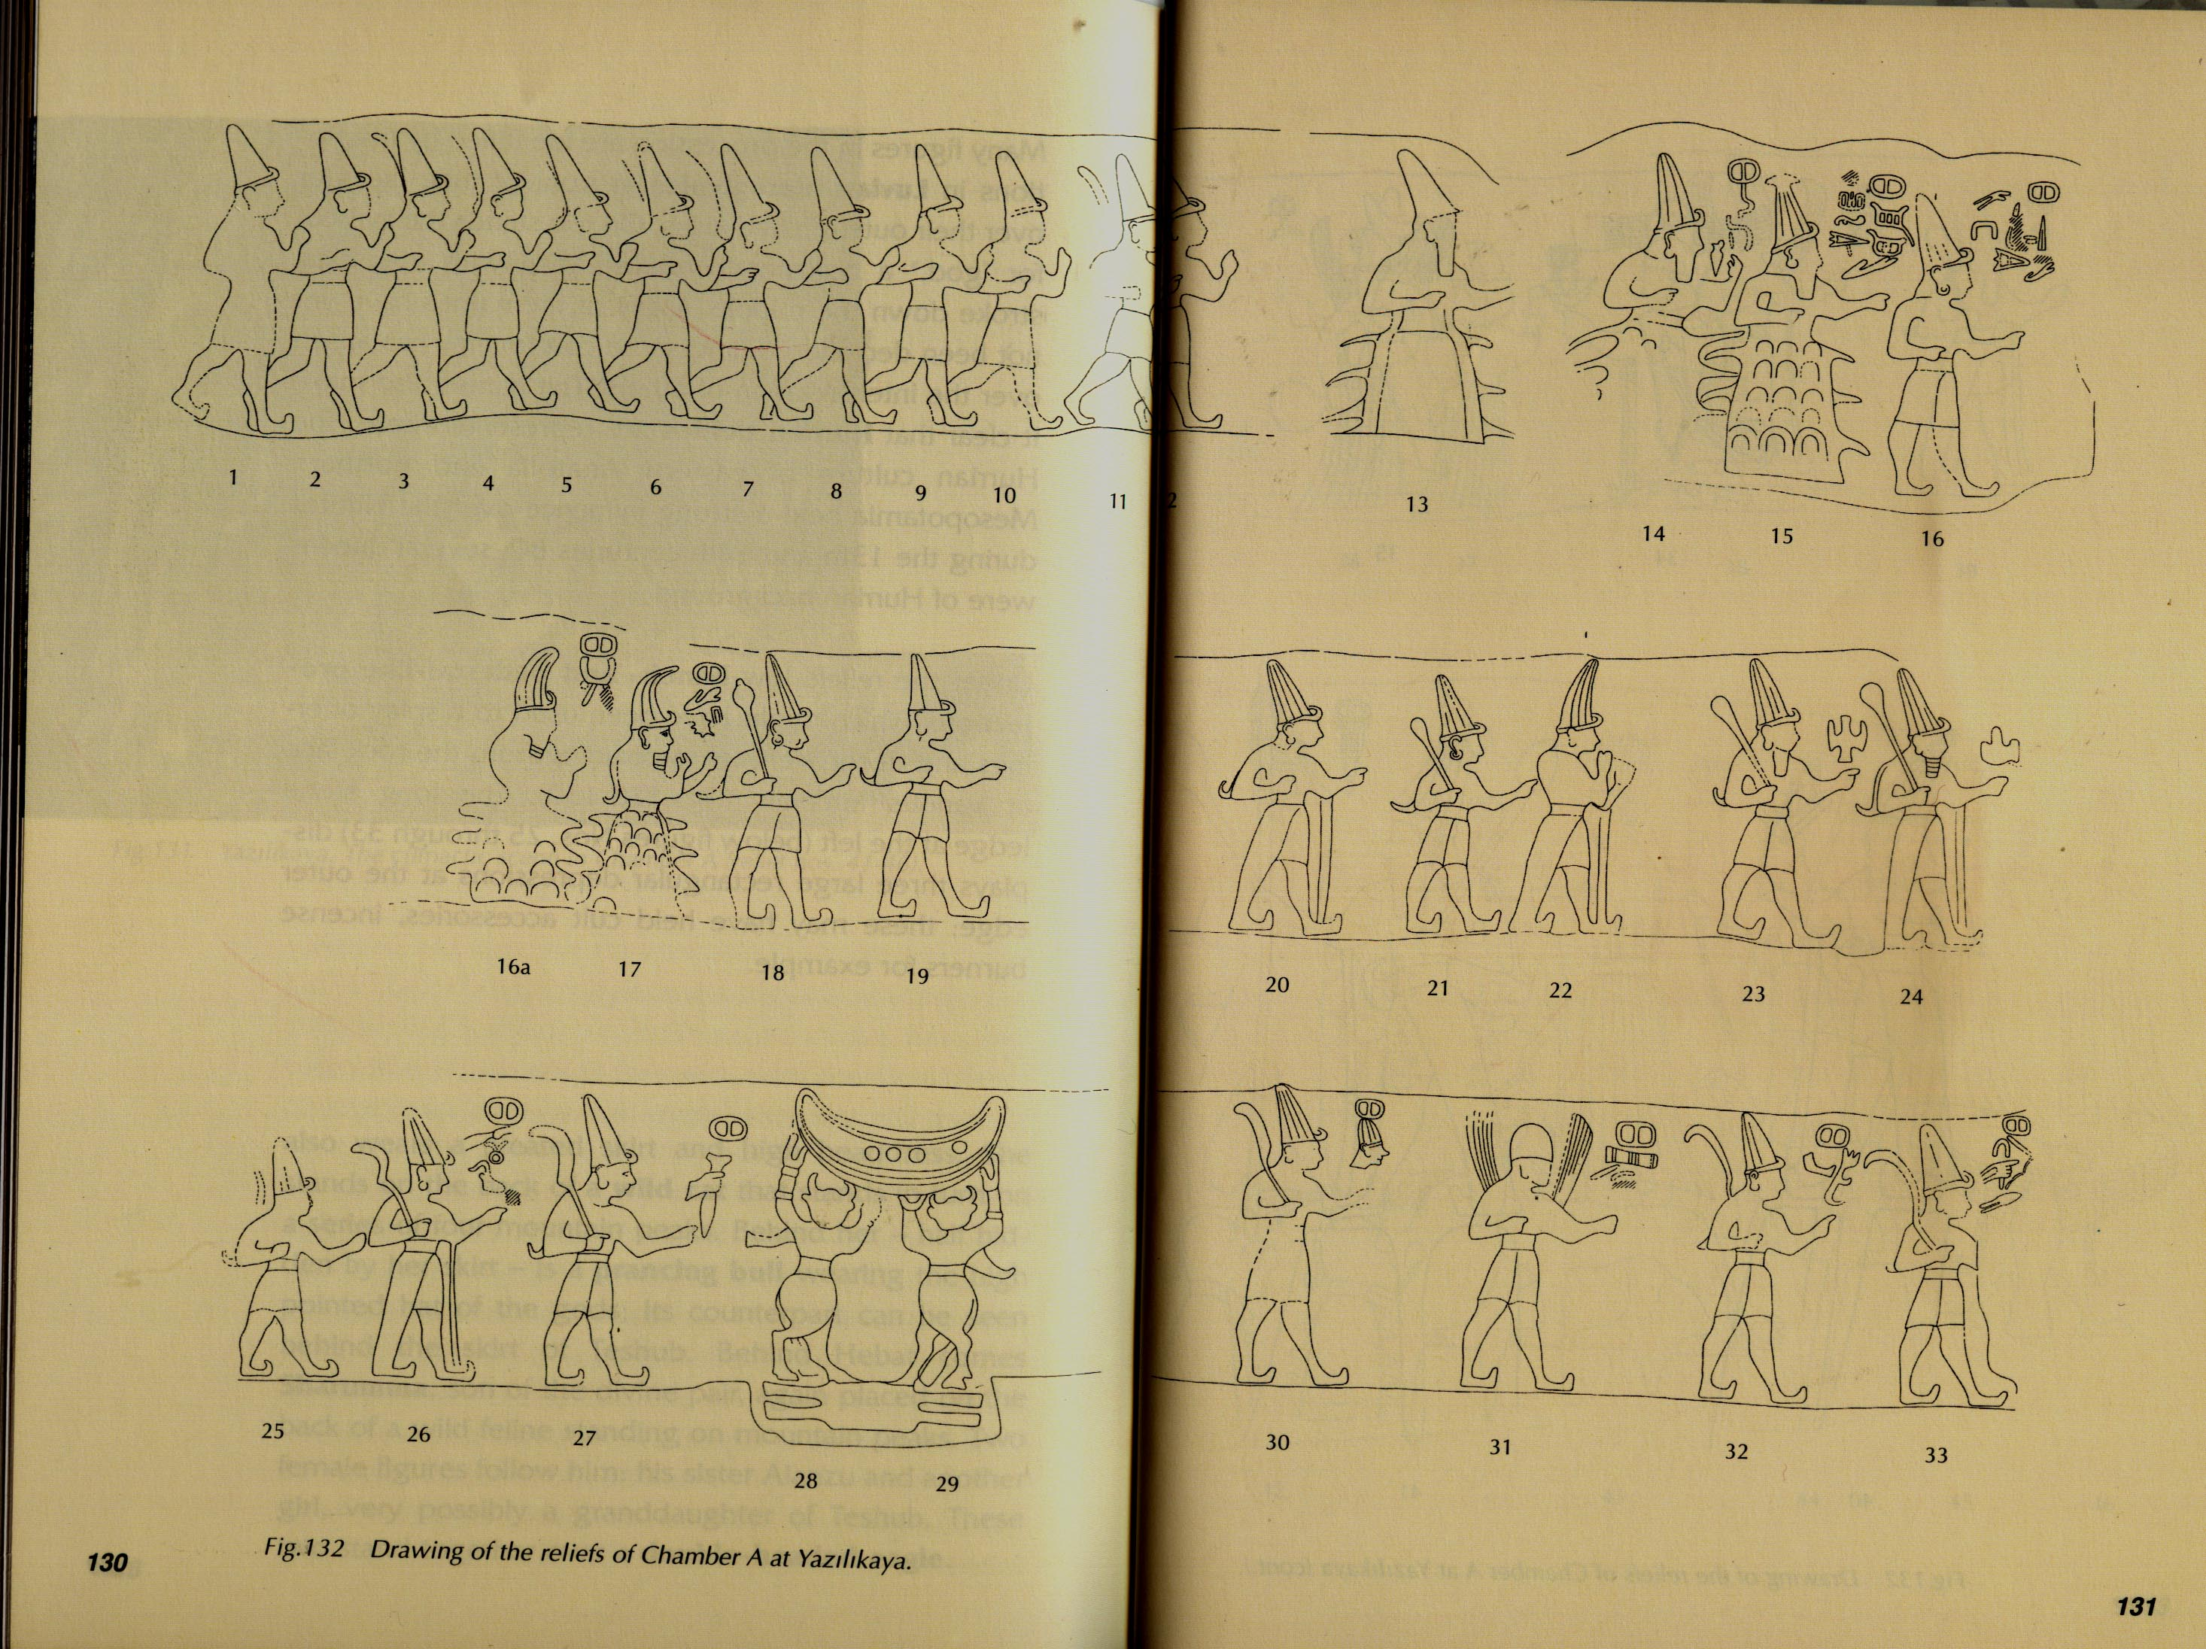

Slide 15
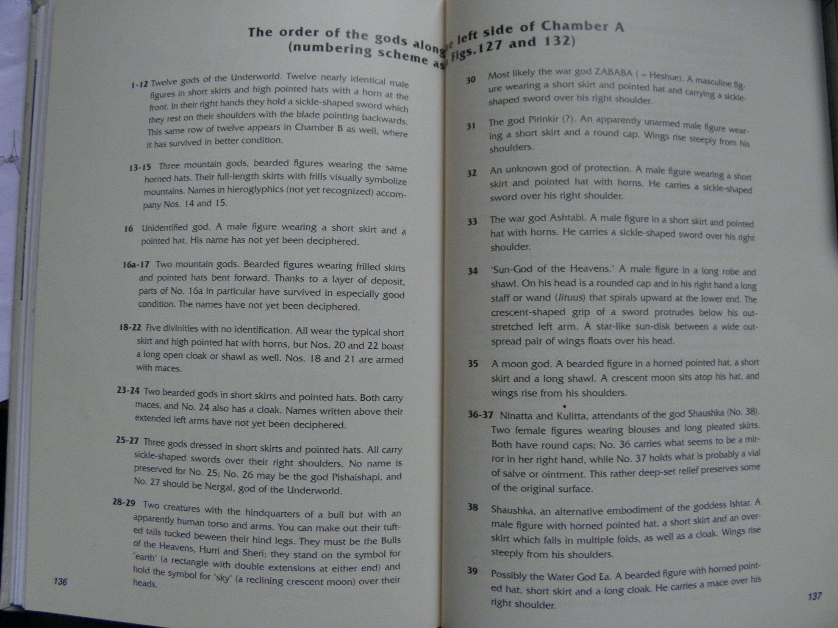

Slide 16
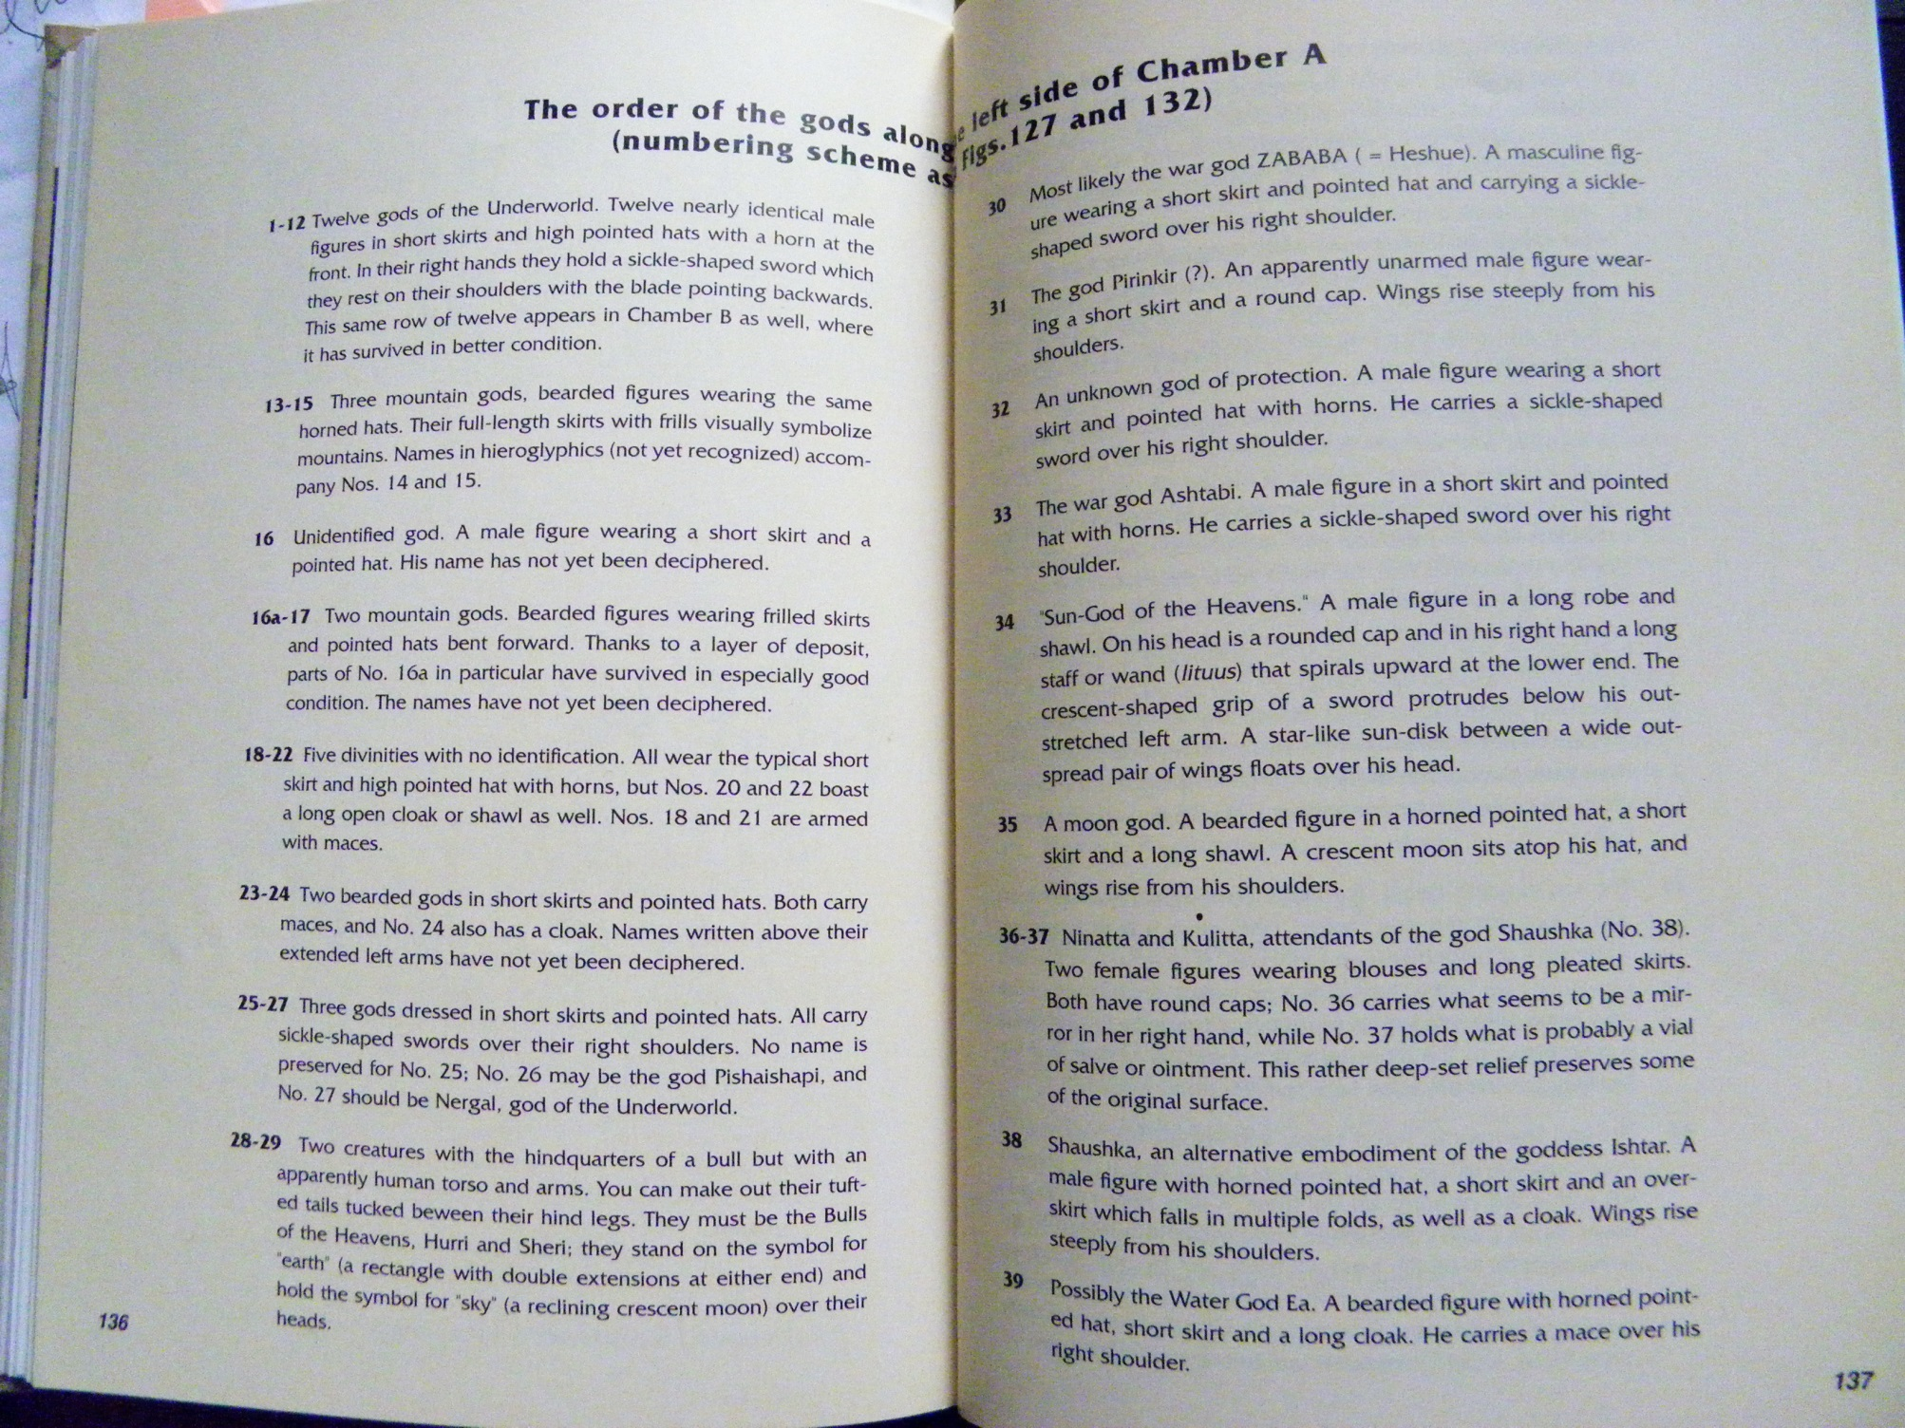

Slide 17
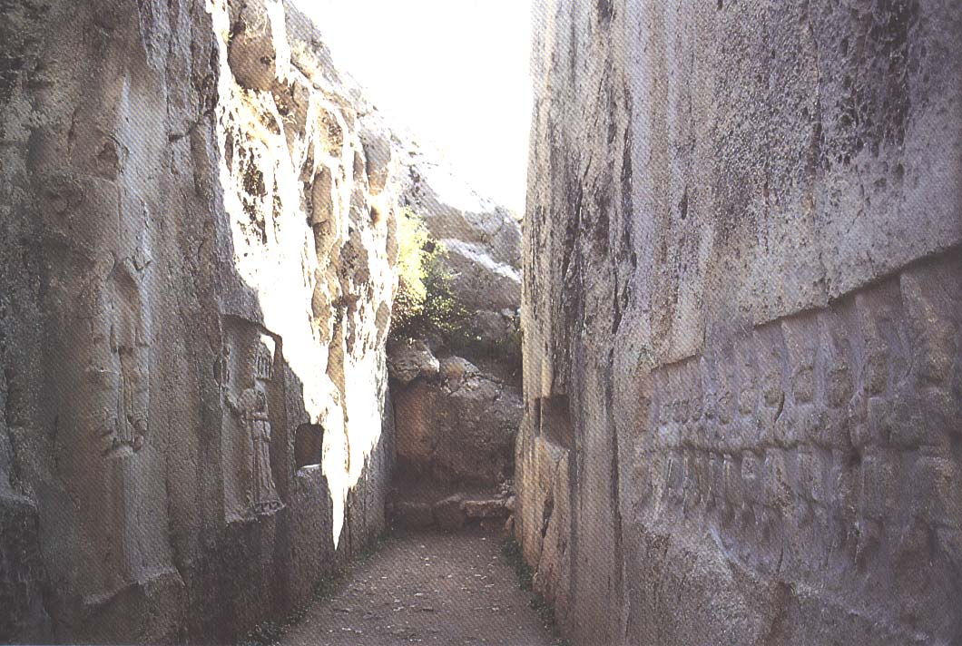
Chamber B at Yazılıkaya

Slide 18
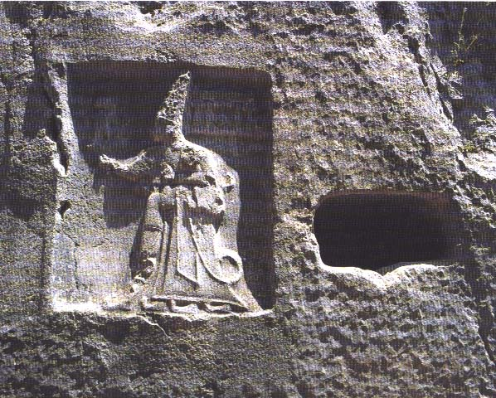
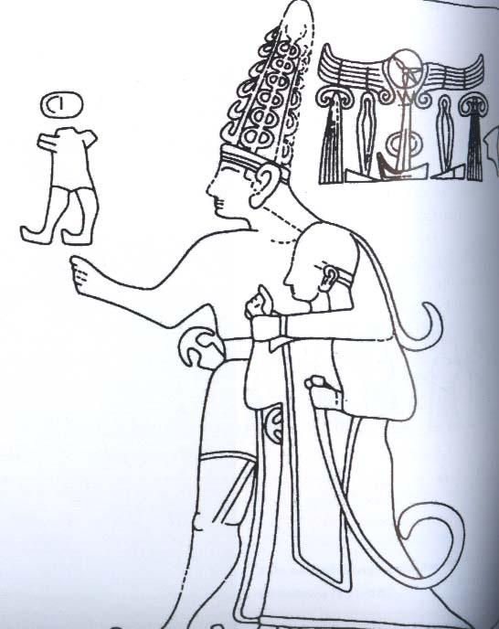
Tudhaliyas IV hugged by his patron god Saruma in Chamber B at Yazılıkaya

Slide 19
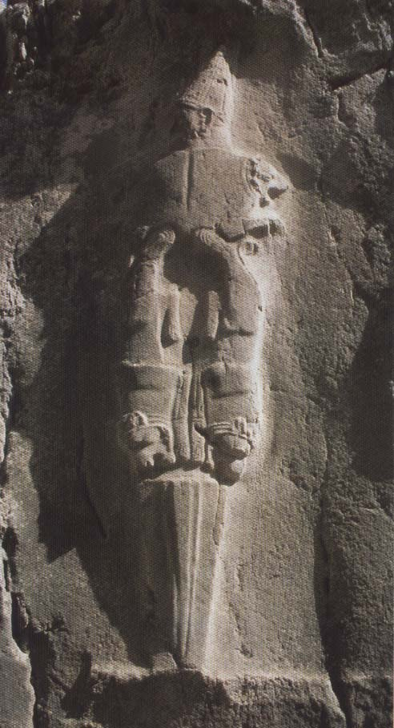
The Sword God in Chamber B

Slide 20
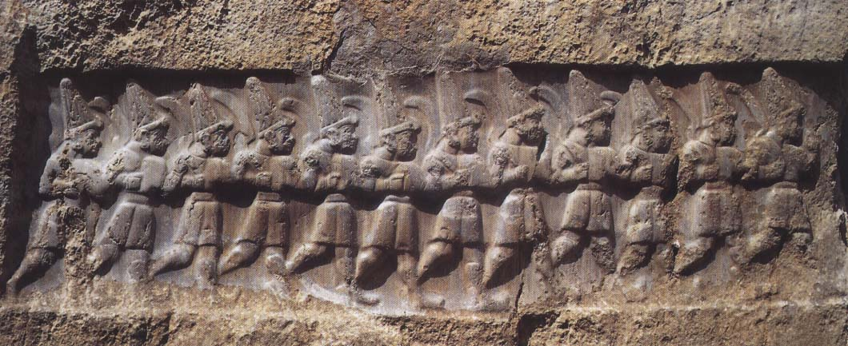
The twelve gods of the Underworld in Chamber B

Slide 21
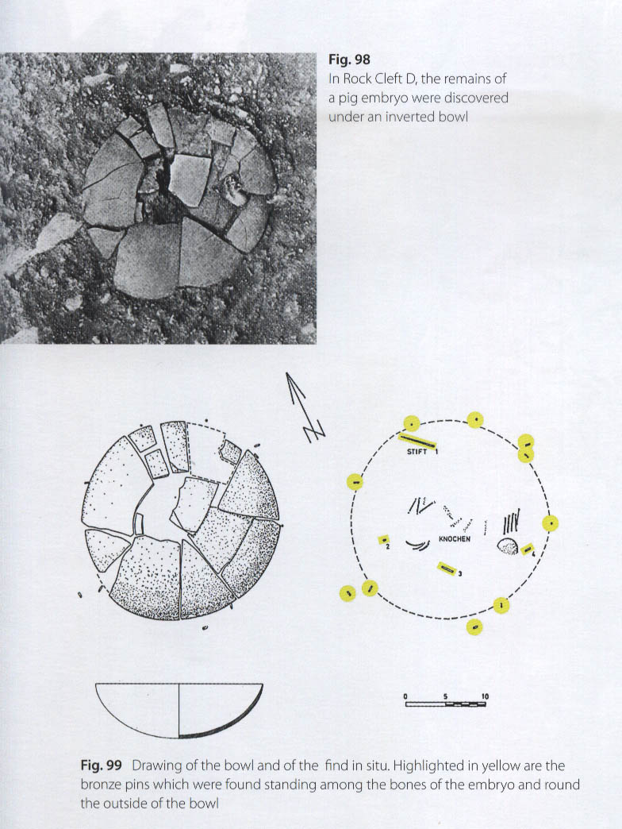
Chamber D

