Slide 1
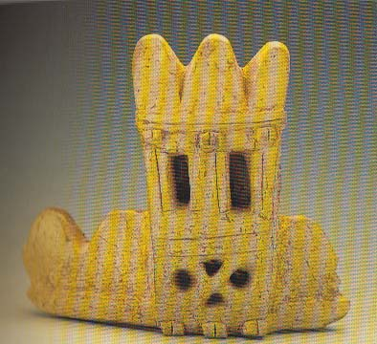
Modern reconstruction of two towers at Hattusa, based on clay models
Mouth rim sherd of a big vessel showing city wall and a tower

Slide 2
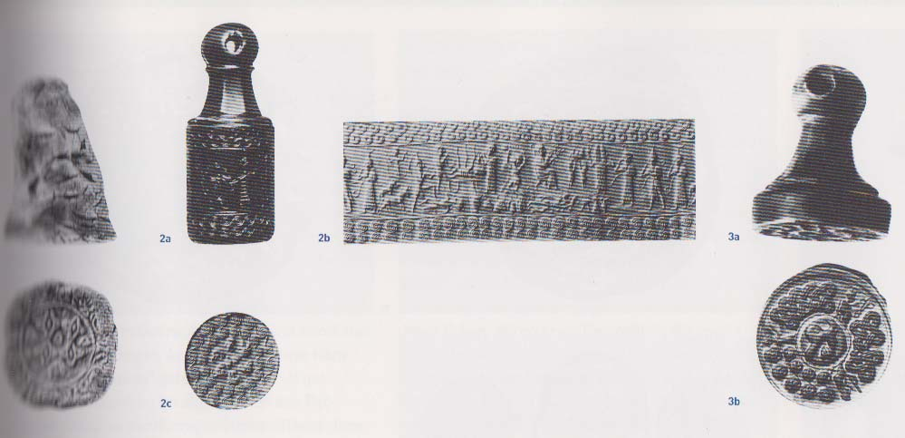
Hittite seals

Slide 3
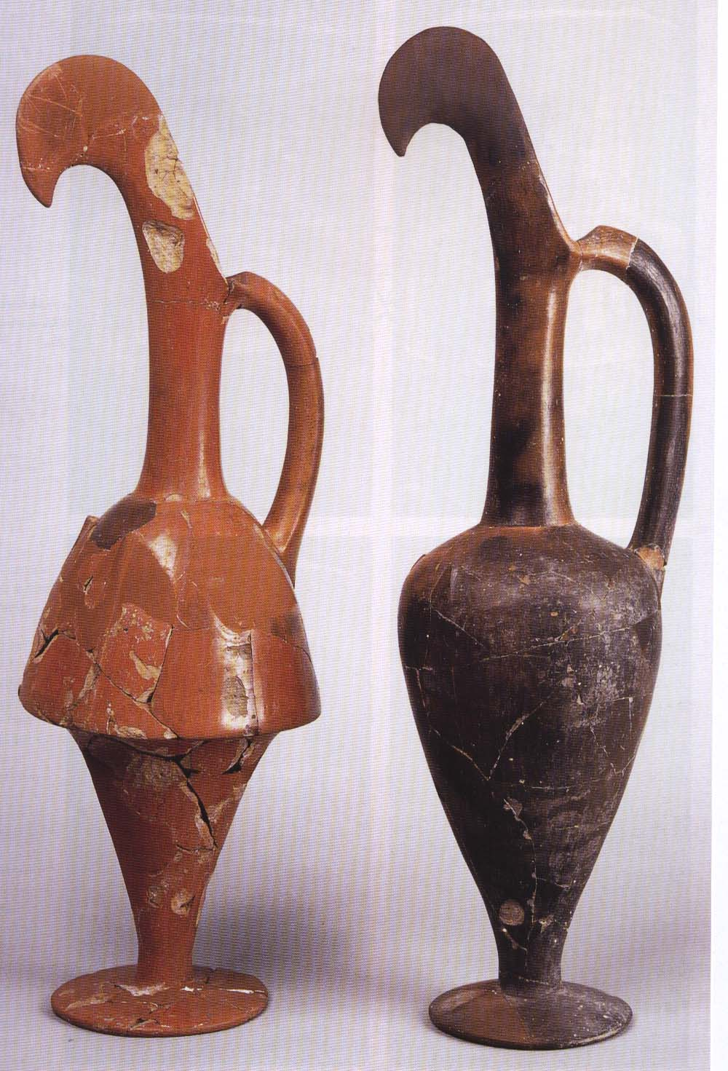
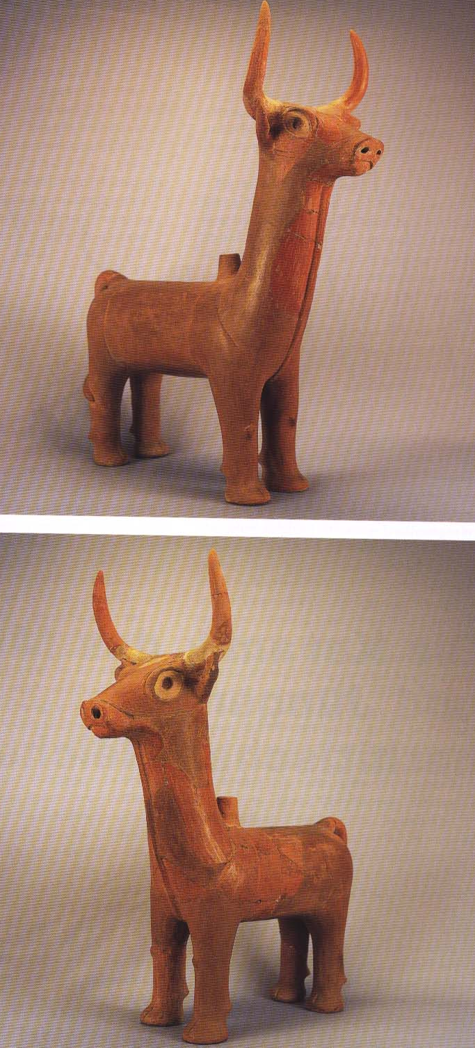
Hittite ritual vessels

Slide 4
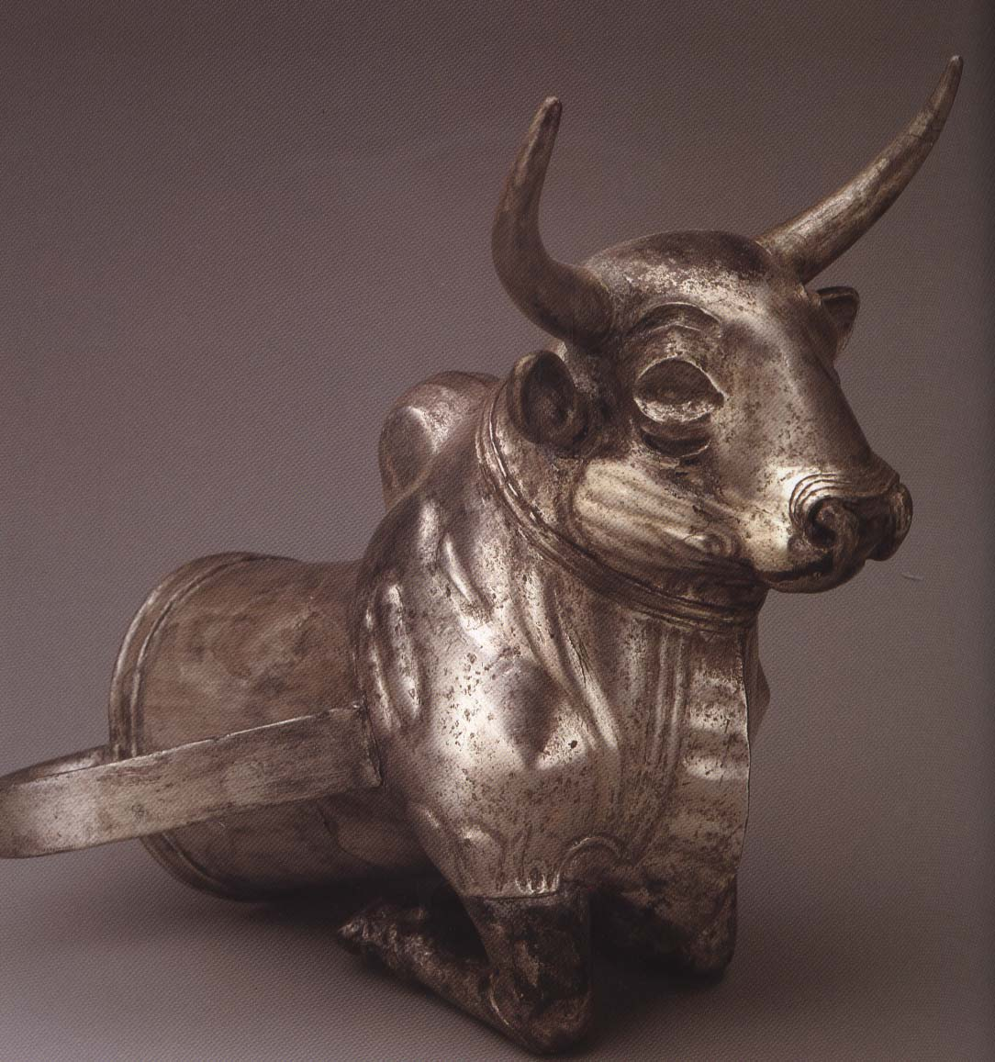
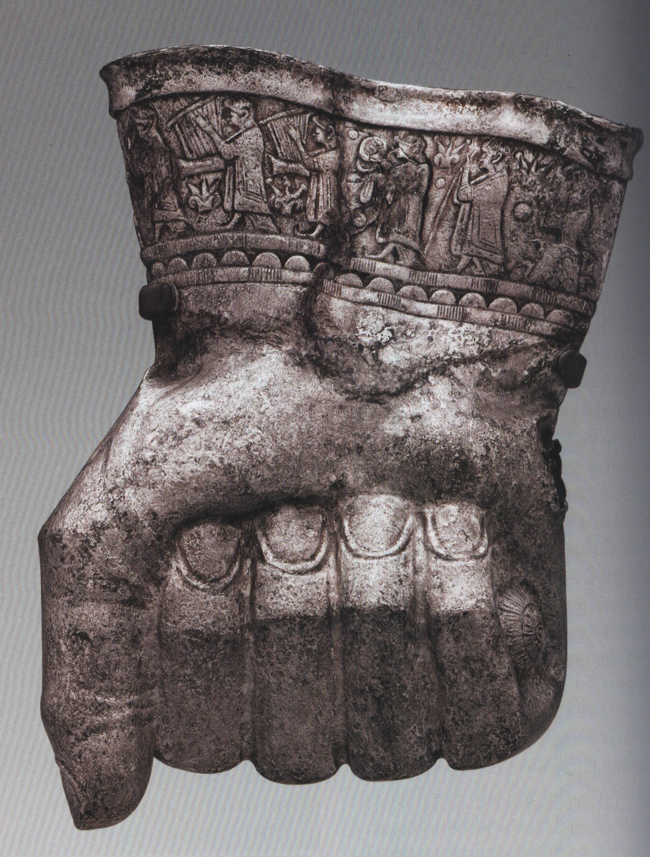

Slide 5
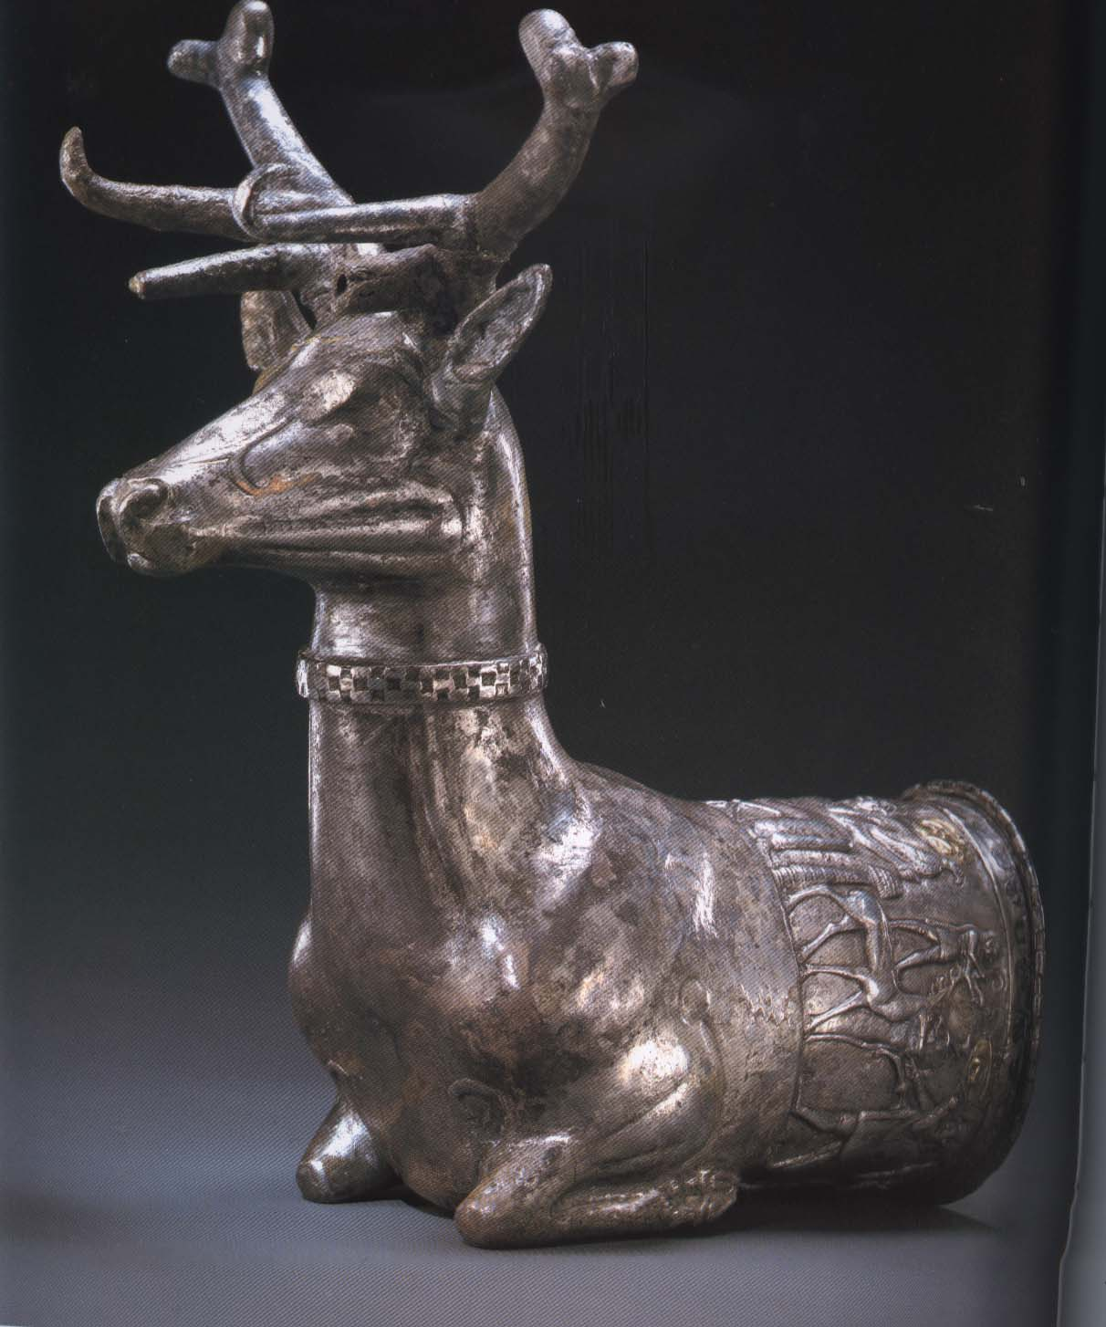

Slide 6
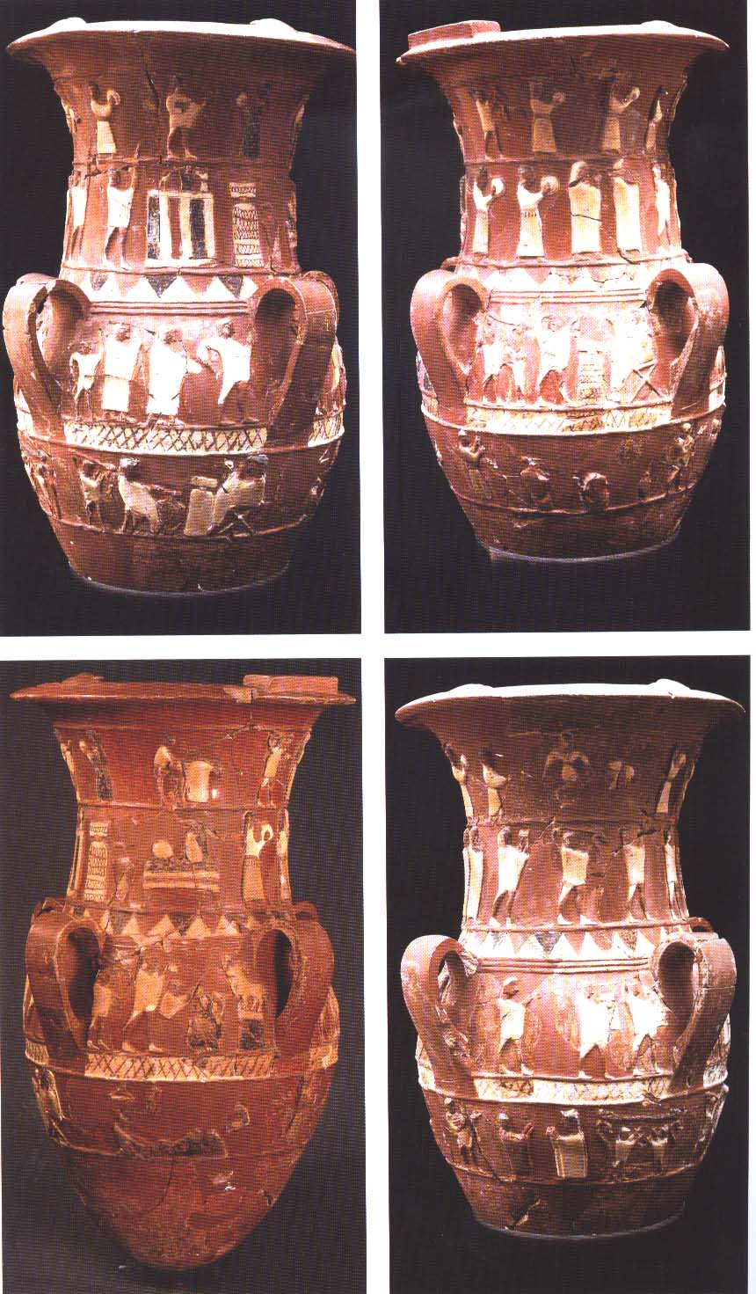
Relief vase from Inandık

Slide 7
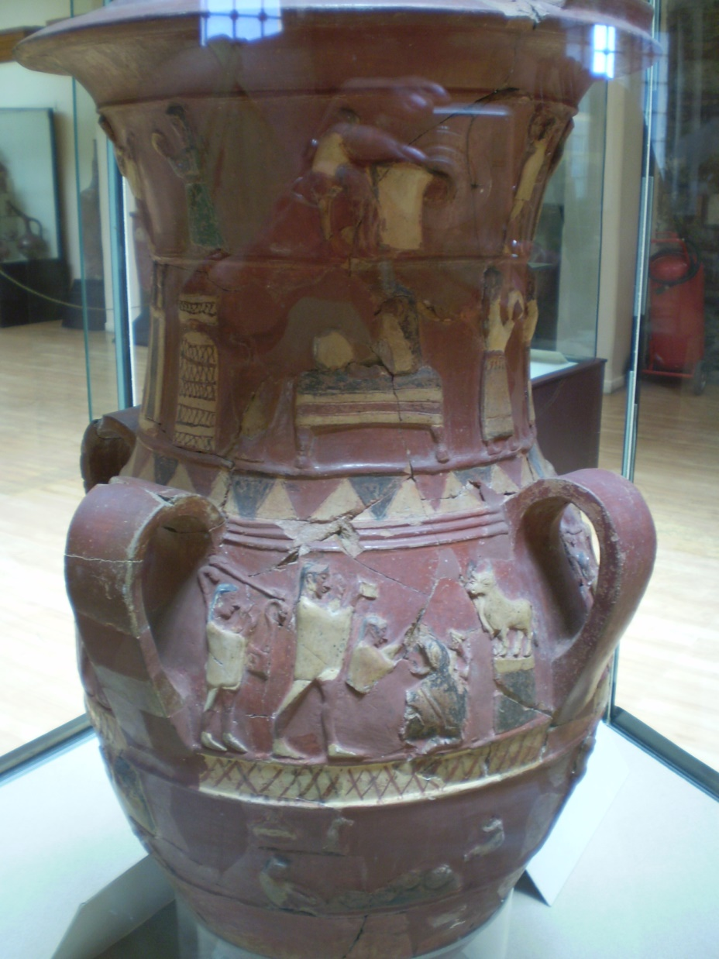
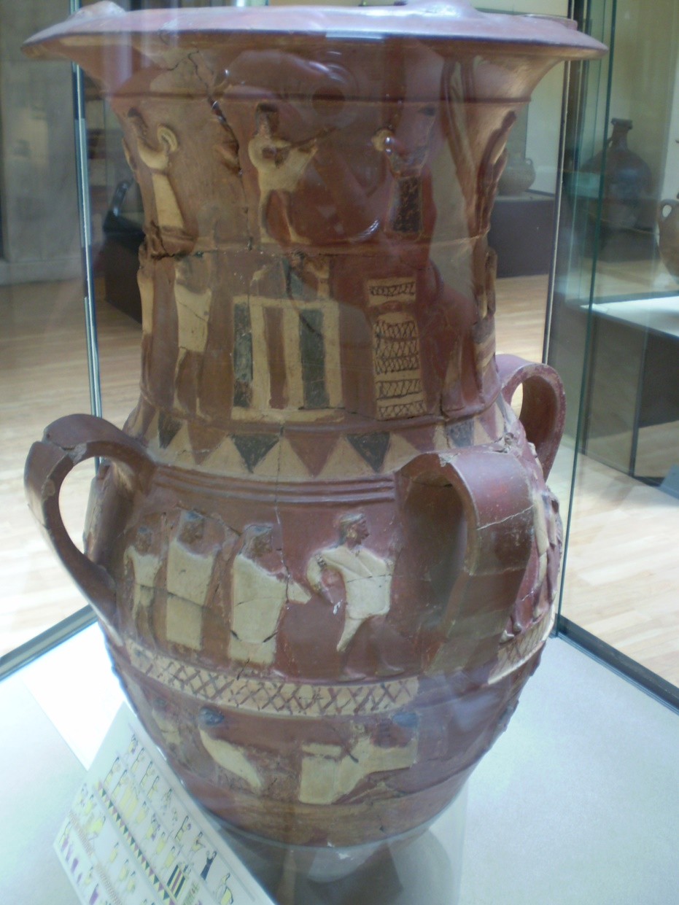
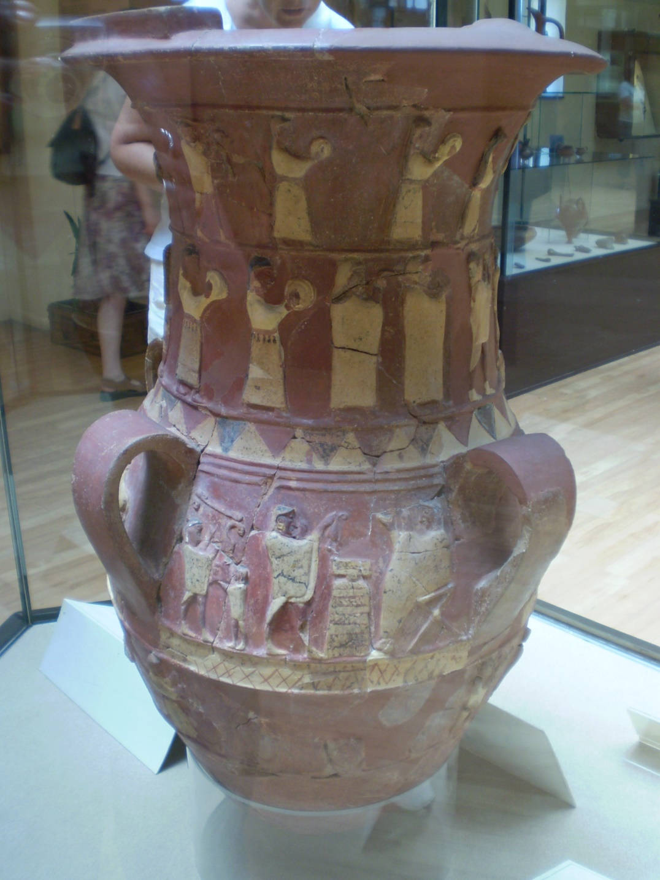

Slide 8
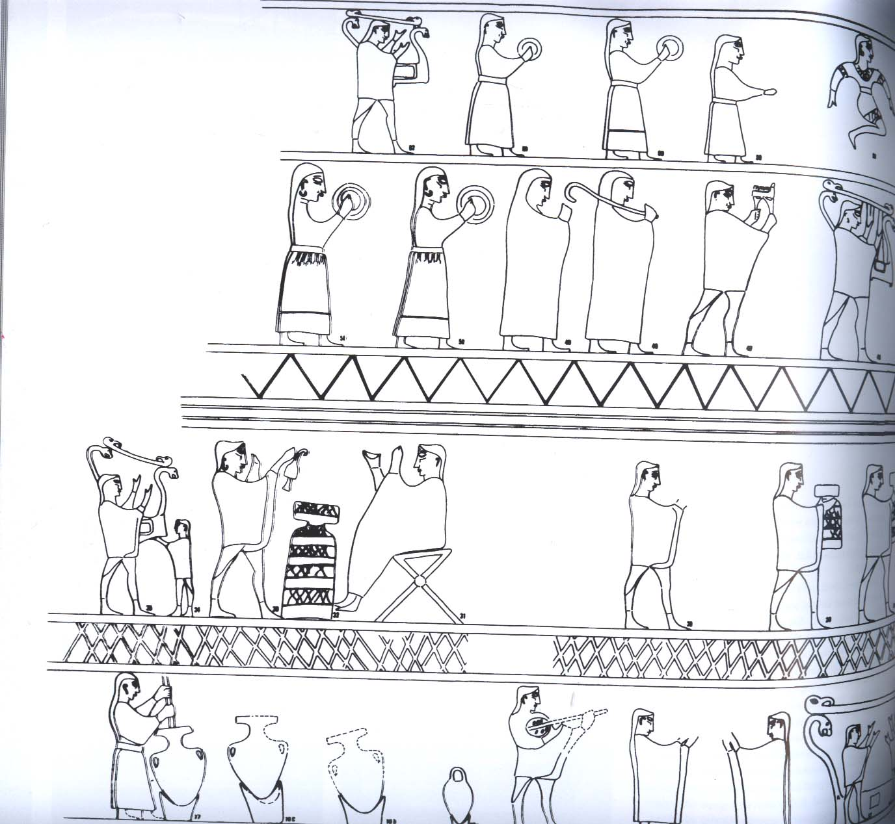
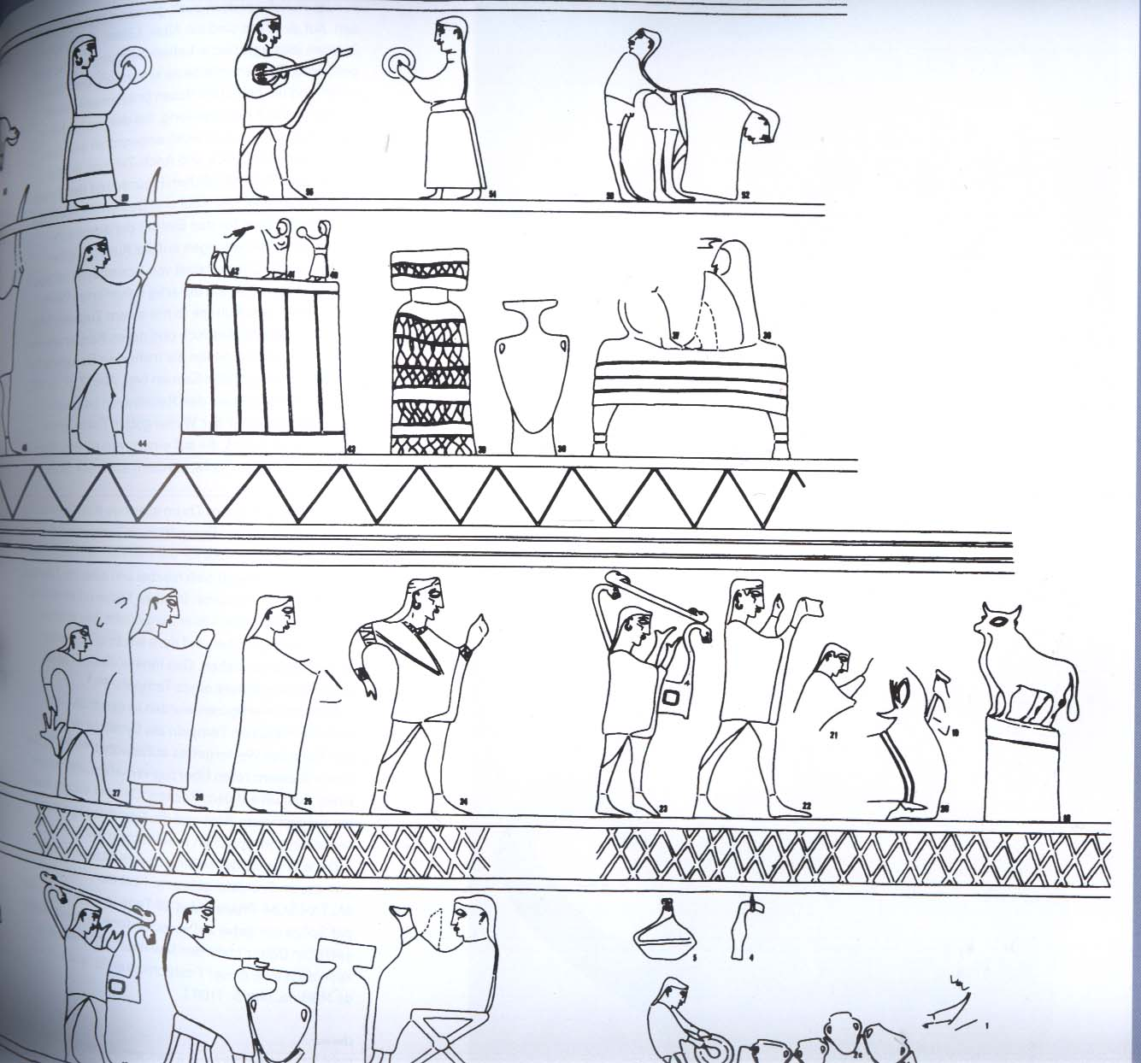

Slide 9
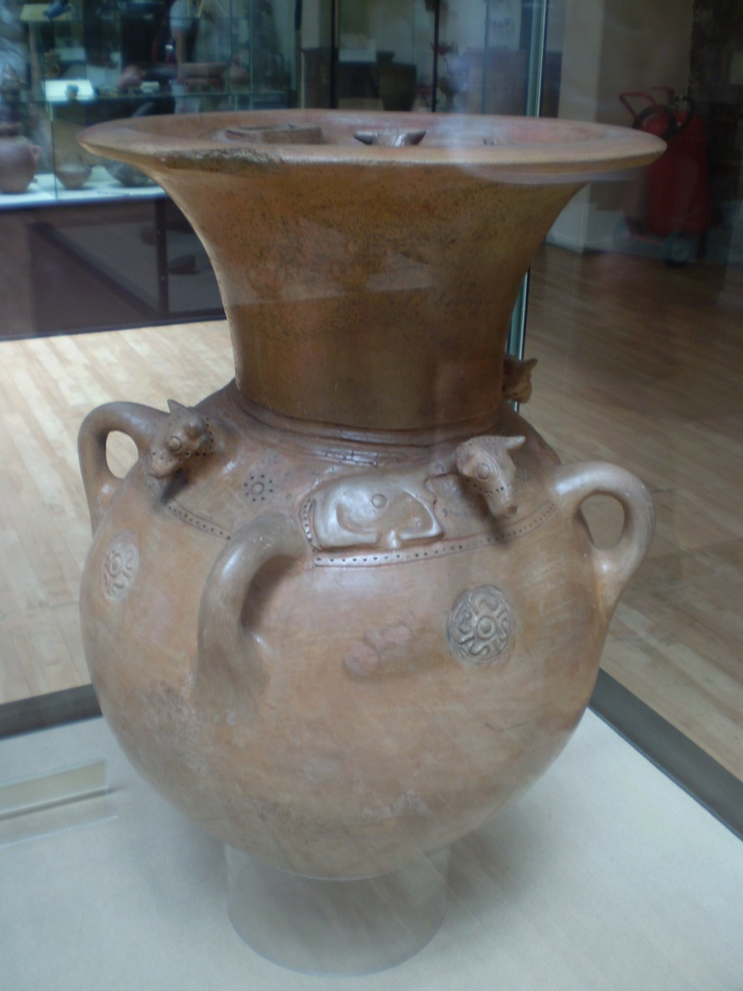
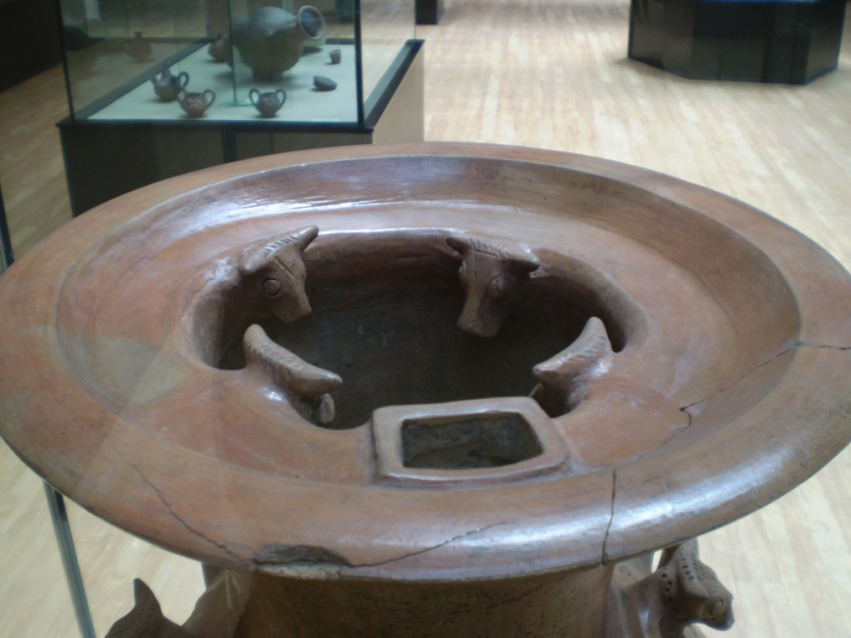
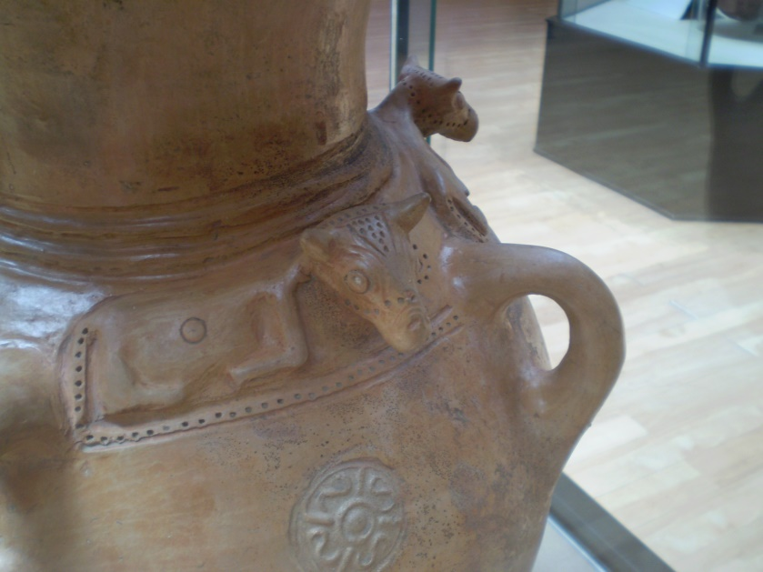

Slide 10
Relief vase from Hüseindede

Slide 11
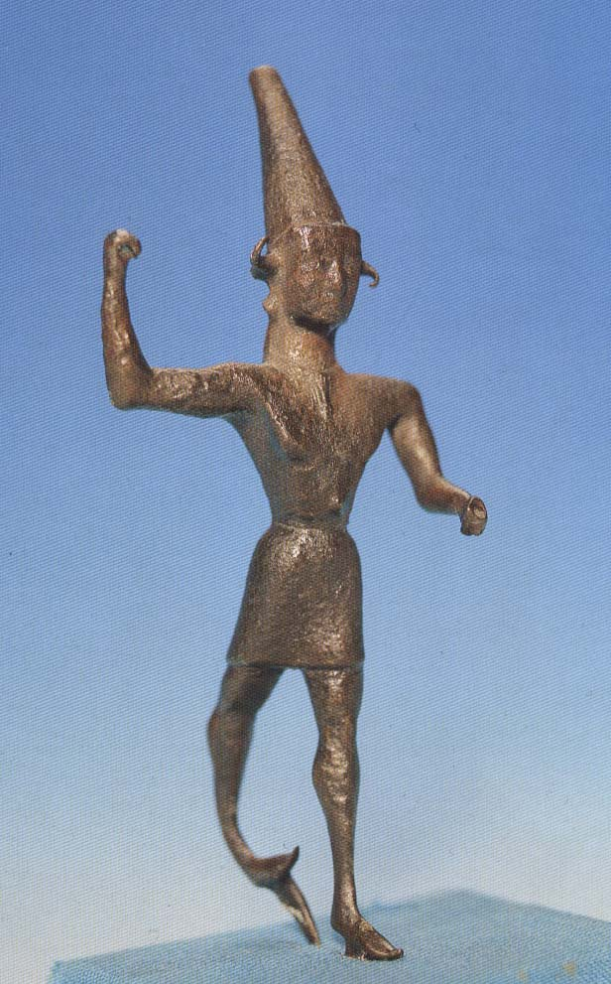
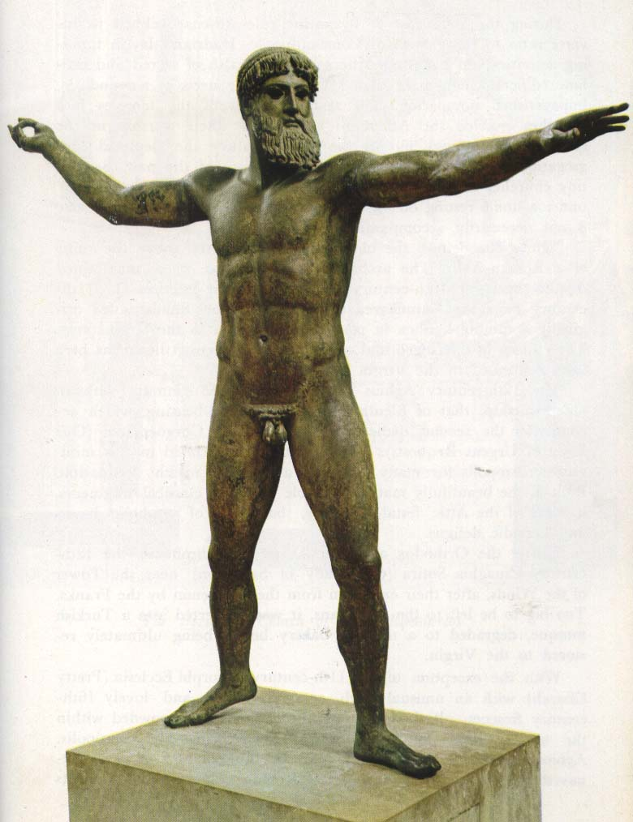
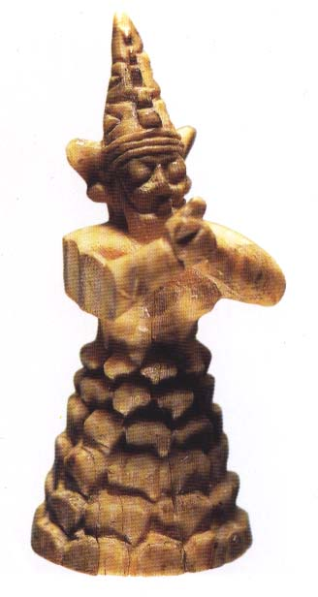
The Smiting God (the Storm God)

Slide 12
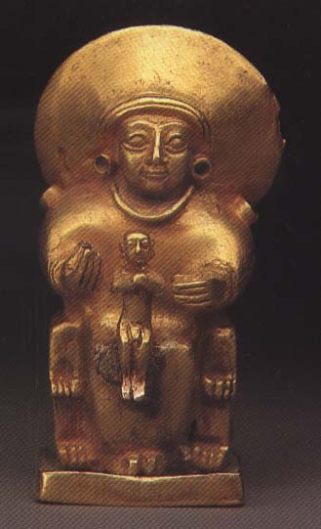
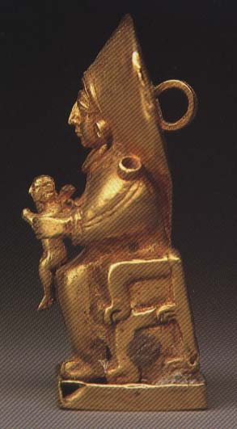
The Sungoddess of Arinna (?) (H: 3 cm)

Slide 13
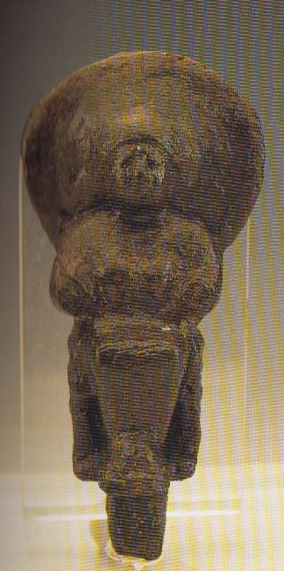
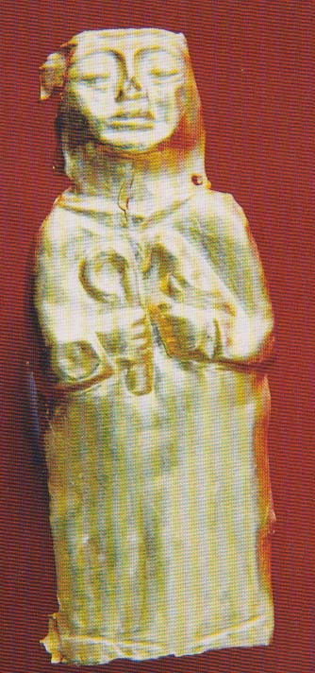
Ivory figurine of a Mountain God from Hattusa (H: 3.6 cm)
Gold applique (for a statue?) from Alacahöyük (H: 2.9 cm)
Bronze statuette from Alacahöyük (H: 10.5 cm)

Slide 14
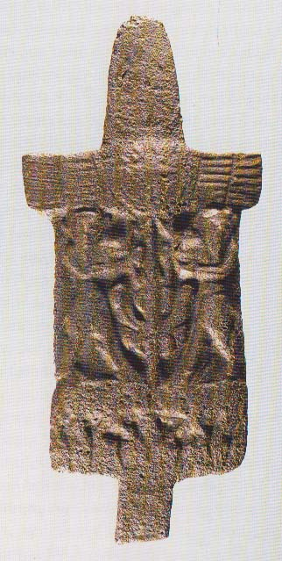
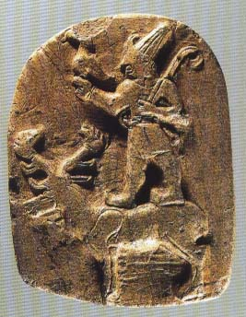
Bronze plaque from Alacahöyük& two bull-men and the tree of life (H: 15.2 cm).
Stone plaque from Çorum (H: 6.3 cm)

Slide 15
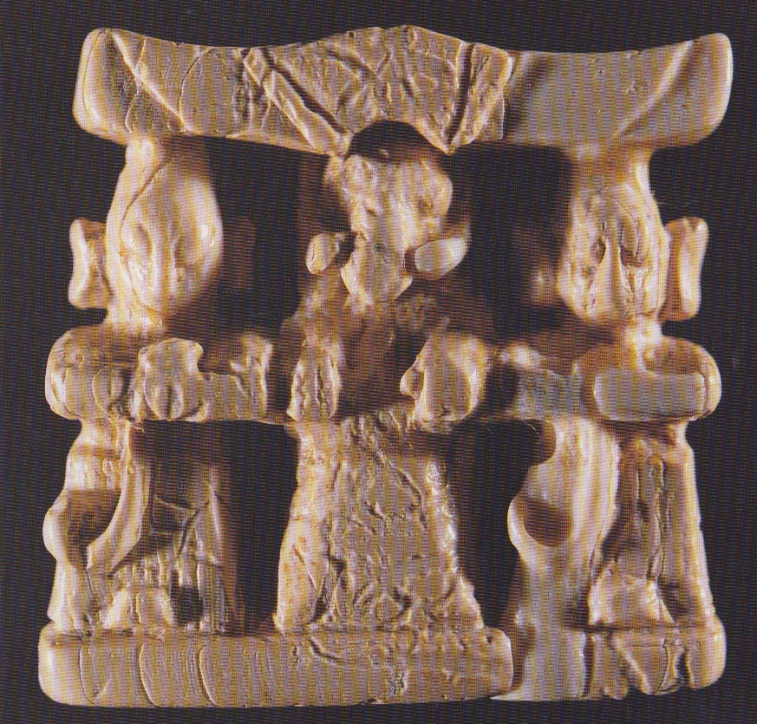
Ivory plaque from Hattusa, (H: 3.7 cm); divine triad; bull-man in the middle.

Slide 16
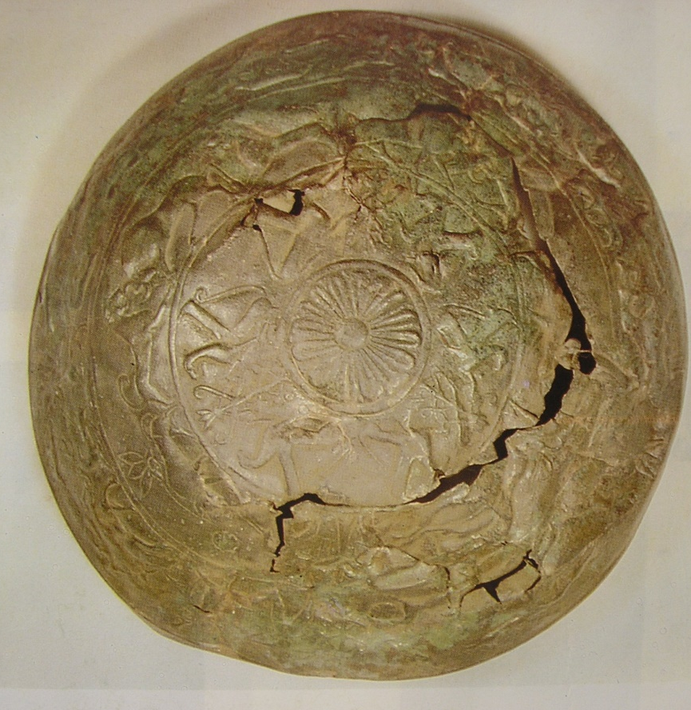
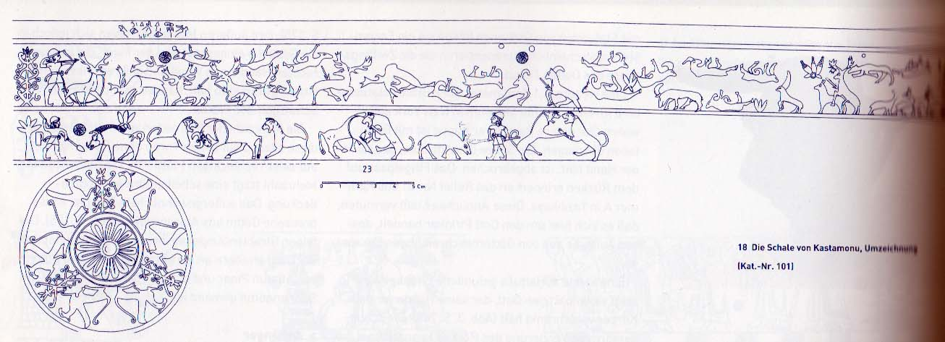
Kastamonou bowl. From the time of Tudhalyias I/II (mentions Taruiza =Troy)

